Slide 1
AS Revision
Levers

Slide 2
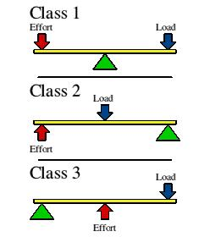
Levers – 3 classes
Mnemonic -1,2,3:
First class lever –
in middle
Second class lever -
in middle
Third class lever –
in middle
F.R.E.
Fulcrum
Resistance
Effort

Slide 3
Levers
1st class – – throwing
2nd class – – plantar flexion
3rd class –
triceps at elbow
gastrocnemius at ankle
all other joints

Slide 4
Mechanical advantage and disadvantage
Depends on:
length of effort arm –
length of resistance arm –
distance from fulcrum to effort
distance from fulcrum to resistance

Slide 5
Third class lever
resistance arm
effort arm

Slide 6
Second class lever
effort arm
resistance arm

Slide 7
Mechanical advantage and disadvantage
Third class lever:
Short effort arm and long resistance arm – force exerted; but range and rapid movement
Second class lever:
Long effort arm and short resistance arm – forces exerted; range and speed of movement
limited
wide
large
limited

Slide 8
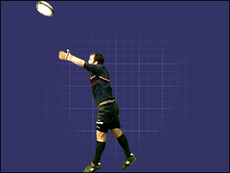
Typical question
Figure 1 shows the movements involved as a player throws the ball back onto the field of play during a game of rugby.
Figure 1
A B
Using figure 1, name, sketch and label the lever system operating at the elbow during the movement from position A to position B. (3 marks)

Slide 9
Answer
First class/order;
Correct order - Fulcrum in middle
Correct labels – resistance/load; fulcrum/pivot; effort/force

Slide 10
Typical question
Name, sketch and label the lever system operating at the ankle of the take off foot of a long jumper. (3 marks)
When running, the knee joint works as a lever system. Name, sketch and label the lever system operating at the knee during running. (2 marks)
During the take-off phase of a jump, the lever system operating at the knee is a third class lever system. What are the advantages and disadvantages of this class of lever system? (3 marks)

Slide 11
Answer
Qu 1
2nd class/order;
Resistance in middle;
Resistance, fulcrum, force labelled correctly;
Qu 2
Third class/order lever;
Identify effort/fulcrum/resistance – effort in middle;

Slide 12
Answer
Qu 3
Advantages
Wide range of movements possible
The length of the resistance arm is long/force/effort arm is short
Speed of movement rather than force
Small movement of effort/force = large movement of lever
Disadvantages
Effort/force arm is short/resistance arm is long
Unable to move/lift much/great resistance/load
More effort/force required is greater than resistance/load/weight
Known as mechanical disadvantage

