Slide 1
World Games

Slide 2
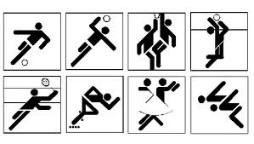
World Games
Any sporting competition that takes place at world, continental or regional level on a single or multi sport basis.

Slide 3
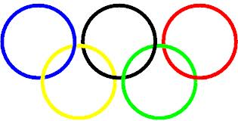
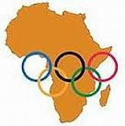
Can you think of any?

Slide 4
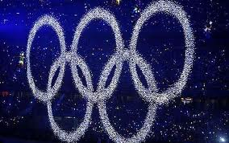
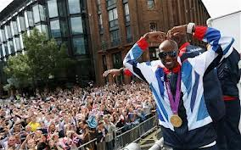
World Games Examples
Olympic Games
Paralympic Games
Commonwealth games
Pan America Games
All Africa Games
Special Olympics Latin America Games

Slide 5
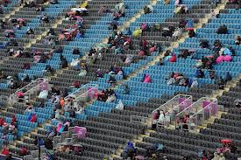
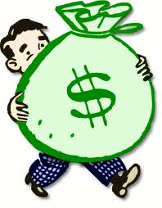
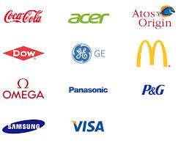
World Games
Think about ……
Number of competitor's
Number of sports involved
Structure of competition
TV audience
Cost
Length of event

Slide 6
London 2012
Over 14,000 athletes from 205 Olympic teams and 170 Paralympic teams will be competing at the London 2012 Games
26 Olympic sports at London 2012

Slide 7
London 2012
Across BBC One, BBC Three and BBC HD, along with the 24 live video streams made available via the Red Button, the BBC's Olympics coverage on television reached 51.9 million viewers in the UK - the largest combined audience for a major event for at least 10 years. The Opening and Closing ceremonies proved hugely popular, attracting 27m and 26m peak audiences respectively, while Usain Bolt's victory in the 100 meters final was seen by more than 20m viewers. There were 106 million requests for BBC Olympic video content across all online platforms, double the previous highs of 32m for the Beijing Games and 38m for the 2010 World Cup.

Slide 8
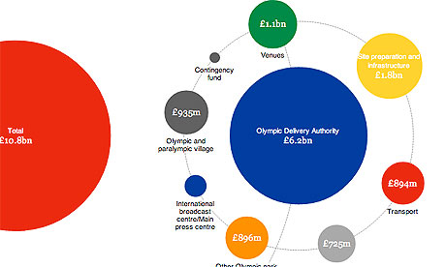
London 2012 £4.5 billion per medal!!
http://www.guardian.co.uk/sport/datablog/interactive/2012/jul/26/london-2012-price-olympic-games-visualised

Slide 9
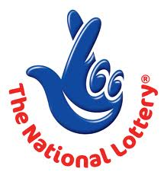
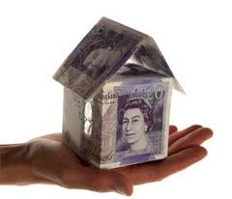
London 2012
Public funding package £2.375 billion
Lottery funding
Council tax- 38p a week/ £20 year

Slide 10
The £11.3billion needed for London 2012 came from £9.3billion of public sector funding and £2billion from the London Organising Committee of the Olympic and Paralympic Games or “LOCOG” as it’s known. Public sector funding includes money from central Government (ie taxpayers), the National Lottery and local authorities in London. It was spent on building venues and infrastructure (£5.3billion), elite sport and Paralympic funding (£400million), security (£600million), regeneration of Lea Valley (£1.7billion), a contingency fund (£2.7billion) and VAT (£800million).
Worldwide partners include McDonald’s, Proctor & Gamble, Coca-Cola, Acer, Dow, Visa and General Electric. Global sponsors get exclusive Olympic worldwide marketing rights for their money.
McDonald’s pays a reported $100m (£64million) for each two-games deal of one winter and one summer games.
LOCOG is essentially privately funded. It received about £700million from the International Olympic Committee (IOC), £700million from local sponsorship and £600million from ticket sales and merchandise. From that money it doesn’t have to build venues (that comes from the public sector money) but it does have to organise and run the events. The opening ceremony alone cost £80million, with LOCOG contributing £40million and the Government £40million.

Slide 11
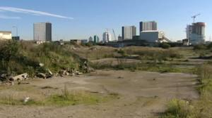
London 2012
Help London with Economic growth and social regeneration
New green spaces
3,600 new homes form the Olympic village
Opportunities for business
Sports facilities
Inspire a generation
Other areas to benefit i.e. Weymouth

Slide 12
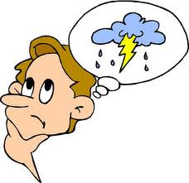
World Games
All World Games share certain characteristics, some more than others..

Slide 13
Characteristics
Elite Performers
Pre event qualifications- selections/ trials
Shop window for city
Highly commercialised- TV rights, sponsorship
Infrastructure development
Development of sports facilities
Spectators
Nationalism/ patriotism
Officials/ volunteers
Positive values
Deviancy
Symbols

Slide 14
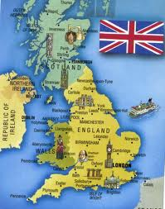
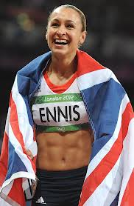
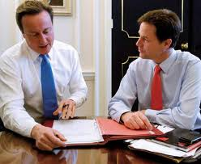
Impact on the games
Country
Government
Individuals

Slide 15
Individual
Want to be the best- highly motivated.
Test themselves against the best
Fulfill potential
Driven by personal gain- make a living as a professional
Pride/ satisfaction
Expectations from those close to them
Spectators inspired by role models
Pride in country

Slide 16
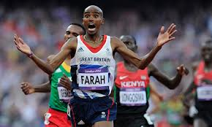
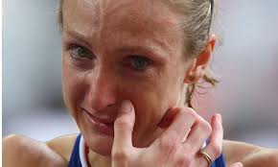
What if it goes a bit wrong..
Tremendous amount of sacrifice for one moment…
Lack self discipline
Injury
Lack of financial support
Lack of motivation
Decide to take a different path/ part time
Use illegal methods- blame the pressure

Slide 17
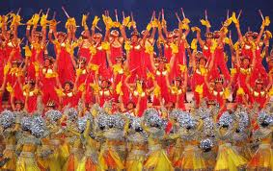
Country
Cultural Effects
Some countries have this as part of their national culture. National hero's
Social Effects
Hep unify a country

Slide 18
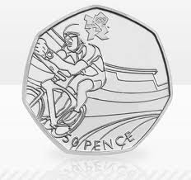
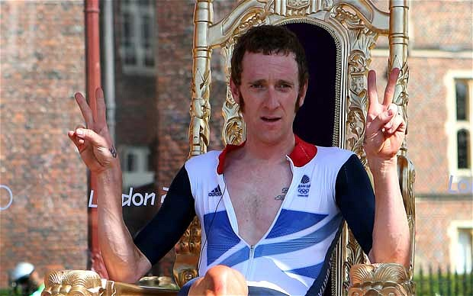
Economic Effects
Financial investment
Shop window
Tourism
New sports Increase levels of participation
500,000 extra cyclists had taken to the road or the track since Britain's unprecedented success in Beijing.
Stimulus for infrastructure
Regional regeneration

Slide 19
Downside
Cost exceeds the revenue- who pays?
Legacy facilities left are not in the right location
http://www.theblaze.com/stories/decrepit-four-years-after-hosting-the-beijing-olympics-this-is-what-chinas-40b-investment-looks-like/
Construction delays- negative effect with the press etc
If it doesn't go smoothly damaging press coverage

Slide 20
Government
Needs government support- Big Time!
Support bidding, planning, bring it to fruition- have to believe in long term benefits
Can use it to demonstrate political philosophy
USA black power salute, Hitlers games.
Beijing – help human rights ???
Televised all over world – boost government popularity
Or could go wrong!!

Slide 21
Debate
London 2012 was a huge success for Britain in terms of economic and social growth……

