Slide 1
Why do you play your sport?
http://www.youtube.com/watch?v=9z4Kft47kBM

Slide 3
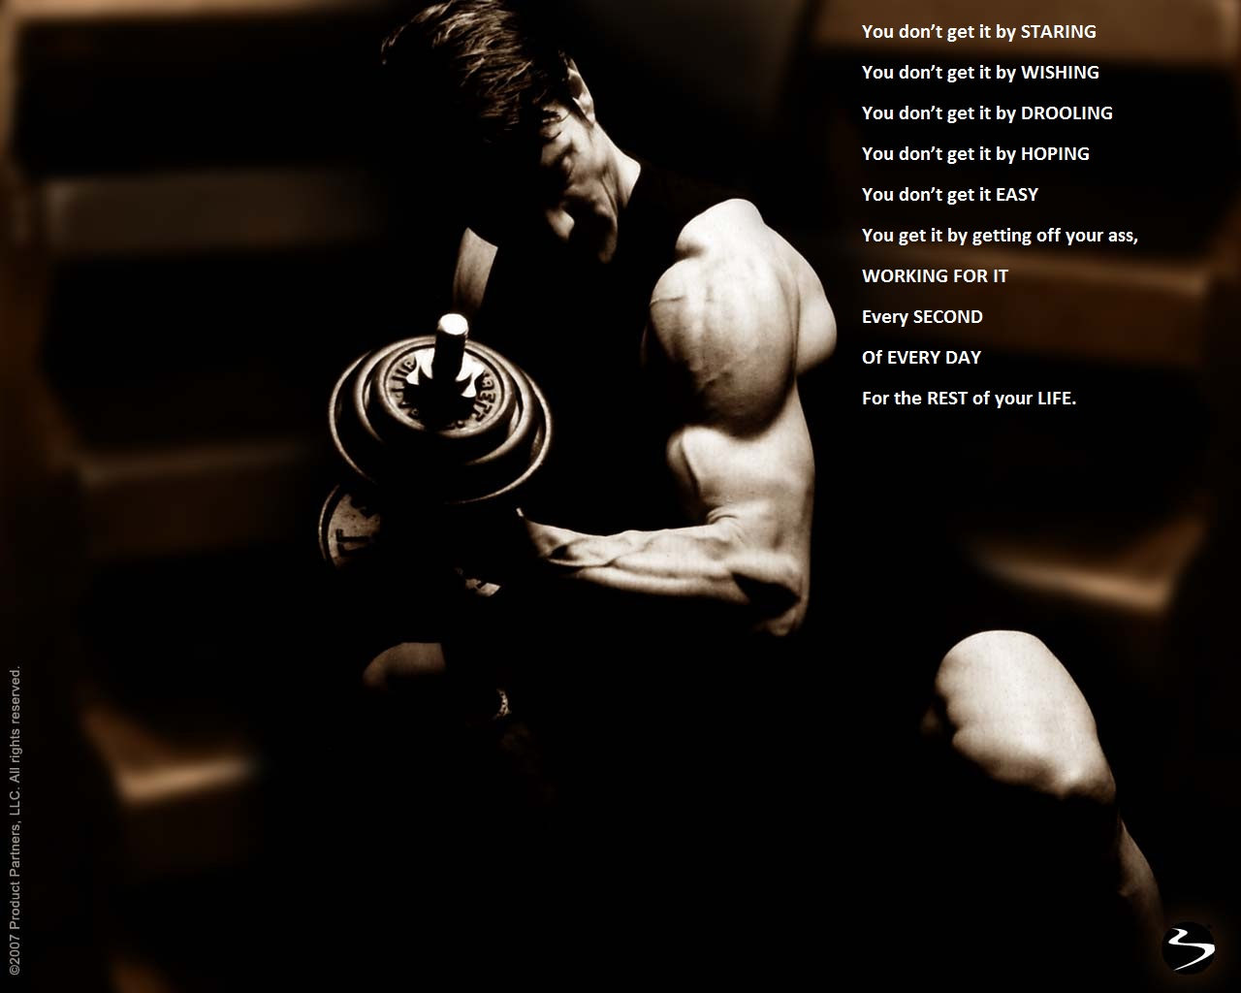

Slide 4
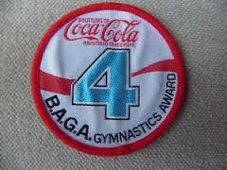
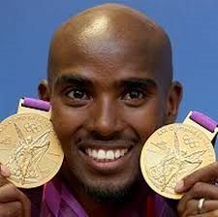
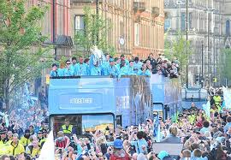
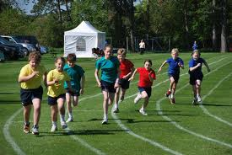
Motivation
Trophies?
Medals?
Personal satisfaction?
Status?
Self worth?
Money?
Praise from others?

Slide 5
What motivates these athletes?
http://www.youtube.com/watch?v=j9o97NuggM4 1 min 10
http://www.youtube.com/watch?v=rss88LcN-Is 2 mins 20
http://www.youtube.com/watch?v=I2CYuNHrkj8
http://www.youtube.com/watch?v=OaiSHcHM0PA

Slide 6
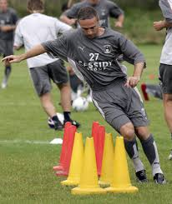
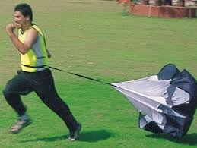
Motivation affects your….
Selection and preference of activity
Persistence
Effort levels
Performance levels relative to your ability

Slide 7
Types of Motivation
Intrinsic- Drive from within. Self satisfaction, pride.
Extrinsic- Drive we experience from external reward (outside)
Tangible- things we can touch/ physical medals, money, badges.
Non tangible – things we cant touch cheers from crowd, congratulations from coach, fans.

Slide 8
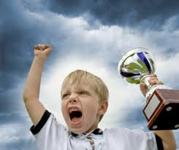
Exam Question
Q.Explain the meaning of the term ‘motivation’? (2 marks)
Q.
How does intrinsic motivation differ from extrinsic ?

Slide 9
Answer
Intrinsic from within and extrinsic from outside.
Intrinsic is a drive/urge from within

Slide 10
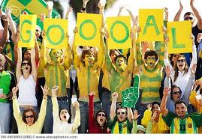
Exam Question
Q.
Using examples, name the two different types of extrinsic motivation (2)

Slide 11
Answer
A. Tangible – badges/prizes/rewards/ cups/medals
B. Intangible – Praise/peers/fans/crowd cheering/fame

Slide 12
Discuss
Explain why intrinsic motivation is thought to be better form of motivation than extrinsic motivation.

Slide 13
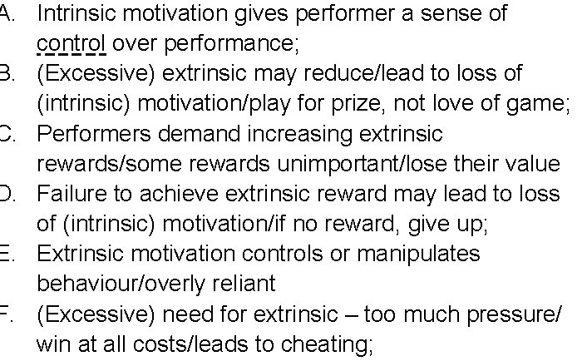
Answer

Slide 14
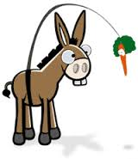
Exam Question
Explain the disadvantages of using 'extrinsic' motivation to motivate an individual.

Slide 15
Answer
(Excessive) extrinsic may damage/lead to loss of intrinsic motivation/love of the game
Become dependent on/loss of extrinsic motivation;
Excessive extrinsic motivation eventually loses its effect/becomes worthless;
Removal/failure to achieve extrinsic reward may lead to loss of motivation;
Too much pressure, leading to cheating;

Slide 16
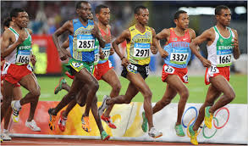
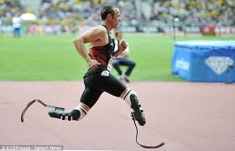
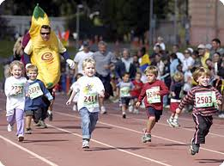
Exam Question
How could a coach motivate a group of performers, of differing abilities, who
regularly practise together? (4)

Slide 17
Answer
Allow success/ handicap races/competitions/group similar abilities together;
Use of external rewards/prizes
Make it fun/enjoyable;
Use of role models;
Use praise/verbal encouragement/reinforcement/positive feedback;
Emphasise personal improvement/set personal goals/challenges;
Avoid punishment;
Immediate reinforcement for the weaker runners;
Attribute success internally;

