Slide 1
Section B- Exercise Physiology
Warm ups & Cool Downs

Slide 2
Warm Ups should consist of:
1. The Pulse Raiser: 5-10 min jog of increasing intensity. Aim is to: Increase Heart Rate, Increase Body Temperature and Vascular Shunt blood towards the skeletal muscles.
2. Stretching: Take muscle through the full range of movement, held for 15 sec . Could include active stretches (performed by self) or passive stretches (partner assisted). They could be static (standing still), ballistic (powerful, fast stretching movements) or dynamic (controlled, slow, moving stretches like lunges).
3. Skill practice: Improve coordination i.e. shooting in basketball or taking corners in football.

Slide 3
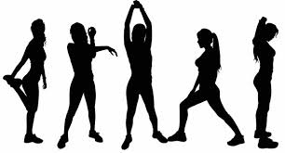
Reasons for a Warm Up:
Improves O2 delivery to the muscles due to an increase in Heart Rate and Vasodilation
Increase in Venous Return —> Increase in stroke volume thus increase in Cardiac Output
Increased temperature so increased contractility as nerve impulses are quicker and elasticity of muscles, increased blood flow and enzyme activity.
Reduces muscle soreness

Slide 4
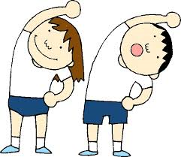
Reasons for a Warm Up:
Better chemical reactions
Improved sensitivity of nerve receptors and speed of nerve conduction
Rehearsal of movement
Improved psychological preparation
Reduces likelihood of injuries/ increases flexibility
Supplies adequate blood flow to the heart
Release of synovial fluid

Slide 5
Reasons for a Cool Down:
Heart rate and breathing rate remains high as does vasodilation- flush through oxygenated blood and reduces lactic acid effects (muscle soreness DOMS)
Maintains venous return– don’t become dizzy!
Prevents blood pooling
Reduces levels of adrenaline
Allow heart rate to return to resting
Allows time for reflection of the performance/ game.

Slide 6
Exam Questions
Q)
Explain why a warm up is needed to start the session.
A)
Reasons for a warm-up, addressing points such as:
Reduces possibility of injury/ increase flexibility/elasticity of muscle tissue;
Release of synovial fluid/elasticity of connective tissue;
Increases body/muscle temperature;
Better oxygen delivery/ blood flow/ vasodilation to muscle tissues;
Better chemical reactions/higher metabolism;
Increased sensitivity of nerve receptors/ speed of nerve conduction/reaction time;
Allows for rehearsal of movement/ same skills as in activity;
Mental rehearsal/stress or anxiety reduction/psychological preparation/relaxation/alertness
Supplies adequate blood flow to heart so increasing its efficiency;

Slide 7
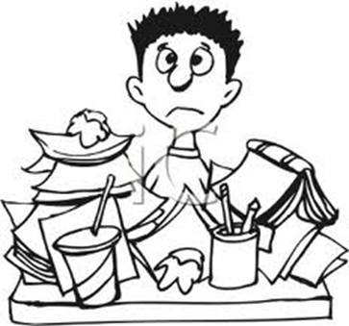
Exam Questions
Explain why a cool down is needed to finish the session.

