Slide 1
Section –B Applied Psychology
Types of Practice

Slide 2
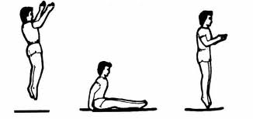
Massed Practice
Continuous practice without rest.
Practice conditions are long in duration.
High level of fitness crucial, therefore better with autonomous motivated performers.
Helps groove skills so they become habitual
E.g trampolinist continually practicing a seat jump to
make it automatic.

Slide 3
Distributed Practice
Training which includes rest periods.
Gives time to recover physically and mentally.
Good for practicing dangerous, tiring or complex skills,
Performers who lack fitness
Cognitive stage as coach can give feedback when performers rest.
E.g. hurdlers jumping, stopping, mentally rehearsing receiving feedback then hurdling again

Slide 4
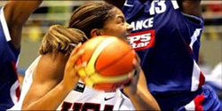
Variable Practice
Where the environment and/ or skill is constantly changing.
Best for open skills.
Helps develop schema, develop perceptual and decision making skills, improves selective attention.
E.g. basketball players playing 1v1, then 2v3 so they players can develop their passing, moving and dribbling

Slide 5
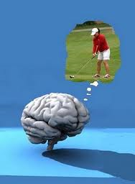
Mental Practice
Involves the performers going over the task in their mind without moving
This has been found to improve reaction times, confidence and motivation.
The best improvements in performance are made when physical practice is combined with mental rehearsal.
E.g. Football penalty takers visualising where they are going to hit the football. How the movement will feel the stages of the movement.

Slide 6
Exam Questions
Q) Describe the factors that you would consider when deciding whether to use ’massed practice’ or ’distributed practice’ to develop skills.
A)
Factors concerning performer that affect decision:
Stage of learning – Massed for experienced or autonomous performer/distributed for
novice or cognitive performer;
Fitness – Massed for very fit performer/distributed for less fit;
Motivation – Massed for highly motivated performer/distributed for less motivated
Factors concerning task that affect decision:
Complexity – Massed for simple skills/distributed for complex/strenuous;
Continuity – Massed for discrete skills/distributed for continuous skills;
Muscles used – Massed for fine skills/distributed for gross skills;
Time available – Massed when time is limited/distributed when plenty of time available;
Speed of action – Massed for quick/rapid skills/distributed for long-lasting skills;
Safety – Massed when no danger/distributed when potential danger.

