Slide 1
Transfer of Learning

Slide 2
Transfer of learning
The application of previous experience to present learning. The effect on the performance of practising one skill or learning together

Slide 3
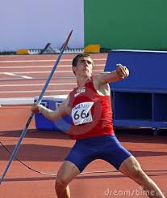
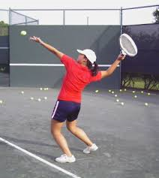
Positive Transfer
The effect of a previously learnt skill has a beneficial effect on another.
Overarm throwing technique to help learn a tennis serve to a javelin throw.

Slide 4
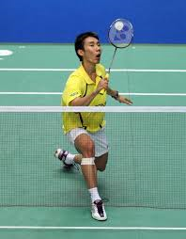
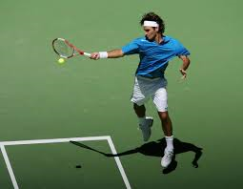
Negative Transfer
The effect of the previously learnt skill is damaging to the learning or performance of the new skill

Slide 5
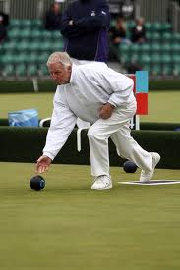
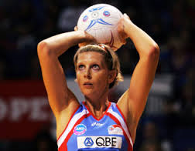
Zero Transfer
There is no effect on current performance or learning from previous learning.

Slide 6
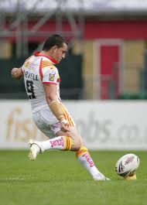
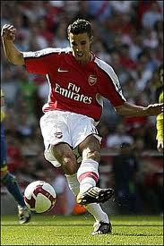
Bilateral Transfer
Transfer from one limb to another

Slide 7
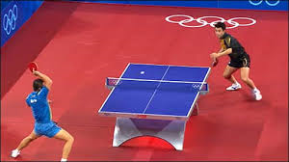
Proactive Transfer
Occurs when what the learner is practising has an effect on a later skill or
performance

Slide 8
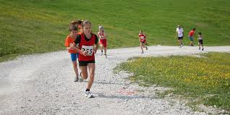
Retroactive Transfer
Occurs when the current learning of a skill affects the skill that was learnt in the past

Slide 9
Exam Question
Coaches will encourage performers to practise skills so that the skills can transfer to the competitive situation.
Describe what is meant by the term transfer of learning and explain two different forms that transfer can take. (3)

Slide 10
Answer
Skills learnt in one activity affects/ influence/impact/eq in another
Positive – enhances/helps/aids the learning of a new skill/egs
Negative – hinders learning of new skill
Zero – has no effect on learning of new skill
Retroactive – current practice enhances learning of previously learned skill
Proactive – current practice enhances learning of skill yet to be learned
Bilateral – practise on limb on one side of body improves other side

Slide 11
Exam Question
The action of throwing can be transferred from one activity to another.
Describe what is meant by the term positive transfer of learning..
(1 mark)
Name and explain three other forms of transfer of learning that can take place.
(3 marks)

Slide 12
How can a coach make sure that successful transfer of learning takes place? (3 marks)
3 marks for 3 of:
Coach makes performer aware of transfer potential/highlight elements of
skill that are similar;
Identify elements that may hinder learning;
Ensure original task is well learnt/ practice;
Planned progression;
Make practice sessions realistic/ relevant to the competitive environment;
Eg practicing against opposition/time/ equiv;
Eliminate bad habits;
Performer is well motivated/ confidence.

