Slide 1
Section B- Exercise Physiology
Training Methods

Slide 2
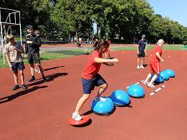
Training Methods
Explain the principles of each method, specific examples, advantages and disadvantages.

Slide 3
Interval/ Intermittent Training
Exercise interspersed with rest periods.
Intermittent- run 1 mile, rest, run 1 mile , rest
Interval- intense- 400m rest, 400m rest
Body does greater total workload than continuous
The distance/ intensity/ number of sets/repetitions/ number and time of rest periods can be varied depending on your goal. This allows for variety of training sessions.
Can be anaerobic or Aerobic

Slide 4
Interval/ Intermittent Training
IMPROVES: Can be used for speed/ power and strength or stamina and muscular endurance.
Intensity measured using % HR
EXAMPLE: To improve speed—3 sets x 10 repetitions of 30m sprints with rest between reps. To improve stamina 3 x 1000m run with 4 min rest between reps.
Vary the intensity/ duration of sessions and adjust the recovery/ repetitions
ADVANTAGES: Variety of pace and duration.
DISADVANTAGES: Requires a measured distance to train on

Slide 5
Weight Training-Strength, Power and Muscular Endurance
Using free weights or resistance machines to overload the body.
Specific weight training exercises- develop particular muscle groups
Eg upper body to develop powerful tennis strokes
Overload- increase % of 1 rep max

Slide 6
Weight Training-Strength, Power and Muscular Endurance
IMPROVES: Strength and Power if lifting heavy weights or Muscular Endurance if completing lots of repetitions.
Intensity measured using % 1 rep max
EXAMPLE: For strength gains 5 sets of 6 reps at 85% 1 rep max. For ME 3 sets of 20 reps at 50% 1 rep max.
ADVANTAGES: Best method to improve strength and power, can focus of specific muscle groups.
DISADVANTAGES: Injury risk at higher intensities, need specialist equipment, need to know the correct techniques, need more recovery time compared to other forms of training.

Slide 7
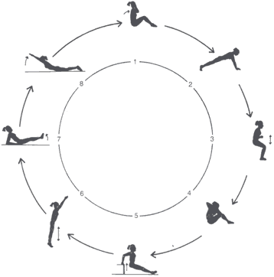
Circuit Training- strength, power, stamina, speed etc !
General conditioning activity where you perform different exercises at different stations. Exercises can be made sport specific.
Can develop MANY different components
Make it harder by decreasing rest between stations or more stations
How can you adapt a press up?
POWER- Rapidly with resistance
STRENGTH- Normal with weights
STAMINA- light and quick to increase HR

Slide 8
Circuit Training- strength, power, stamina, speed etc !
IMPROVES: Stamina and Muscular Endurance.
Intensity measured using time.
EXAMPLE: 8 exercises at 30seconds each repeat 3 times.
ADVANTAGES: Can perform with large numbers, vary stations to suit motivation levels, sports specific etc.
DISADVANTAGES: Does not have maximal improvements in terms of stamina and difficult to measure actual intensity.

Slide 9
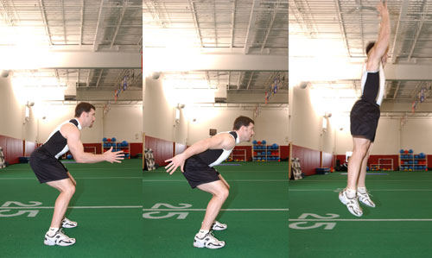
Plyometrics- Power
Eccentric muscle contraction (down phase) followed by an explosive concentric contraction.
Faster and greater the load- more powerful the following contraction.
IMPROVES: Strength, Power and Speed.
Intensity measured using repetitions/ distance.
EXAMPLE: Plyometric circuit that includes depth jumps, hopping, skipping etc.
ADVANTAGES: Excellent method of developing Power. Activities can represent actions from sport.
DISADVANTAGES: Injury risk at higher intensities, appropriate technique is essential.

Slide 10
PNF Proprioceptive neuromuscular facilitation (Mobility)
Stretching technique that inhibits the stretch reflex that occurs when a muscle is stretched to its limit. By isometrically stretching a muscle, with the aid of a partner, the stretch reflex is diminished and a greater stretch can occur.
IMPROVES: Flexibility.
Intensity measured using time/ distance.
EXAMPLE: Stretch a muscle to its maximum, isometrically contract it against a partner, then stretch further.
ADVANTAGES: Excellent method of developing flexibility.
DISADVANTAGES: Injury risk at higher intensities, appropriate technique is essential, need a partner.

Slide 11
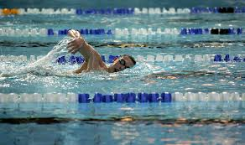
Continuous Training - Improves Stamina
Trains AEROBIC system
Low intensity rhythmic exercise using large muscle groups. STEADY STATE.
60-85% HRmax, 30mins 2 hours duration.
IMPROVES: Cardiovascular and muscular endurance
Intensity measured using % HRmax
EXAMPLE: Distance running, swimming, rowing 5-10k steady run @ 65% HRmax

Slide 12
Continuous Training
ADVANTAGES: Time efficient, easy to follow, less chance of injury.
DISADVANTAGES: Monotonous, may need to train at higher intensities, may not be specific to some activities such as team sports.
MEASURE: Borg Scale of 13-15 or Heart Rate 70% maximum 130-150 bpm

Slide 13
Not been examined so far!
Most likely to ask about specific types of training
Examples:
Explain how you could use different training methods to improve strength/power/stamina.
TOP TIP!
Think about fitness components and see if you can link them to a training method. Can you write down 6-7 points about each method?

Slide 14
Explain how you could use different training methods to improve strength & stamina
Stamina – Continuous
For example rowing, swimming, cycling
Trains AEROBIC system
Low intensity rhythmic exercise using large muscle groups. STEADY STATE.
60-85% HRmax, 30mins 2 hours duration.
Strength – Weight Lifting
Using free weights or resistance machines to overload the body.
Specific weight training exercises- develop particular muscle groups
Eg upper body to develop powerful tennis strokes
Overload- increase % of 1 rep max

