Slide 1
Section B- Applied Psychology
Teaching Styles

Slide 2
Command
Where the coach instructs the group and is in full control—the coach makes the decisions
Advantages
In dangerous situations
With cognitive performers
With Large groups
With a task that has only 1 response
When the learner knows what is required e.g. ball
needing to go in the net.

Slide 3
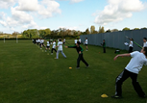
Command
Disadvantages:
Discourages creativity
May be no differentiation in tasks.
Learners may become bored and demotivated.

Slide 4
Ideal conditions to use this style
Group are large e.g. aerobics or undisciplined
Novice performers need to be taught recognised technique.
The situation is dangerous e.g. rock climbing and athletic throwing events
Tasks are complex e.g. serial skills such as triple jump
Environmental distractions may require issuing of instructions quickly i.e. bad weather or ‘time outs’ in games

Slide 5
RECIPROCAL STYLE
Where the coach delegates some of teaching to the more able members of the group (often in pairs)
Advantages:
Increases communication and contact
with the group
All ability levels develop
Feedback is given instantly: several coaches
Coaches may develop new ideas

Slide 6
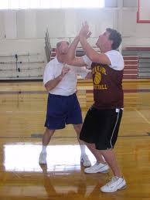
RECIPROCAL STYLE
Disadvantages:
Its time consuming
Student coaches may lack experience
Student coaches may instruct or demonstrate incorrectly

Slide 7
Ideal conditions to use this style
Leaners are more experienced
Simple skills are involved e.g. passing and dribbling
There is limited danger present
Time is available

Slide 8
PROBLEM SOLVING STYLE
Involves the teacher setting a problem and the learner devising a suitable solution
Advantages:
Open ended approach = creativity
Develops the cognitive and performance elements of the performer.
Good when there is no correct outcome
Performers are forced to draw on their previous knowledge

Slide 9
PROBLEM SOLVING STYLE
Disadvantages:
Very time consuming
Can’t be used in dangerous activities
May learn/ practice the incorrect technique and develop bad habits

Slide 10
Ideal conditions to use this style
Creativity is required e.g. devising tactics
No right or wrong outcome e.g. dance sequence
Performers have good communication and interactive skills
More experienced performers are involved

Slide 11
DISCOVERY STYLE
Coach guiding the learner to find the correct movement pattern/ answer by providing information, or giving specific cues. They are the facilitator
Advantages:
Increased contact and communication
Adapt response for ability
Motivational: learners achieve at own level
Creativity is encourages - more than 1 right answer

Slide 12
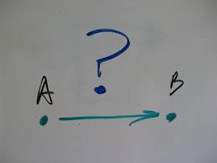
DISCOVERY STYLE
Disadvantages:
Time consuming
Incorrect techniques can be developed
Difficult to give feedback to large groups
Safety implications: learners working alone

Slide 13
Ideal conditions to use this style
Creativity is required e.g. devising tactics
No right or wrong outcome e.g. dance sequence
Performers have good communication and interactive skills
More experienced performers are involved

Slide 14
Exam Questions
What factors would you need to consider when deciding whether to teach the students using the command style of teaching or reciprocal style of teaching?

Slide 15
Q)
Explain how the characteristics of the learner and the situation may influence your decision to use ‘command style’ teaching to improve the skills of the group.
A)
Command style – depends on:
Use for cognitive learner;
Use when learner lacks fitness;
Use if learner lacks motivation;
Use if teacher/coach has limited experience/lacks confidence;
Use if class misbehaves/hard to control/disruptive;
Use with large numbers to teach;
Use when little equipment/time;
Use if skill has element of risk/ dangerous/safety concerns;
Use if skill is highly complex/difficult;

