Slide 1
Contemporary Questions

Slide 2
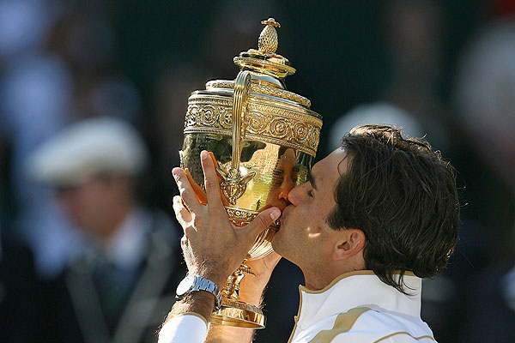
World Games
List the characteristics of World Games (12 if you can!)

Slide 3
Answers
Elite Performers
Pre event qualifications- selections/ trials
Shop window for city
Highly commercialised- TV rights, sponsorship
Infrastructure development
Development of sports facilities
Spectators
Nationalism/ patriotism
Officials/ volunteers
Positive values
Deviancy
Symbols

Slide 4
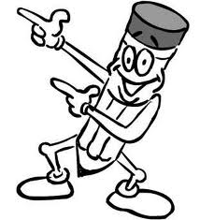
World Games
London 2012 was hailed as a great success for the UK, not just in terms of the medal haul and 3rd place achieved.
What is the impact in World games on the individual, country and government?

Slide 5
Individual
Want to be the best- highly motivated.
Test themselves against the best
Fulfil potential
Driven by personal gain- make a living as a professional
Pride/ satisfaction
Expectations from those close to them
Spectators inspired by role models
Pride in country

Slide 6
Cultural Effects
Some countries have this as part of their national culture. National hero's
Social Effects
Hep unify a country
Economic Effects
Financial investment
Shop window
Tourism
New sports Increase levels of participation
Stimulus for infrastructure
Regional regeneration

Slide 7
Government
Needs government support- Big Time!
Support bidding, planning, bring it to fruition- have to believe in long term benefits
Can use it to demonstrate political philosophy
USA black power salute, Hitlers games.
Beijing – help human rights ???
Televised all over world – boost government popularity
Or could go wrong!!

