Slide 1
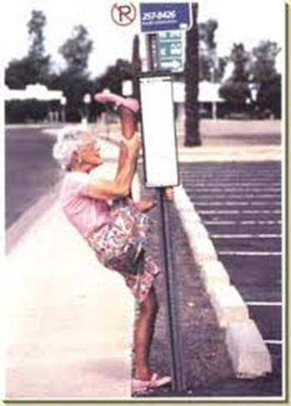
Section B- Exercise Physiology
Types of Stretching

Slide 2
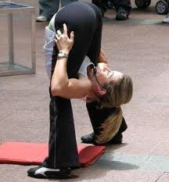
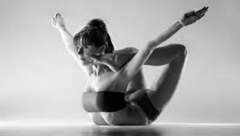
Benefits to the performer of increasing flexibility
Increased range of movement/ reduce injury
Adopt held or aesthetic positions in gymnastics
Can reach a ball or player in game better
Can apply more power/ longer levers in athletic examples.

Slide 3
Safe stretching
Warm up prior to stretching/ begin slowly/ stretch as part of a cool down
Make the stretch sports specific
Hold/ repeat stretch for 30 seconds
Never hold a painful stretch/ no ballistic
balance/ equalise stretches/ agonists/ antagonists

Slide 4
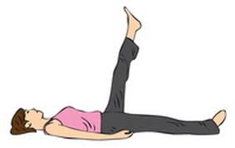
Active Stretching
Assume a position and hold it there with no assistance other than using the strength of your agonist muscles.
Example: Bringing your leg high and holding it there without anything to keep the leg in that extended position.
The tension in the agonist is an active stretch and helps to relax the muscles being stretched (antagonist).
Hard to hold 10-15 seconds

Slide 5
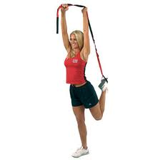
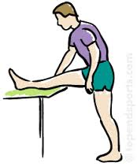
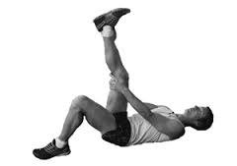
Passive Stretching
Assume a position and hold it there with some part of your body, or with assistance of a partner or some apparatus.
Example: Bringing your leg up high and then a partner holds it there with their hand.
Splits- floor is the apparatus
Good for cooling down

Slide 6
Static Stretching
Holding a position
Stretch to the furthest point and hold the stretch
Isometric contractions of the stretched muscle groups.
Fastest way to develop flexibility
Also develops the strength in the tensed muscle.

Slide 7
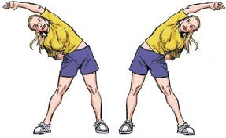
Ballistic Stretching
Uses the momentum of a moving body or limb in an attempt to force it beyond its normal range of motion.
Bouncing in or out of a stretched position
Not useful and can lead to injury
May even tighten muscles as activating the stretch reflex.

Slide 8
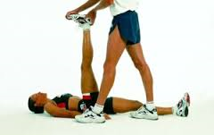
PNF
Position held and isometric contraction
Use a partner or apparatus
‘Tricks’ the stretch reflex

Slide 9
Exam Questions
Q)
Describe the different types of stretching that could be safely used with the group.
A)
Active – position held by agonist/muscles
Passive – position held by another body part or position held by partner
Static – position held with isometric contraction
Ballistic – bounce in and out of stretch
PNF position held and isometric contraction
Warm-up prior to stretching
Make stretch sports specific
(Begin) slowly
Hold stretch for few/no more than (30) seconds
Never hold a painful stretch – injury
No bouncing/ballistic
Balance/equalise stretches/agonists and antagonists

Slide 10
Q)
Describe the various ways that flexibility can be improved and, using examples explain the benefits to the performer of improved flexibility.
A)
Flexibility is the range of movement of a joint. Ways in which flexibility can be improved, addressing points such as:
Active stretching – holding a stretched position by contraction of your own agonistic muscles
Passive (or relaxed) stretching – stretch position being held by something other than the agonistic muscles
Static/PNF stretching – stretching to limit of range and then isometrically contracting the stretched muscles
Ballistic stretching – using movement to ‘bounce’ in and out of a stretch position
Benefits to the performer of improved flexibility, addressing points such as:
Increased range of movement/reduce injury
Adopt held or aesthetic positions in gymnastic activities/alternative example
Can reach ball or player in games/alternative example
Can apply more power/longer levers in athletic activities/alternative example

