Slide 1
Stages of learning

Slide 2
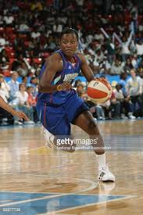
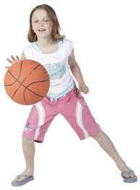
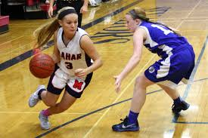
Stages of learning-Characteristics
Cognitive
Associative
Autonomous
Practice stage
Fluency increases
More trial and error
Match technical model to performance
EMP stored in LTM
Knowledge of results
Knowledge of performance
Accurate
Grooved
Over-learned
Fluent
Efficient
Little thought
Intrinsic feedback (Kinaesthesis)
Mental picture
Conscious thought
No kinaesthesis
Lacks fluency
Trial and error learning
Building S-R bond
Extrinsic feedback

Slide 3
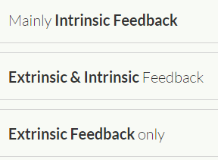
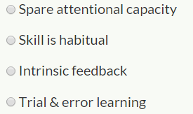
1)
2)

Slide 4
Performance curves
Whenever we learn something we learn it at different rates and we can have different levels of success.
These can be illustrated through performance curves.
A learning plateau occurs when the learner stops progressing and no improvement in skill is evident. The athlete may still be learning but performance does not improve.
Positive
The more you do it, the faster you improve
Negative
Rate of increase of performance will gradually reduce
Learn it quickly and then slow down (plateau)
P
Performance
Trial
Trial
Linear
Rate of improvement remains constant
S-Shape
Combination
Little improvement
Rapid improvement
learning plateau
P
P
Trial
Trial

Slide 5
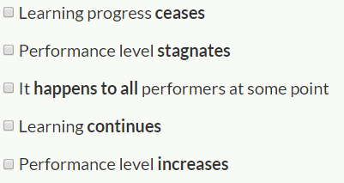
3)
4)
Positive

Slide 6
What causes learning plateaus?
How can we reduce this happening?
Not physically ready yet
Ability
Fundamental skills learnt poorly
Fatigue
Simple to complex skills
Boredom
Motivation
Ensure athletes are ready
Reset goals
Avoid fatigue
Break the skill down (part practice)
Visualise/mental rehearsal

Slide 7
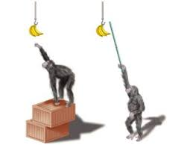
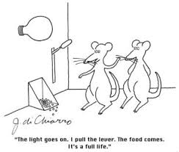
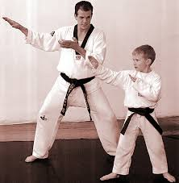
Theories of learning
Operant conditioning
Insight learning
Observational

Slide 8
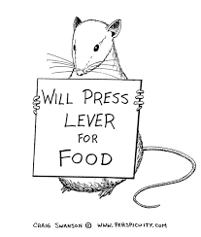
Operant conditioning
BF SKINNER
Also known as behaviourism
We learn through the consequences of our actions.
A form of connectionist learning.
Skinner’s box- https://www.youtube.com/watch?v=I_ctJqjlrHA
https://www.youtube.com/watch?v=Mt4N9GSBoMI
Reinforcement
Punishment

Slide 9
Operant conditioning-What is it exactly?
Learning is based on strengthening the relationship between stimulus and response (S-R bond)
The likelihood of the desired response is increased
The learner associates consequences of previous action with current situation
Trial and error learning
How can a coach use operant conditioning to develop skills?
Correct mistakes
Punishment to decrease probability of undesired response
Praise and reward
Shaping: manipulation of the environment to get the desired action
E.g Use of targets/lower baskets to give success
Negative reinforcement

Slide 10
Different types of reinforcement
Positive reinforcement, negative reinforcement and punishment
Positive - Use of praise/rewards/self-satisfaction to encourage correct behaviour
Negative - Removal of criticism when fault is corrected/unpleasant stimulus to encourage desired response/eg coach stops shouting
Punishment- criticism

Slide 11
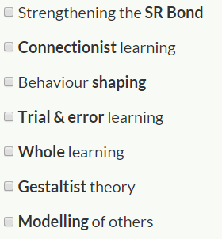
5)
6)

Slide 12
7)
8)

Slide 13
Practical example- Operant conditioning
If a shot goes long and high
Our performer knows to move back and to the left.
Stimulus=Long, high shot.
Response=move back and left
The more it is practiced/grooved, the stronger the bond will become.
The coach has noticed that player A moves their left leg first when he should move their right leg.
Using operant conditioning, what can the coach do?
A
Manipulates the environment- puts a hoop down so the player has to step into the hoop with their right leg before going over to the left.
Trying to create a new response to the same stimulus.
Shaping the environment to get the desired response.
B

Slide 14
Learning theories
Operant conditioning
(Learning through reinforcement)
Social Learning Theory (Learning through observation)
Cognitive/Insight Learning Theory
(Learning through problem solving)

Slide 15
Cognitive/Insight theory- Wolfgang Kohler
https://www.youtube.com/watch?v=6-YWrPzsmEE
This theory requires the learner to look at the problem and work out how to solve it.
WHY??? Have to understand the process
Learning the WHOLE skill (Gestalist)
Based on our PERCEPTION of the situation (improving our information processing system)
Involves trial and error
Involves problem solving
This problem solving will involve making sense of the information
So you can apply it to a new situation and adapt it better
Based on PAST EXPERIENCES (works well with SCHEMA theory)

Slide 16
Links to sport
How can this approach have a positive effect on learning a skill
Cognitive theory that involves cognitive processes/development
Is about understanding the process to achieve the result/why/reasons you do things
Coach questions performer about why they’re performing in a particular way
Experiences the ‘whole’ activity rather than skills in isolation
Can apply it to health-Understand why they need to be healthy and the best way they can do that.
Allows learners to develop their own strategies and/or routes of understanding
Better for the performer rather than being told what to do all the time
Performer able to adjust movements as required
Improves motivation.

Slide 17
Practical example- Cognitive/Insight learning
Player A- Perfect player
Causing player B lots of problems, hitting it high and deep to the back corner and player B cannot respond with an effective back hand shot.
Using Cognitive learning theory, what could a coach do?
Coach: ‘How can we solve this problem?’
Player B: ‘I need to improve my backhand’
Coach: ‘What else?’
Player B: ‘Well, They are putting me back in that corner when I hit into the middle’
Coach: ‘So what can you do differently?’
Player B: ‘Well on my shots I’m going to try to send them to the corner or bring them into the middle.’
Helping the performer to find a solution.
A
B

Slide 18
Social Learning theory- Observational (Bandura)
Main idea is that people learn by observing others.
Situational/environmental learning
Modelling
Most people learn by copying
Vicarious experience
Builds up mental picture
Creates patterns more easily
Demonstrations- visual image

Slide 19
Demonstrations must be effective…
Relevant to the learner
Accuracy
Status of the demonstrator- are they respected? Are they going to be taken seriously?
Physical and mental readiness
Motivation of learners

Slide 20
Bandura’s Model explaining observational learning
Demonstration
Attention
Retention
Motor production
Motivation
Actual performance

Slide 21
Bandura’s Model of social learning
Attention | Retention | Motor Production | Motivation
Amount of notice taken by the learner, NOT just paying attention
Coach can aid this by highlighting cues
Needs to be accurate
Not too long
Must be attractive
Significant other
Role model/ peer
Needs to be seen
Internalisation
Can they remember the skill?
Creation of a mental picture
Meaningful demo
Coach careful not to overload performer with too much verbal
Mental rehearsal
2nd image to help- hand in cookie jar
Must have the physical ability to copy the skill
Must be given the opportunity to do this straight after the skill
Reproducing the skill
Performer wants to learn the skill- do they have the desire to copy the action?
Based on successful completion of skill
Reinforcement/ praise
Perceived status of the model
Perception- taking note and retaining information
Psychomotor- reproduce the skill

Slide 22
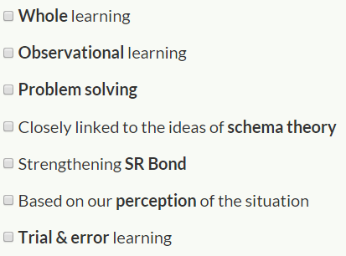
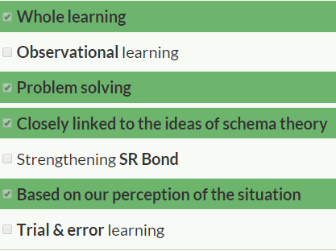

Slide 23
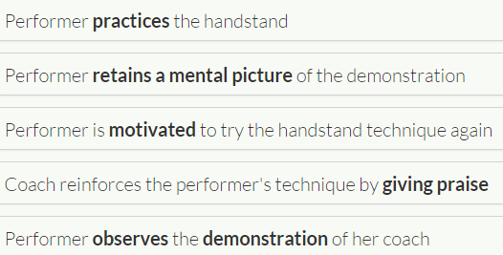
3
2
5
4
1

Slide 24
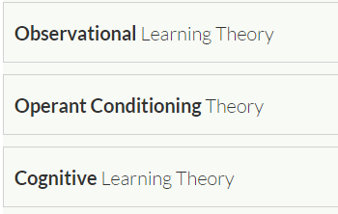
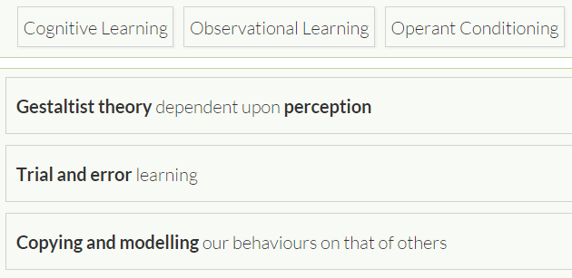

Slide 25
