Slide 1
Skill Acquisition
Classification of skill

Slide 2
Classification of skill
Trying to classify or group motor skill in sport is an inexact science, because one motor skill involves interlinking many factors.
A good way to classify a skill is by judging it against several narrow criteria. We will look at a few of these.
open – closed
discrete – serial – continuous
gross – fine
self paced – externally paced

Slide 3
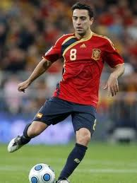
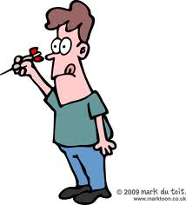
Open - Closed
Environmental Influence
This classification concerns the environment in which a skill is performed.
An open skill is performed in an environment with changing factors e.g. passing to a team mate in football.
This skill is directly affected by changing factors such as the movement of the ball, the movement of your team mate, the surface of the pitch, wind and other weather, positions of opposing players etc.
A closed skill is one in which external factors do not
change e.g. throwing a dart.
The position of the board, type of dart etc. are all
fixed and will not vary from one throw to the next.

Slide 4
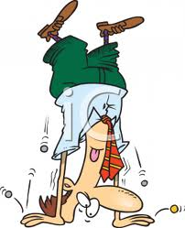
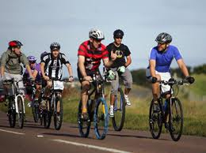
Discrete – Serial – Continuous
Continuity Continuum
Discrete skills have a definite beginning and a definite end e.g. a handstand. Start balanced on feet, end balanced on hands.
Serial skills are discrete skills linked together e.g. a triple jump links a hop, a step and a jump.
Continuous skills cannot be easily broken
down into discreet skills as they must be
performed continually e.g. pedalling a bike.

Slide 5
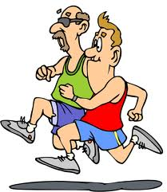
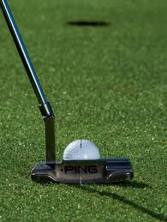
Gross - Fine
Muscular Involvement
This classification is based on the size and accuracy of movements.
Gross skills involve big movements such
as the leg and arm movements found
in running.
Fine skills involve precise, usually
smaller movements such as the fine adjustments of the wrist when aiming
a putt in golf.

Slide 6
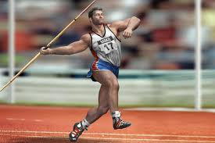
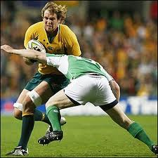
Self Paced - Externally Paced
Pacing continuum
The timing or pacing of a skill can be classified according to where the control of the pace lies.
Self paced skills are under the control
of the performer.
E.g. throwing a javelin.
Externally paced skills are dictated to by the surrounding environment.
E.g. timing a rugby tackle correctly to hit a moving opponent.

Slide 7
Continua
As you have probably already realised skills rarely fit neatly into one of these criteria, they usually have a combination of both/all the features of the criteria.
To really classify skill, the criteria have to be viewed as a continuum which the skill sits on. The dart throw mentioned earlier as a closed skill could still be affected by background noise, so has small elements of open skill while being predominantly a closed skill.
Here you can see how some different skills fit onto the open closed continuum.
Pick up a rolling cricket ball
dart
throw
football
pass
Open
Closed
unless it hits a bump

Slide 8
Task-21st September
1) Can you place the pictures of the skills on the correct continuum?
2) Complete the table to bring our knowledge together.
For each one:
Name the skill.
Identify the type(s) of skill being used.
List as many abilities as possible the athlete might be drawing on to complete the skill.
Classify the skill using each of the four continua we have covered today.
Justify your answers with a short explanation. (Sorry you are past GCSE now).
Working together and discussing answers is fine but please produce your own set of answers. You will need them for exam revision.
Any you don't finish in this lesson please finish at home.

Slide 9
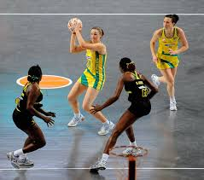
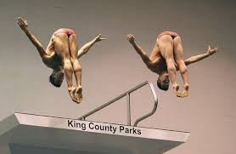
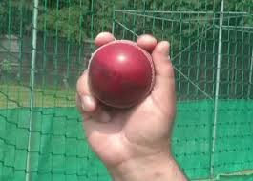
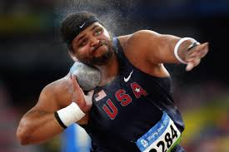
Environmental influence
OPEN
CLOSED
Muscular involvement
GROSS
FINE

Slide 10
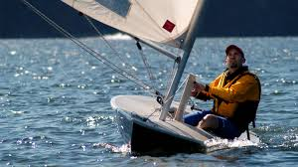
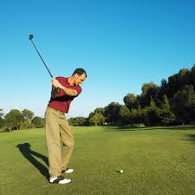
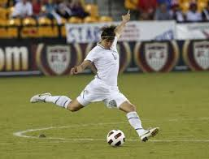
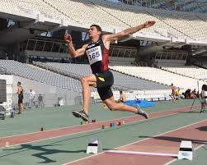
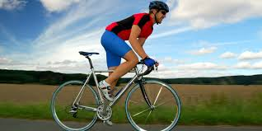
Pacing continuum
SELF-PACED
EXTERNALLY PACED
Continuity continuum
SERIAL
DISCRETE
CONTINUOUS

Slide 11
Next week....
Classroom session
We will look at how our brains process and store information.

