Slide 1
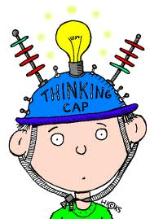
Skill Acquisition

Slide 2
Skilled Performance
Acquisition- skill is something that you gain as opposed to already have.
We can recognise the outcome or end product of a skilled performance
We need to know……
How does this product come about?

Slide 3
Skilled Performance
What processes underlies acquisition of skill and control of movement?
How is skill acquired?
What factors influence its attainment and how is it retained?

Slide 4
Unit Content
Skills
Skill, ability, classification
Information Processing
Memory, decision making, reaction time, motor programmes
Learning & Performance
Stages of learning, plateaus, theories- Bandura, Schmidt, transfer

Slide 5
Skill
http://www.youtube.com/watch?v=-3z1zag621Y
http://www.youtube.com/watch?v=DU1xkoxCMow skill in sport

Slide 6
Task
With a partner- write down a definition of a skilled performance.

Slide 7
Task
What do you think ability is?
Can you come up with a definition?

Slide 8
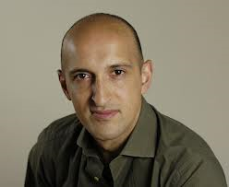
Skill Vs Ability
http://www.youtube.com/watch?v=NMRyyxAl77c

Slide 9
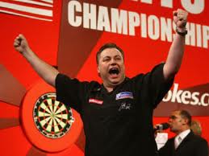
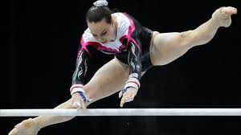
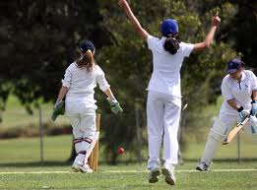
Skilled Performance
Learned behaviour to bring about pre determined results with maximum certainty often with the minimum outlay of time, energy or both as a result of evaluating information and decision making.
Skilled actions have an objective- goal directed and pre determined

Slide 10
Skilled Performance Characteristics
Learnt Economic
Efficient Fluent/ Smooth
Aesthetically pleasing
Adaptable
Consistent/ repeatable/ few mistakes
Goal orientated
Accurate/ Precise

Slide 11
Exam Question
Performers need to learn skills in order to take part in physical activity. Skilled movements are learned, economic and efficient – they do not waste energy.
Suggest three other characteristics of skill. (3)

Slide 12
Answer
3 of 3 from;
A. Consistency/repeatable success/few mistakes/maximum certainty
B. Coordinated/controlled
C. Fluency/flowing/smooth
D. Adaptable
E. Aesthetically pleasing
F. Goal orientated behaviour/ predetermined results
G. Precise/Accurate/Correct

Slide 13
Ability
Inherited, innate, stable traits that determine a persons potential to acquire sills.
E.g. coordination, balance, agility and reaction time
Use and combination of abilities underpins the development of skilled actions.

Slide 14
Types of Abilities
Motor ability – concerned with movements/actions/performing task;
Eg Leg/arm/body muscle contractions/ pushing off the blocks
Series of genetically inherited traits that determines an individuals coordination, balance and speed of reactions.

Slide 15
Types of Abilities
Perceptual ability – receiving/ recognising/selecting information from senses;
Eg reacting to the gun
To be able to take in information, recognise it and make sense of it.
Information received from our senses- sight, sound, touch, kinesthesis. Information from display.

Slide 16
Types of Skill
Skilled performance…
Information from environment
Select relevant information
Understand the information we have received and attend to it
Select and use correct physical response.

Slide 17
Detect stimuli
Execute Movement
Rugby Player
Make Decision
Interpret Stimuli

Slide 18
Cognitive Skill
Use of the brain to reason and problem solve as a result of leaning and experience.
Decision making, tactics and strategies, reasoning, deciding what to do, which action to use when.
Developed over time
Make better decision about an opponent if you have played them before

Slide 19
Perceptual Skill
Selecting, interpreting and making sense of information from our senses.
How well we select, organise and recognise information gained from our senses.
Ability to quickly analyse location of teammates and own location before deciding best pass to do
Developed as getting older and practise
Selective Attention
http://www.bing.com/videos/search?q=ronaldo+in+dark&docid=4729340020327751&mid=3697874CD3C1A92C9B7C3697874CD3C1A92C9B7C&view=detail&FORM=VIRE1#view=detail&mid=3697874CD3C1A92C9B7C3697874CD3C1A92C9B7C

Slide 20
Psycho- Motor Skill
Movement decided upon and controlled by the brain
Being able to coordinate the muscle contractions and relaxations to control movement such as badminton overheard clear
AKA Perceptual motor skills – most commonly used in sport
Interpretation of environmental stimuli and execution of movement.

Slide 21
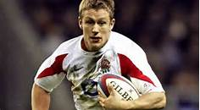
Example
Rugby player receives ball will have to analyse situation, decide if best option is to run, pass or kick ball then execute movement whilst constantly updating new stimuli and modifying actions as needed.

Slide 22
Relationship between Skill and Ability
In order to perform any skill we require specific abilities to perform the movement effectively.
TIP’s try to measure abilities in hope they can improve skill
Many skills require similar abilities and transfer does occur
http://www.uksport.gov.uk/pages/sporting-giants/

Slide 23
Key Words
Skill
Cognitive Skill
Perceptual skill
Psycho-motor skill
Ability
Perceptual ability
Motor Ability

Slide 24
Exam Question
Passing the ball is an important aspect of many team games
Using examples from a team game, explain the differences between motor ability and perceptual ability. (3)

Slide 25
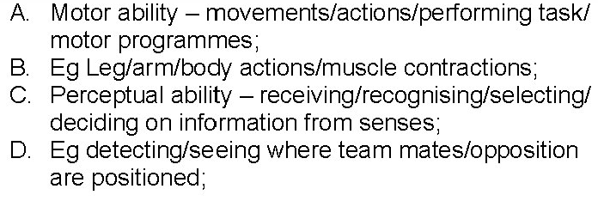
Answers

Slide 26
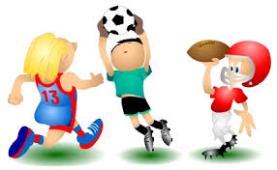
Classification of Skill
Analysis of skill- useful to group them together if they have similar characteristics
Based on a continuum/ sliding scale
Compare skills and interpret at same time
Open/closed
Gross/fine
Self paced/ externally paced
Discrete/serial/continuous
Gross- Fine

Slide 27
Open/ Closed
Based on influence of environment
OPEN
Payers position, proximity of crowd, playing conditions
Tennis Rally
http://www.youtube.com/watch?v=xdjNghcCNPU
CLOSED
Conditions don’t change
Dive in pool
However, tennis player- serve is closed in an open environment
http://www.youtube.com/watch?v=guS51jCLcQg

Slide 28
Externally Paced- Self Paced
Based on the amount of control a performer has over the execution and timing of the movement.
SELF PACED
Gym routine, golf swing
http://www.youtube.com/watch?v=saF6Dvlvu4Q
EXTERNALLY PACED
Sailing
http://www.youtube.com/watch?v=Y9-Bn1iUfBg

Slide 29
Gross/ Fine
Based on amount of muscular movement and precision of movement required during the execution of the skill
Many combine both
Cricketer run up gross- bowling wrist action fine
GROSS
Running, Throwing, Jumping
http://www.youtube.com/watch?v=C93qwVmBseE
FINE
Darts, snooker
http://www.youtube.com/watch?v=TZItHDuIUS0

Slide 30
Discrete/ Serial/ Continuous
Based on relationship between sub routines
Is there a definite beginning or end? Is it composed of separate movements?
DISCRETE
Clear beginning and end- b’ball free throw
http://www.youtube.com/watch?v=kvavitKZHGM
SERIAL
Number of discrete skills chained together- triple jump
http://www.youtube.com/watch?v=LDw4bFgiTMQ
CONTINUOUS
On going movement, cycle repeated – running, cycling
http://www.youtube.com/watch?v=0mcRaUzdI5M

Slide 31
TASK
A3 paper
Produce guide to skill classifications
Draw continuums
Description of each
Definition of each
Sporting examples
Pictures- newspapers in library/ internet

