Slide 1
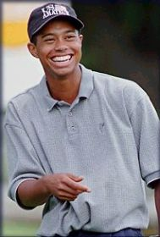
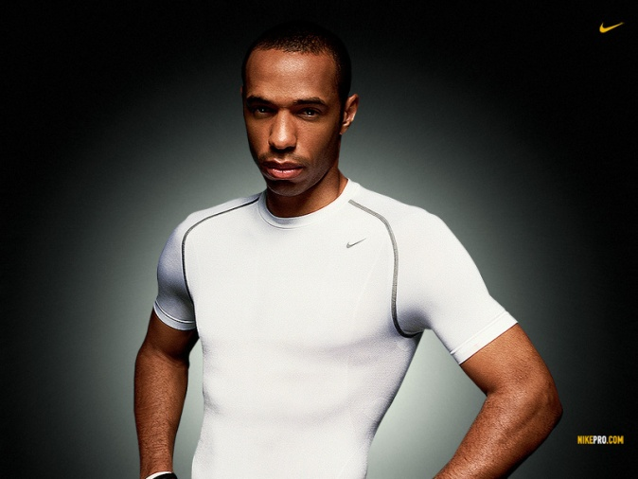
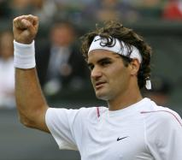
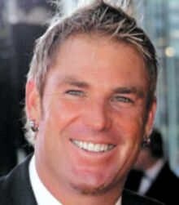
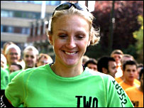
Confidence in sport 1

Slide 2
Context
“The most consistent difference between elite and less successful athletes is that elite athletes possess greater self-confidence.” Gould et al.

Slide 3
Lesson 1 aims:
Understand how confidence affects commitment.
Understand how goal setting can be used to influence confidence.
Examine Bandura’s self-efficacy theory.

Slide 4
How confidence affects commitment
Success > Builds confidence > Increases future expectations of success > improves likelihood of good future performance.
Commitment builds as a result.
Failure > Reduces confidence > Increases anxiety > impedes future performance.
Commitment withdrawn as a result.

Slide 5
Commitment
Linked to achievement motivation.
Committed performers in sport persevere through thick and thin. They are more likely to display approach behaviours
Without this commitment the performer will not achieve goals and may display avoidance behaviours.

Slide 6
Goal setting
Can help to increase both confidence and commitment.
Goal – the standard of excellence that the individual is trying to accomplish.
Long term goal – ultimate aim, e.g. participating in the olympics.
Medium term goal – monthly or annual basis.
Short term goal – daily or weekly basis.

Slide 7
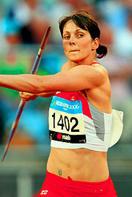
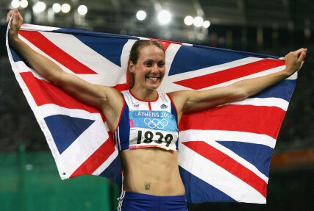
Self-efficacy
Situation specific self-confidence.
Kelly Sotherton – very confident in 6 of the 7 heptathlon events, but has no confidence at all in the Javelin.

Slide 8
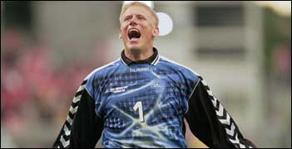
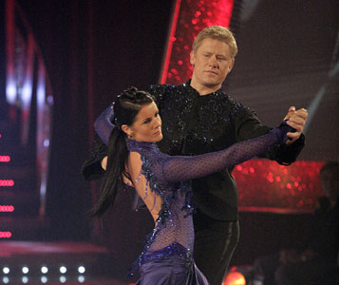
Another example
That’s counts for nothing when dancing on a reality TV show though!
Peter Schmeichel has played in front of huge crowds and global TV audiences, displaying supreme confidence in football.

Slide 9
Self-efficacy theory
Bandura.
People with high self-efficacy display approach behaviour.
They attribute success to their own merits, e.g. effort and ability.
This builds confidence and increases future expectations.

Slide 10
On the other hand…
Those low in self-efficacy avoid challenges tendency to avoid failure.
They attribute failure to themselves.
This lowers confidence.

Slide 11
Bandura’s self-efficacy theory
Performance
Accomplishments
Vicarious Experiences
Verbal Persuasion
Emotional Control
Efficacy Expectations
Behaviour patterns Choice Effort Persistence
Thought patterns Goals Worry Attributions
Athletic performance

Slide 12
Components of self-efficacy
Previous accomplishments – remind yourself about past achievements. Powerful as it is based on personal mastery.
Vicarious experiences – Watch others perform the skill in question. This reduces worry (anxiety).
Verbal persuasion – can be done by coach or self (‘self-talk’)
Emotional control – Evaluation performer makes. Some may consider a few nerves to be positive whereas others may believe them to be detrimental to performance.

Slide 13
These lead to efficacy expectations
Behaviour patterns
Choice
Effort
Persistence
Thought patterns
Goals
Worry
Attributions
Which in turn influences athletic performance.

Slide 14
How can you as a coach improve a performers self efficacy?

Slide 15
Performance Accomplishments
Highlight past success of the players and performance failures of the opposition.
i.e the team have already been beaten in the league.
Success achieved at early stage- tasks they are capable of.
i.e Practise without opposition first.

Slide 16
Vicarious Experience
Accurate demo of skill
Point out other players who are succeeding at the skill and use them as role models.
Care not to use too high ability models.

Slide 17
Verbal Persuasion
Used in lead up to the game
Encouragement, praise
Rewards/ incentives
Clear to players that success is down to them and not external factors- attribution.

Slide 18
Emotional Arousal
Lower emotional arousal and anxiety
Methods

Slide 19
Exam Link
Explain what you understand by the term self efficacy (2)
What strategies would a coach employ to improve self efficacy of a performer? (6)

