Slide 1
Information Processing

Slide 2
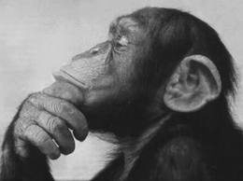
Is it better to play well and lose than it is to play badly and win?

Slide 3
1) Draw a basic model of information processing

Slide 4
2) Define the term ‘display’

Slide 5
3) Explain the term ‘perception’

Slide 6
4) Name four senses

Slide 7
5) What type of information do we get from the external environment?
6) What type of information do we get from the internal environment?

Slide 8
7) During perception, identification of stimulus occurs. This involves three elements
What are they?

Slide 9
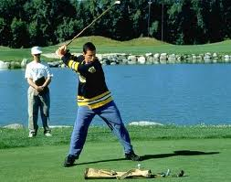
`12 H/ W questions & TASK
http://www.youtube.com/watch?v=HbjvIdGFGIQ

Slide 10
Selective Attention
http://www.youtube.com/watch?v=vJG698U2Mvo
http://www.youtube.com/watch?v=q59zG1fFk0k

Slide 11
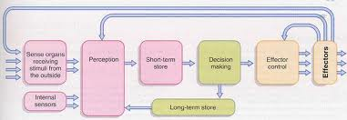
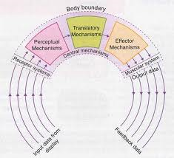
Selective Attention
Where?
Perceptual mechanism
Between STSS and STM
STSS- large capacity temporary store for all incoming sensory info

Slide 12
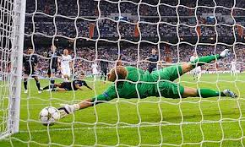
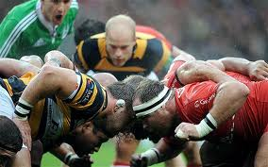
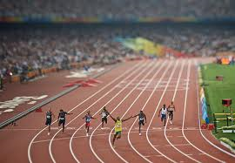
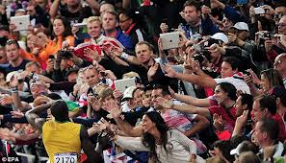
Selective Attention
In sport there is huge amount of information from our senses
What are the senses?

Slide 13
Selective Attention
All info can be stored in STSS- huge capacity lasts ½ second or less. Not attended to it is lost…
Vast majority ignored i.e. temperature, clothing touching you, firmness of ground etc
Information is irrelevant
We are only concerned with information that is directly our concern -relevant

Slide 14
Selective Attention
We have to concentrate on the stimuli that is important to us
Selective Attention
Ability to select relevant information from irrelevant information
Concentrate on relevant information
Prevents overload of information

Slide 15
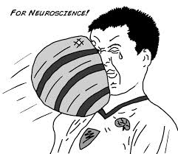
Selective Attention
Amount of information presented to you will depend on experience of skill
If new/ beginner- lots of information
= overload
If experienced- you automatically filter out the irrelevant stuff
We focus on just a few of the millions of stimuli

Slide 16
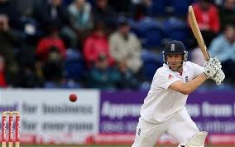
Selective Attention
Experienced cricketer
Ignores majority of information and concentrates on flight of ball automatically
Detects relevant stimuli quicker without thinking= improved stimulus identification

Slide 17
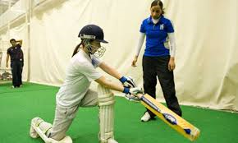
Selective Attention
Novice Cricketer
Taking in lots of irrelevant stimuli
Bowlers action, noise from crowd, feeling of bat in hand before thinking about the flight of the ball.
Slow process

Slide 18
What can we do to improve out selective attention?
In pairs brainstorm a few ideas of how you as a coach may improve selective attention in your sport.

Slide 19
Improving Selective Attention
Increase the intensity of the stimulus
Motivate the performer- correct arousal level
Refer to past experiences (transfer)
Cue identification- direct them to a cue
Learn to ignore irrelevant stimuli (practise with distractions)
Make the stimulus meaningful/ unique (wave goodbye to basketball)

Slide 20
Selective attention is an important part of the information processing system.
Use figure 1 to identify where selective attention occurs and explain how it aids performance (3)

Slide 21
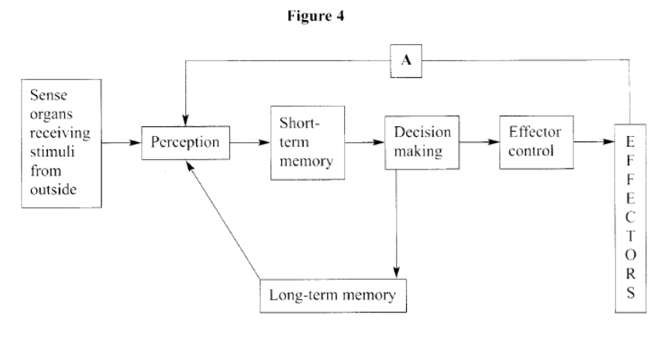
Using Figure 4, identify where selective attention occurs and explain how it aids performance. (3)
How can a coach improve a performer’s selective attention? (3)

Slide 22
Use figure 1 to explain the functions of the
Perceptual mechanism (3)

Slide 23
Answer
Perceptual Mechanism
Information/stimulus is received from/display
By the sensory organs;
Discriminates information/selective attention/filters out of information;
Coding of important information/interpretation of data/identify the stimulus/making sense of the information/realise the importance/equiv;
Pass information into translatory mechanism 3 marks

