Slide 1
Schema Theory

Slide 2
Schema Theory
When we want to develop a skill, if we understand schema theory it can reduce the time taken to reinforce the skill/ learn it
Motor programme theory- criticism is that all movement are pre planned and stored in our long term memory

Slide 3
Schema Theory
Rather than using memory and perceptual traces to initiate movement..
We store generalised series of movement patterns and adapt them to the current environment.
We want to learn new skill recall motor programme and alter it.
Modify running, jumping, throwing and catching- refined skill

Slide 4
Schema…..
Set of rules/ relationships to help us make decisions about movement patterns

Slide 5
Schemas are initiated and evaluated by 2 processes….
Recall Schema- Starts movement
Initial- What's going on
Response- What's needed
Recognition Schema - Controls and evaluates movement
Sensory consequences- How did it feel
Response Outcomes -What happened

Slide 6
Various sources of information used to modify behaviour
RECALL
Prior to performance
Initiates movement
Knowledge of initial conditions
What can you see hear feel?
Knowledge of Response Specifications
What is expected/ what should I do?

Slide 7
Various sources of information used to modify behaviour
RECOGNITION
Following/ during movement/action
Sensory consequences
Feedback info concerning performance- intrinsic/ kinaesthetic how it felt
Response Outcome
Comparison of actual and intended outcome/ knowledge of results/ what happened?

Slide 8
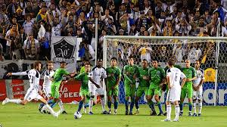
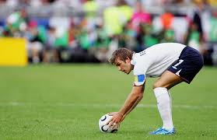
David Beckham
Wide range of schema for free kicks
Faced with a free kick, assesses the situation and selects the type of shot he s to use to avoid the GK and defenders
Recall Schema

Slide 9
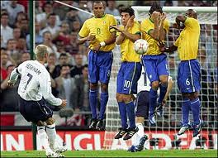
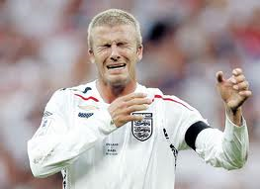
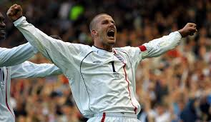
David Beckham
The fact that he has build up a wide range of schema for the skill allows him to take the free kick form a variety of locations.
Controls the execution of the shot and assesses its outcome, retaining any information that may be useful in the future if faced with a similar situation
Recognition Schema

Slide 10
Implications of schema on the way we teach skills
Vary practise conditions by changing initial conditions
I.e. team mates in different places/ opposition
Realistic practise
Build up set of response specifications/ movement requirements
Develop as many schema as possible
Frequent feedback
Teach simple skills before sport specific skills
Challenging and progressive tasks

