Slide 1
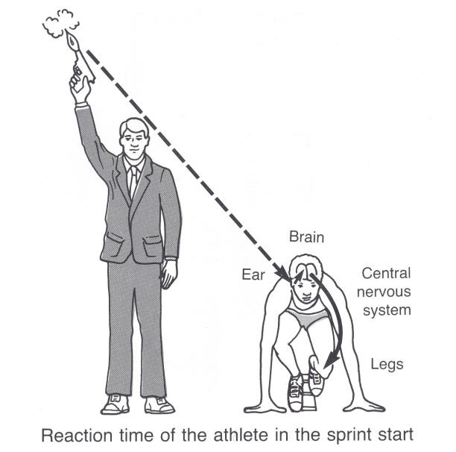
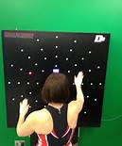
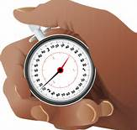
Reaction Time

Slide 3
Memory helps us identify a stimulus, we now need to know how to make a decision and respond to the information that has been received.
Response Selection Stage
Need to decide what movement to make
Ball coming towards me…should I catch it? if so how?

Slide 4
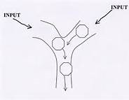
Translation Process
Until one stimulus has had a decision made about it another can not be acted upon
Single channel hypothesis
Knowledge of a stimulus helps and decision making time can be improved.

Slide 5
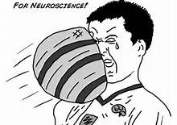
Reaction Time
Genetically determined
Influenced by the uncertainty of the stimulus to the performer i.e. knowledge
Are you familiar with the stimulus?

Slide 7
Reaction Time- Time take to make a decision
Movement Time – Time from when movement is initiated to the point when the movement is complete
Determined by muscle fibre type, level of learning of motor programme involved.
Response Time- Time from stimulus being given to the end of the result

Slide 8
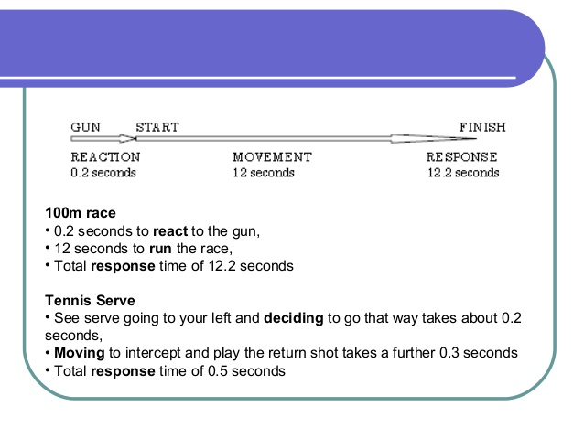

Slide 9
Response Time=
Reaction time + movement time

Slide 11
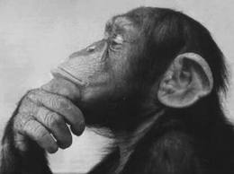
What affects Reaction Time?
?

Slide 12
What affects Reaction Time?
Age
Gender
Fatigue
Intensity of stimulus
Probability of stimulus occurring- if expected reduced element of doubt i.e. same shot
Presence of a warning signal- call or gesture

Slide 15
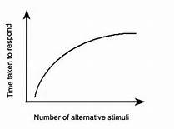

Slide 16
What can players do to improve their reaction time?
?

Slide 17
What can players do to improve their reaction time?
Concentrate on a cue/ selective attention
Relevant practise
Optimum arousal level
Anticipation
Mental rehearsal
Improve movement time
Increase intensity of stimulus

Slide 18
Question
Reaction time is far more common in team games than simple reaction time.
Explain this statement. (2 marks)

Slide 19
Answer
A. Choice Reaction Time – numerous stimuli and/or responses and Simple Reaction Time – one stimulus and one possible response
B. Games – open skills need CRT mainly/predominate/many choices/ decisions/few SRT skills/moments

Slide 20
Question
Performing a skill involves ‘movement time’, ‘response time’ and ‘reaction time’.
What is the relationship between these three time phases?
(1 mark)

Slide 21
Answer
Response time = reaction time + movement time

Slide 22
Question
What can games players do to improve their response time? (3 marks)

Slide 23
Answer
Concentrate on a cue/ selective attention
Relevant practise
Optimum arousal level
Anticipation
Mental rehearsal
Improve movement time
Increase intensity of stimulus

