Slide 1
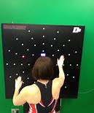
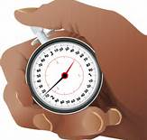
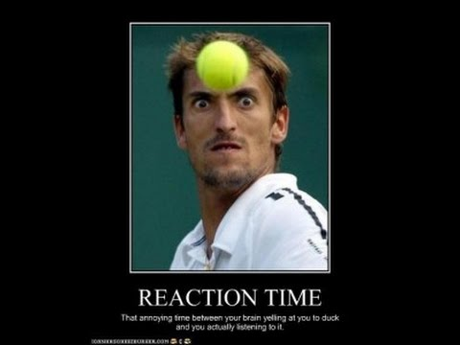
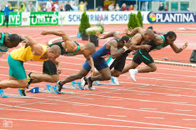
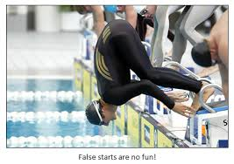
Reaction Time

Slide 2
Memory helps us identify a stimulus, we now need to know how to make a decision and respond to the information that has been received.
Response Selection Stage
Response selection- deciding how to respond
Need to decide what movement to make
Ball coming towards me…should I catch it? if so how?
Translation Process
Decision making
Until one stimulus has had a decision made about it another can not be acted upon. This is called the single channel hypothesis.
Decision making time can be improved by:
Practice
Highlight relevant cues

Slide 3
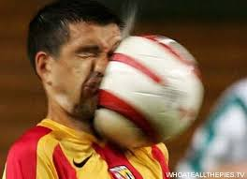
Reaction Time
Genetically determined
Influenced by the uncertainty of the stimulus to the performer i.e. knowledge
Reaction Time- The time taken to make a decision
Movement Time – the time from when movement is initiated to the point when the movement is complete
Determined by muscle fibre type, level of learning of motor programme involved.
Response Time- the time from the stimulus being given to the end of the result
How are they linked?
Reaction Time + Movement Time = Response Time

Slide 4
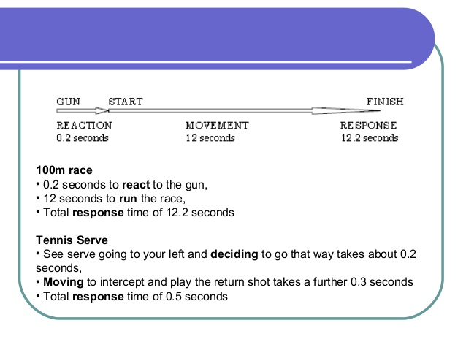
EXAMPLE

Slide 6
What affects Reaction Time?
Age
Gender
Fatigue
Intensity of stimulus
Probability of stimulus occurring- if expected reduced element of doubt i.e. same shot
Presence of a warning signal- call or gesture
Temperature (the colder the body the slower the reaction)
Previous experience
Body size
Anticipation
Psychological refractory period
Hick’s Law

Slide 7
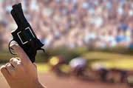
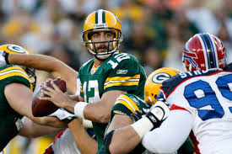
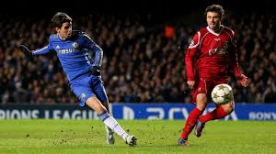
Types of reaction time
Simple reaction time
One stimulus with only one correct response e.g reacting to the starting gun by running down the track towards the finish
Choice reaction time
Several stimuli, which may have any number of responses OR one stimulus with a number of responses.

Slide 8
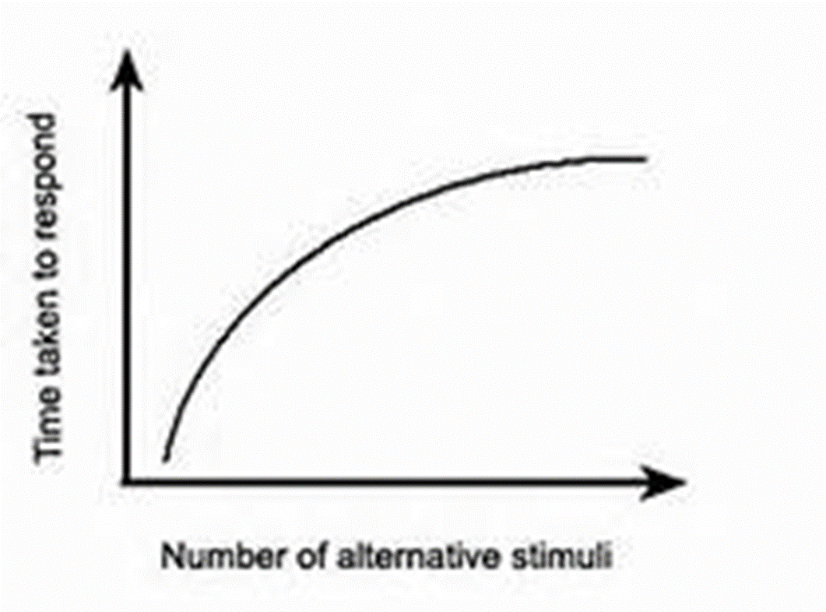
Hick’s Law 1952
The more stimuli that there are, the longer it will take to choose the correct response.
‘’Choice reaction time is related to the amount of information that must be processed to resolve uncertainty about the various possible stimulus response alternatives.’’

Slide 9
What can players do to improve reaction time?
Concentrate on a cue/ selective attention
Relevant practise
Optimum arousal level
Anticipation
Mental rehearsal
Improve movement time/fitness
Increase intensity of stimulus

Slide 10
Match up the definition to the key word.
The time taken from the start of the movement to completion of the movement
Response time
The time taken from initiation of signal to completion of movement
Simple reaction time
The more choices there are, the slower the reaction time will be
Choice reaction time
The time taken between stimulus being given to the end of the response
Movement time
The time taken to start a single response to a single stimulus
Hick’s Law
The time taken to start a single response to a choice of different stimuli
Reaction time

Slide 11
The time taken from the start of the movement to completion of the movement
Movement time
The time taken from initiation of signal to completion of movement
Response time
The more choices there are, the slower the reaction time will be
Hick’s Law
The time taken between stimulus being given to the end of the response
Reaction time
The time taken to start a single response to a single stimulus
Simple reaction time
The time taken to start a single response to a choice of different stimuli
Choice reaction time

