Slide 1
Psychological Refractory Period & Anticipation

Slide 2
Psychological Refractory Period
The delay in response to the second of two closely spaced out stimuli.
Linked to reaction time
Stimulus -Response bond

Slide 3
Stimulus 1 Response 1
Stimulus presented and there is a response for that stimulus.
If a second stimulus in received in quick succession, there will be a response for that stimulus.
Stimulus 2 Response 2

Slide 4
Psychological Refractory Period
Stimulus 1 Response 1
Stimulus 2 Response 2
Problem- the performer is locked in (attending) to the response to S1. this must be processed before they can react to S2. This causes a delay

Slide 5
PRP
Stimulus 1 Response 1
Stimulus 2 Response 2
S1-Player 1 plays a forehand drive towards player 2’s forehand
R1-Player 2 prepares to return with a forehand drive
S2- balls hits net slows and changes direction
R2- player 2 must change shot selection from forehand to backhand

Slide 6
Psychological Refectory Period
The brain can only deal with one piece of information at one time/respond to one stimulus at a time
The second stimulus arrives in close succession
One signal must be cleared before another can be responded to
Due to the single channel hypothesis

Slide 7
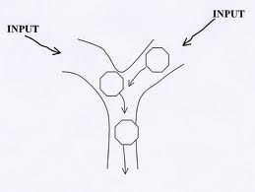
Single Channel Hypothesis
The brain can only process one stimulus at a time
Limited capacity
One stimulus needs to be processed before another can be acted on.

Slide 8
Key Words
Single channel hypothesis
Brain has limited capacity
Response to S1 needs to be attended to and processed before S2 can be responded to.
This causes a delay
PRP
Give Practical examples

Slide 9
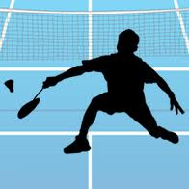
Anticipation
Attempting to predict that a movement will happen
Spatial Anticipation-
Performer predicts what is going to happen
Example- In badminton the performer detects a slight change in the shot action and expects a drop shot
Temporal Anticipation-
Performer predicting when the action will happen
Example- Football, defender tries to guess when the attacker will actually pass the ball

Slide 10
Homework
Finish off exam question on A3 sheet (complete the questions in your book)
Worksheet

