Slide 1
Projectile motion

Slide 2
Factors affecting distance
1) Angle of Release:
To gain maximal horizontal distance, the angle of release is importance.
Optimal angle dependent on release height and landing height.

Slide 3
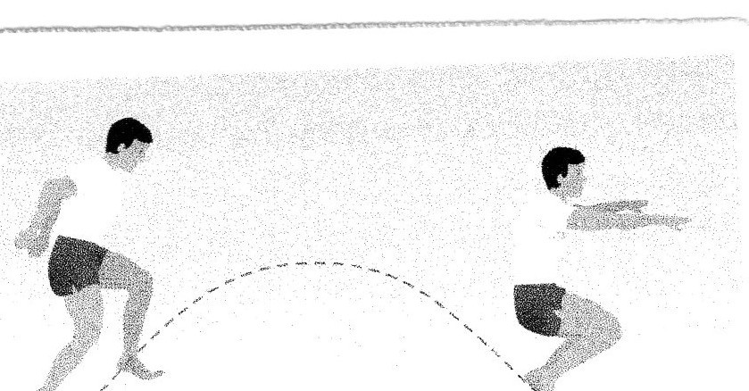
Release height and landing height are equal; optimum angle 45 degrees

Slide 4
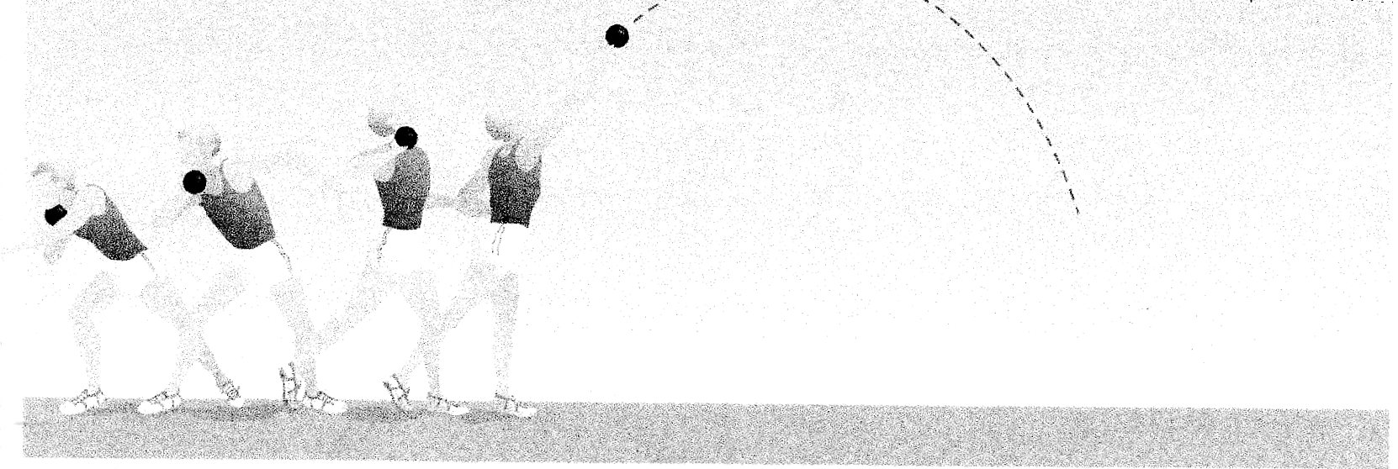
Release height greater than the landing height; optimal angle less than 45 degrees

Slide 5
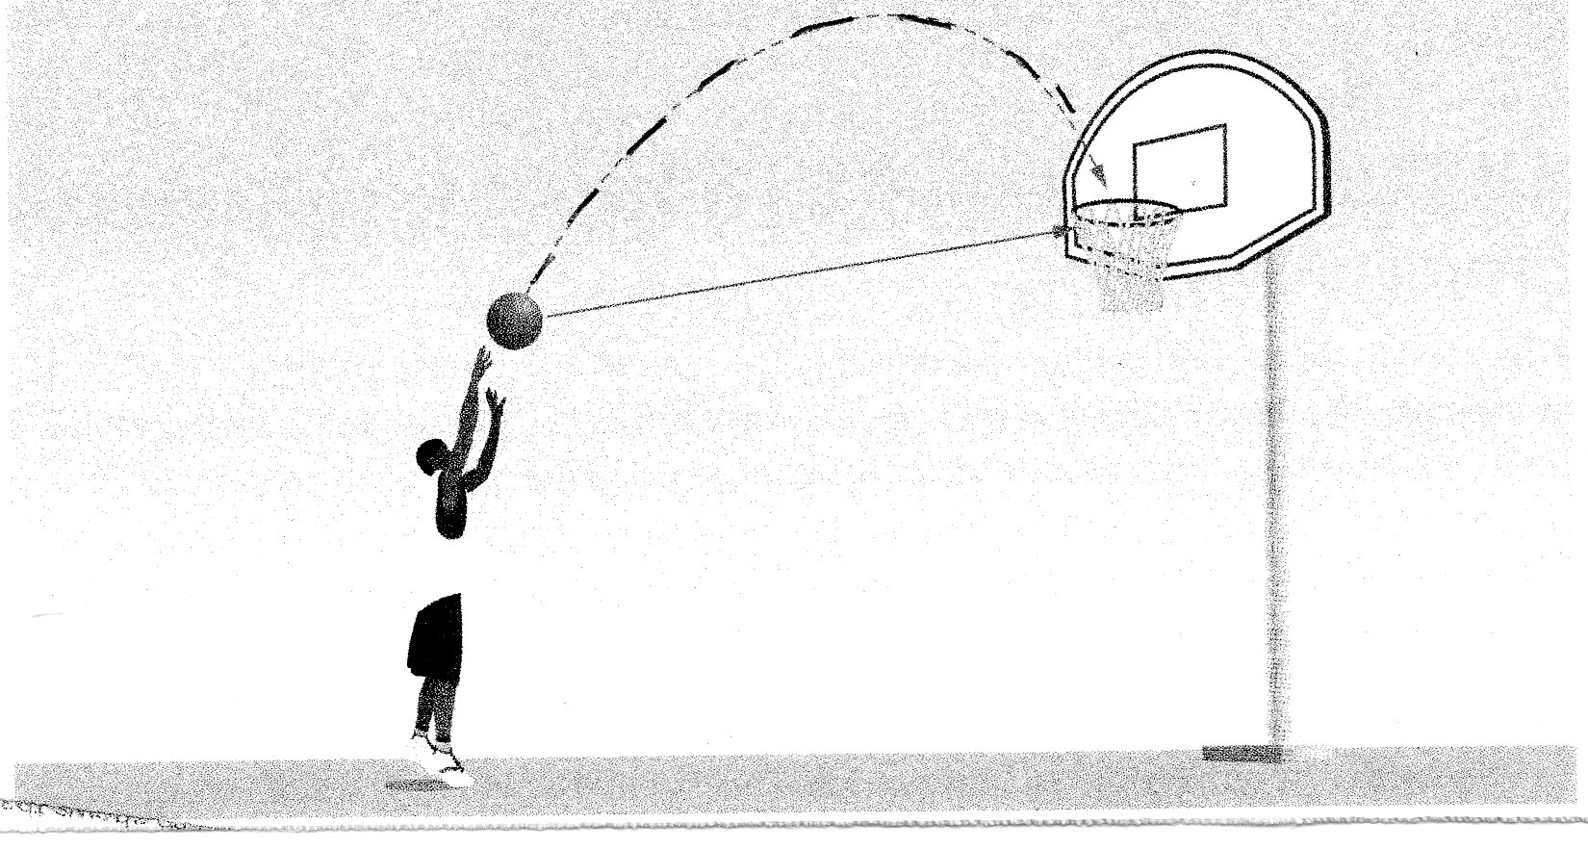
Release height is lower than landing height angle of release is greater than 45 degrees

Slide 6
Factors affecting distance
2) Velocity of Release
Greater the velocity the greater the horizontal distance travelled.
In throwing events in athletics rotational speed across the circle ensures greater distance.

Slide 7
Factors affecting distance
3) Height of Release
Greater release height results in increased horizontal distance
Example; fielder in cricket that is taller will throw further providing the angle or release and velocity are the same
Smaller fielder will have to alter angle or velocity to achieve same distance

Slide 8
Factors affecting projectiles
Weight and air resistance affect projectiles in the air
Projectiles with a large weight have small air resistance and follow a parabolic flight path. Projectiles with a small mass and unusual shape have big air resistance and deviate from the parabolic path
Parabolic curve; flight path of a projectile in the absence of air resistance.

Slide 9
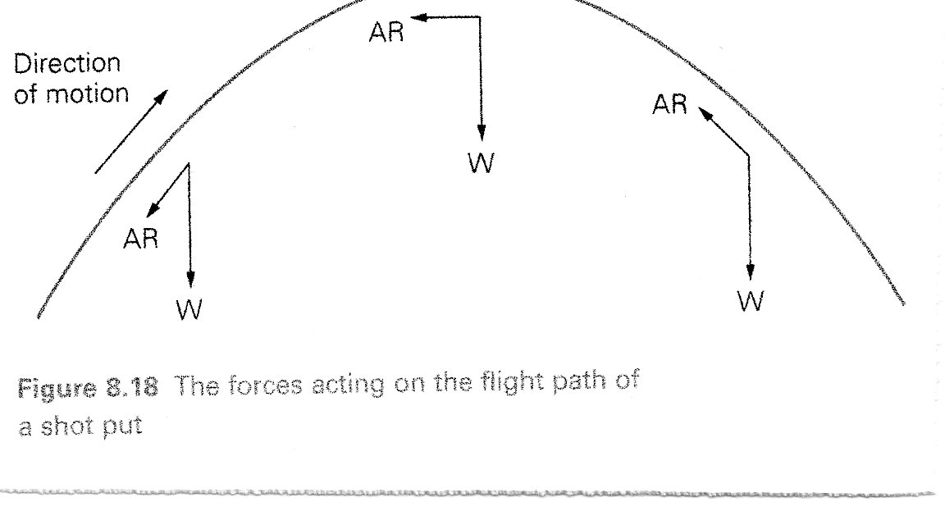
Shot flight path: large mass. Weight arrow longer than air resistance arrow

Slide 10
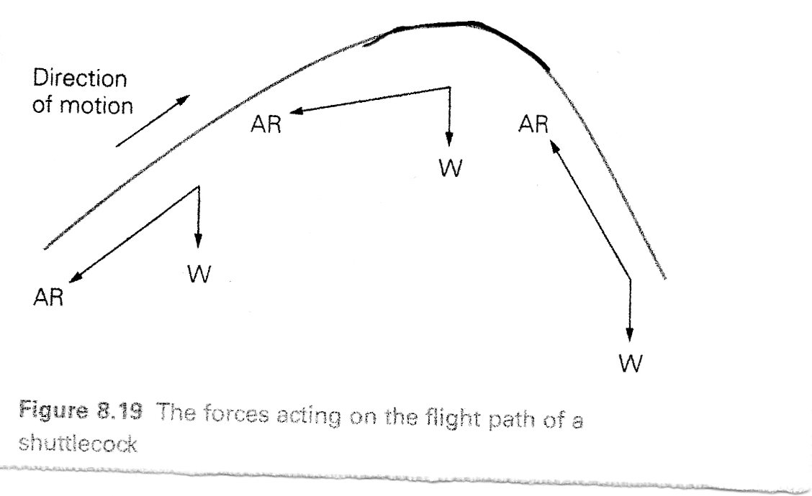
Shuttlecock flight; light mass, unusual shape increases air resistance

Slide 11
Questions
A number of factors affect the distance the shot travels.
What are the three most important factors that affect the distance travelled by the shot? (3)
Why do shot putter use either a glide or a spin technique prior to releasing the shot? (3)
Define parabolic flight with reference to throwing the shot. (4)

