Slide 1
Section B- Physiology
Principles of Training

Slide 2
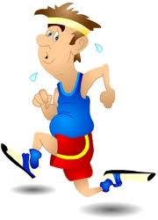
Principles of Training
Specificity
Progression
Overload
Frequency
Intensity
Time
Type
Reversibility
Tedium
You may get a mark for writing ‘SPORT’ as well as explaining them.

Slide 3
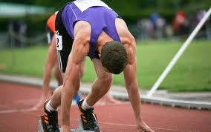
Specificity
Every activity is different in terms of its fitness requirements- you must consider …
Sport you are playing
Muscle fibres types/ muscles used
Similar skills/ movements
Intensity of activity
Time/ duration of activity
Age/gender/ability
Energy system (Aerobic/ Anaerobic )

Slide 4
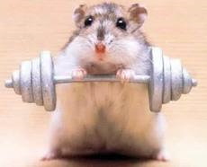
Progressive
Increase the amount and intensity of exercise gradually in order to improve but avoid injury.

Slide 5
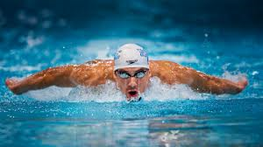
Overload
Working harder/ training harder than normal
Causes adaptions- you gradually increase this to get progression.
Frequency- train more often
Intensity- train harder
Time- training for longer
Type- use different forms of exercise
FITT Principle.

Slide 6
Reversibility
Use it or lose it! Too much rest
Fitness lost quicker than gained
2 weeks off- 3-4 weeks to regain
Remember- you must avoid overtraining- doing too much without sufficient rest. Moderation is important.

Slide 7
Tedium
Need to vary training to prevent boredom by using different training methods
Cross training
Use a training diary

Slide 8
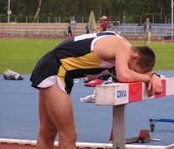
Over Training
Important not to overload the body so much it experiences exhaustion and can not adapt properly as there is too much damage.
A decline in performance is a sign of over training
Irritability and moodiness
Altered sleep patterns
Loss of appetite
Loss of motivation or competitive drive
Persistent muscle soreness

Slide 9
Exam Questions
Previous years;
Describe how you would apply the FITT principles and specificity to improve fitness.
Probably wont be the same question again but will take similar format as in two training principles will be examined.

Slide 10
Exam Questions
Q)
Describe how you would apply the FITT principles and specificity to a training programme.
A)
FITT
Overload – work/train harder than normal; Example
Causes adaptations/body adapts; Example
Frequency – train more often; Example
Intensity – train harder; Example
Type – use different forms of exercise/activity; Example
Time/duration – train for longer; Example
Specificity
Use same energy system/aerobic/ anaerobic;
Use same muscle fibre-type/slow/fast-twitch;
Use similar skills/movements;
Use similar intensity to activity;
Use similar duration/time to activity;

Slide 11
Example Exam Question
Q) Explain how you could use the training principles of ‘progressive overload’ and ‘tedium’ or ‘type’ to improve a performers fitness.
A)
Progressive overload- working harder than normal/ Gradually increasing workload as fitness increases.
Can change the frequency of training- how often you train- must increase this give eg 3 x week
Can change the intensity at which you train- must increase this eg % HR
Can change the time/duration- how long you exercise for eg 30-40mins
Can change the type of exercise- vary the training method- eg circuits
Tedium/Type- vary the training method to prevent boredom.
Use different forms of training
Danger of overuse injuries / overtraining
Suitable examples circuits/ weights/ plyometrics for power
Continuous for stamina

Slide 12
Explain how you would use the principles of training to develop a fitness programme.

