Slide 1
Social facilitation

Slide 2
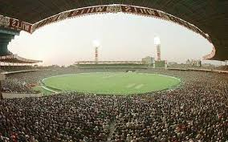
Learning objectives
Explain how the presence of an audience may affect performance
Explain different strategies that may be used to reduce audience effects
Explain home field advantage

Slide 3
How would you feel...
Performing a forward roll in front of your mate
Performing a gymnastics routine in front of your year group
Performing a gymnastics routine that would be televised nationally and your new girlfriend/ boyfriend was in the audience

Slide 4
Being watched / observed whilst playing sport increases your arousal level
This will either make performance better- social facilitation
Or make it worse- social inhibition
How can you cope with the pressure?
We rarely participate in sport ‘alone’
People warming up, competing etc

Slide 5
….Influence of the presence of others on performance may be positive or negative…..

Slide 6
‘others’ who are present
Audience
Watches the play- live or telly, silent crowd at the snooker match
Co actor
Doing the same activity but not in direct competition- merely their presence
Competitive co actors
Direct Competition
Social reinforcers
Direct influence i.e. coach

Slide 7
Others Present
Passive Interactive
Audience Co-actors Competitors Supporters
Effect of a passive audience? Mere presence

Slide 8
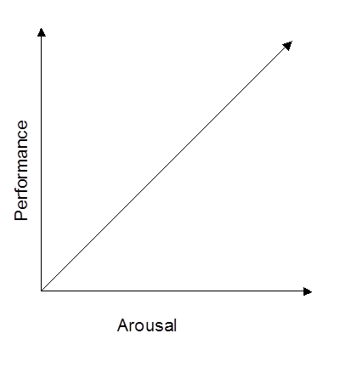
Experience of a performer
Also links to Drive theory and dominate response.
Presence of others increase arousal
High arousal, takes in less info and dominant response occurs.

Slide 9
Experience of a performer
Expert- cope with being watched, can even raise their game and thrive from the crowd. Facilitated
Novice- daunting and put off by the audience. Inhibited performance.
Could be to do with distraction

Slide 10
Complexity of skill
Simple- less decision making- can be performed at high levels of arousal
Performance can be facilitated
Complex- more decision making- more mistakes the higher the arousal.
Performance can be inhibited

Slide 11
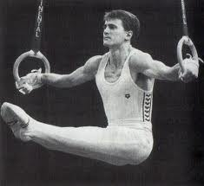
Other research cont...
Gymnast James May - increased arousal interfered with fine motor control required on pommel horse, but improved more explosive movement required on vault.

Slide 12
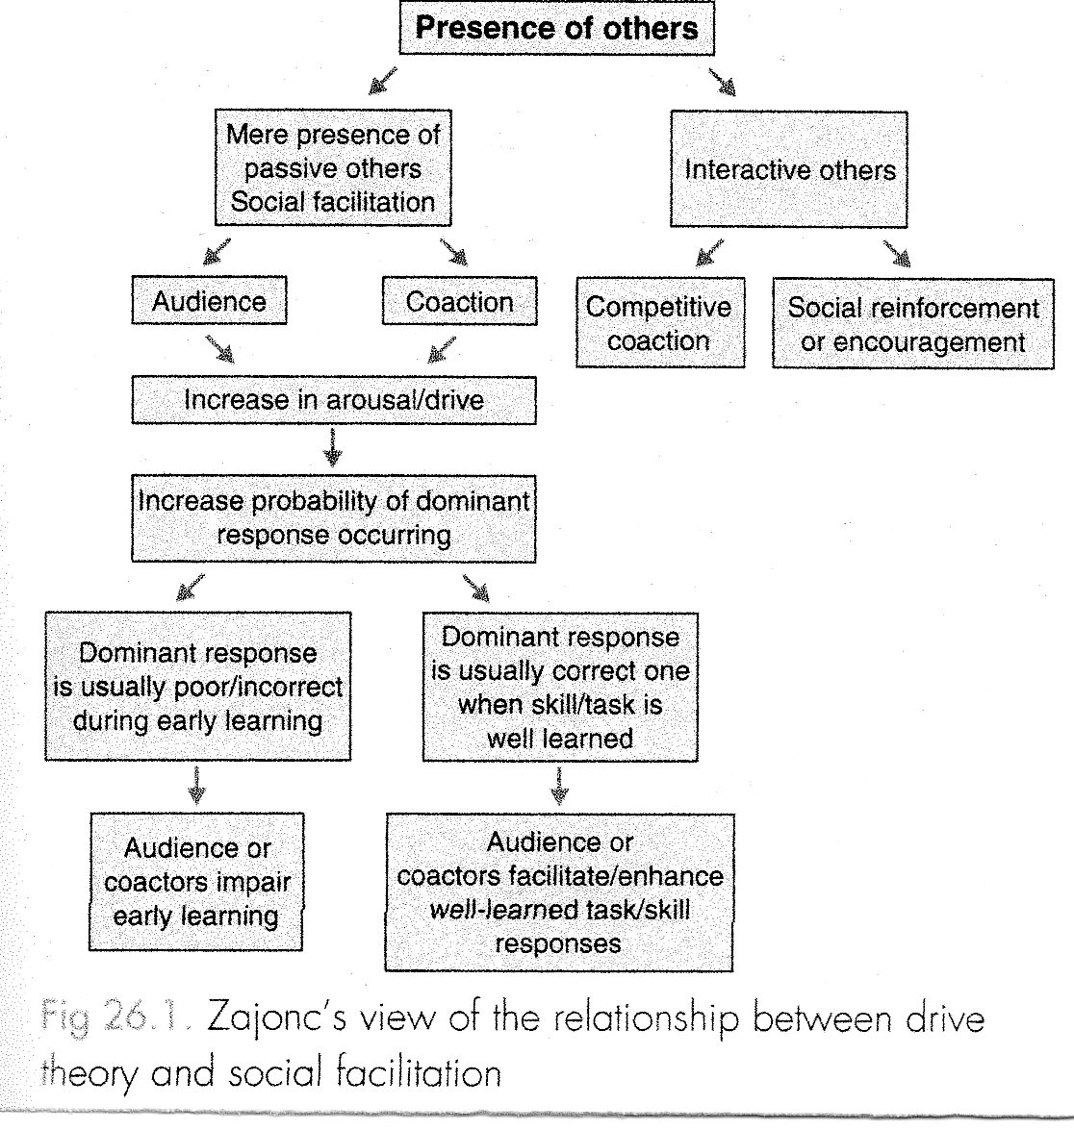

Slide 13
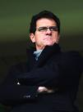
Evaluation Apprehension
Fear of being watched is the fear of being judged- we think we are being watched
Evaluation apprehension is the fear of being judged
Significance of who is watching
Parents first watch you?
Beginner/ first time
How would you feel if a national scout was watching you?
Even elite performers crack performing in front of people with high expectations.

Slide 14
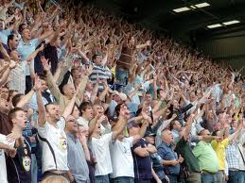
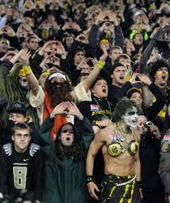
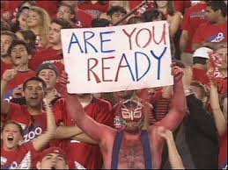
Factors affecting social facilitation
Trait anxiety levels
Personality of performer
Previous experience
Age and gender
Status of the observers
Nature of audience
Proximity of the audience
Size of the audience

Slide 15
Baron’s distraction conflict theory
Linked presence of audience to information processing
Audience takes up most of the Attentional capacity we have
Sufficient attention for simple task
Complex needs more attention and so performance is affected
Lights/ sounds/audience can all affect us.
Need to focus on task and block out distraction

Slide 16
Attends to demands of the task
Athlete
Performing
Conflict
Increased arousal
Social facilitation
Effects
Attends to distractor audience

Slide 17
Limiting effects of an audience (combating social inhibition)
Learn new skills in absence of audience
Audience gradually introduced during training not competition
Strategies to help block out the crowd- self talk etc
Prior to performance- visualise performing the skill in front of audience (imagery)
Self efficacy should be improved through verbal persuasion, performance accomplishments and vicarious experiences.

Slide 18
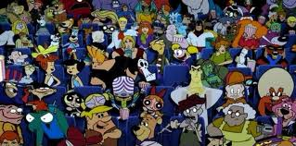
Limiting effects of an audience
Increase selective attention – no narrowing of attention
Reduce the importance of the event
Avoid social comparison with others
Teams mates supportive
Attribute correctly

Slide 19
Think....
Who has the advantage the home or away team?
Why
http://www.youtube.com/watch?v=x_n23pGTPcY
http://www.youtube.com/watch?v=RzZ7ivnWXy0

Slide 20
Home-field advantage
Large supportive home crowds are believed to provide the home team with an advantage.
Audience support increase motivation- higher at home
Play more aggressively at home, but opposing teams commit more fouls.
Most evident in indoor sports.

Slide 21
Home-field advantage
Home crowd may affect teams performance
More important the match more expectations on the performers
Anxiety lower for home team- familiar pitch
‘Choke’ effect only happens at big games
If crowds are located very close to the action they may find it more intimidating than the actual size of the crowd

Slide 22
Audience characteristics
More supportive = better performance
Bigger crowd more home field advantage
Proximity of crowd= closer the better
More hostile the crowd is top the away team
Remember:- big expectant crowds can also increase anxiety.....

Slide 23
Learning objectives
Explain how the presence of an audience may affect performance
Explain different strategies that may be used to reduce audience effects
Explain home field advantage

