Slide 1
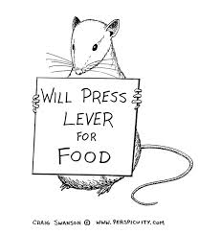
Operant Conditioning

Slide 2
Links
Pavlov
http://www.youtube.com/watch?v=FMJJpbRx_O8
http://www.youtube.com/watch?v=ZpSxJw0BFZs
Skinner box
http://www.youtube.com/watch?v=Mt4N9GSBoMI
Big Bang Theory

Slide 3
Exam Question
What is Operant Conditioning?

Slide 4
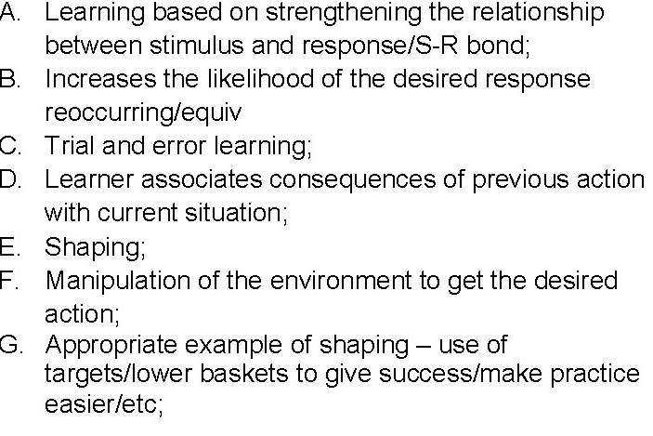
What is Operant Conditioning?

Slide 5
Exam Question
One way of learning a new skill is through operant conditioning which involves reinforcement to strengthen the stimulus-response bond.
Use examples to distinguish between the different types of reinforcement.

Slide 6
Use examples to distinguish between the different types of reinforcement.
Positive and negative reinforcement
Positive - Use of praise/rewards/self-satisfaction to encourage correct behaviour
Negative - Removal of criticism/unpleasant stimulus to encourage desired response/eg coach stops shouting

Slide 7
Apart from reinforcement, how else could a coach make sure that operant conditioning is likely to result in the successful learning of a new skill?

Slide 8
Apart from reinforcement, how else could a coach make sure that operant conditioning is likely to result in the successful learning of a new skill?
Use of punishment
Correcting mistakes
‘Trial and error’ learning
Manipulating the environment to obtain desired response
‘Shaping’
Eg use of target areas/feeders/ equipment/etc;

Slide 9
Exam Question
How can a coach use operant conditioning to develop a gymnast’s skills?
(3 marks)

Slide 10
How can a coach use operant conditioning to develop a gymnast’s skills?
Using rewards/praise
Shaping/altering environment to progress towards success
Use of target areas/mechanical feeders/equipment/etc
Use of negative reinforcement
Removal of criticism – explanation of negative reinforcement
Use of punishment to decrease probability of undesired response
Example of punishment

Slide 11
Exam Question
Explain the term negative reinforcement

Slide 12
Explain the term negative reinforcement

Slide 13
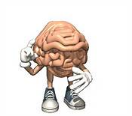
Insight Learning
The Eureka Moment !

Slide 14
Links
http://www.youtube.com/watch?v=XtHYyfDdSUg
http://www.youtube.com/watch?v=fPz6uvIbWZE

Slide 15
What is Insight Learning?
Cognitive theory that involves cognitive processes/development
Is about understanding the process to achieve the result/why/reasons you do things
Coach questions performer about why they’re performing in a particular way
Experiences the ‘whole’ activity rather than skills in isolation

Slide 16
How can this approach have a positive effect on learning a skill
Allows learners to develop their own strategies and/or routes of understanding
Better for the performer rather than being told what to do all the time
Performer able to adjust movements as required
Improves motivation.

Slide 17
Exam Question
Explain the term ‘insight learning’ and suggest how this approach could have a positive effect on learning to long jump.
(3 marks)

