Slide 1
Open and Closed Loop Control
Once the motor programme is selected the movement needs to be regulated and adapted.
This can be done on 2 levels depending on extent the nervous system is involved.
-Open loop
-Closed loop

Slide 2
Open Loop

Slide 3
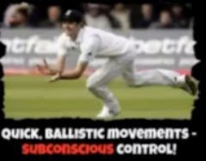
Characteristics
Why is it not applicable to all skills?
Pre-planned/well learnt movement
Without conscious control
Stored as memory trace in long term memory
Once initiated no modification (you can’t change the movement while being performed)
No feedback during movement, only after movement
Very quick/limited time/ballistic movements
Carried out in a stable/predictable environment/closed skills.
Too many stored movements required for memory capacity
Not all environments are predictable or stable
Cannot accommodate new skills
Not applicable to open skills
Many skills have time for feedback during performance/allows corrections.

Slide 4
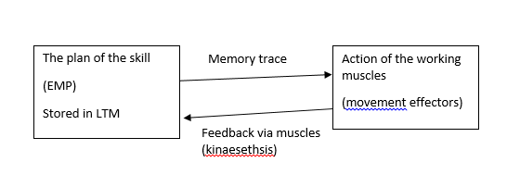
Adam’s Closed Loop

Slide 5
Why is it not applicable to all skills?
Characteristics
Involves feedback
Movement initiated by the memory trace
Action controlled by the perceptual trace which is used as a model of correctness.
Adjusted and strengthened through practice
Does not account for actions too fast for feedback or limitations of memory

Slide 6
Memory and Perceptual Trace
Pieces of information used to control movement
Memory trace-
plan of action/motor programme
Based on experience/past performance
Initiate movement
Perceptual trace-
Directs/controls the movement
Developed through feedback
How they work together…
Memory trace and perceptual trace are compared during movement.
If they match- movement goes ahead
If they don’t match the error is corrected during the performance. Movement is adjusted.
Memory trace is adjusted and you have a new memory trace.

Slide 7
Revision
-decision making – reaction time, simple reaction time, choice reaction time, response time, movement time and the relationship between them – anticipation temporal and spatial – factors affecting reaction time, Hick’s law, psychological refractory period, single channel hypothesis
– motor programmes and sub routines
– open and closed-loop control

