Slide 1
Open and Closed loop control
Once motor programme selected the movement needed to be regulated and adapted.
Do this on 3 levels depending on extend the nervous system is involved.
Open loop
Closed loop

Slide 2
Open loop theory
No – no
Completion of movement automatically
No control
movements
Doesn’t explain:
or skills
feedback
modifications
conscious
Rapid/ballistic
Limits of memory
Novel
open

Slide 3
Open Loop
Stored in long term memory
Retrieved quickly when needed
Memory trace- selection and initiation of motor programme but no influence over it once started

Slide 4
Open Loop-Characteristics
Pre-planned/well learnt movement/without conscious control/stored as memory trace;
Once initiated no modification;
No feedback during movement/only after movement
Very quick/limited time/ballistic movements;
Carried out in a stable/predictable environment/closed skills.

Slide 5
Why is it not applicable to all skills?
Too many stored movements required for memory capacity;
Not all environments are predictable or stable;
Cannot accommodate new or novel skills;
Cannot accommodate flexible movement pattern;
Not applicable to open skills;
Many skills have time for feedback during performance/allows corrections.

Slide 6
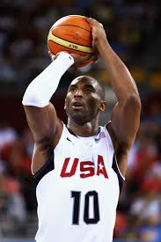
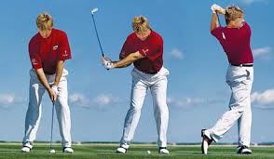
Open Loop
Input
Executive motor programme
Movement
Effector system
Movement output

Slide 7
Open Loop theory
Closed
Command
Decision
Executive
Feedback

Slide 8
Adam’s Closed loop theory
Involves
Movement initiated by – motor programme -
Action controlled by -used as model of correctness - adjusted and strengthened through
Does not account for actions for feedback or
feedback
memory trace
experience
perceptual trace
practice
too fast
limitations of memory

