Slide 1
Observational Learning

Slide 2
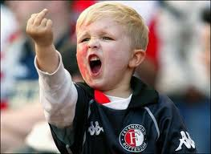
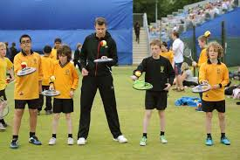
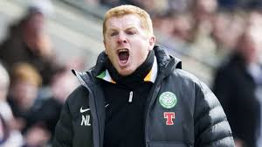
Observational Learning
Social learning theory- modelling
Most people learn by copying
Vicarious experience
Builds up mental picture
Creates patterns more easily

Slide 3
Demo to be effective
Attributes and characteristics of the model
Physical readiness of the learner
Motivation of the learner to attend to the model and to practise

Slide 4
Observational Learning
Attention
Retention
Motor Reproduction
Motivation

Slide 5
Attention
Amount of notice taken by the learner
NOT just paying attention
Coach can aid this by highlighting cues
Needs to be accurate
Not too long
Must be attractive
Significant other
Role model/ peer
Needs to be seen

Slide 6
Retention
Can they remember the skill?
Creation of a mental picture
Meaningful demo
Coach carful not to overload performer with too much verbal
Mental rehearsal
2nd image to help- hand in cookie jar

Slide 7
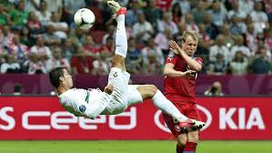
Motor Reproduction
Must have the physical ability to copy the skill
Must be given the opportunity to do this straight after the skill

Slide 8
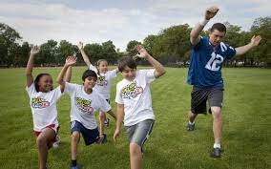
Motivation
Performer wants to learn the skill- do they have the desire to copy the action?
Based on successful completion of skill
Reinforcement/ praise
Perceived status of the model

Slide 9
Exam Questions
Explain the factors that can influence the effectiveness of attention, retention and motor production in observational learning (4)
Explain how attention, motor production and motivation are used to help the process of learning a skill (3)
How can a coach help a performer to retain newly learnt skills? (3)

