Slide 1
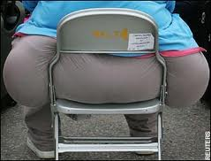
Energy Balance, measurement and Obesity

Slide 2
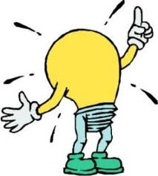
Energy Balance
We all have different energy needs which are influenced by a number of factors:-

Slide 3
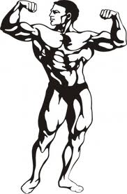
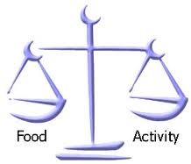
Getting the balance
Consumed = Burnt
Neutral energy balance

Slide 4
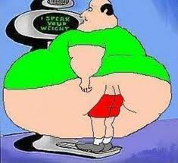
Getting the balance
Calories consumed greater than calories burnt
Positive energy balance

Slide 5
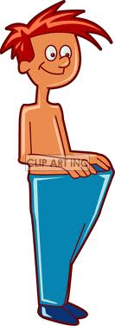
Getting the balance
Less calories consumed than burnt off
Negative energy balance

Slide 6
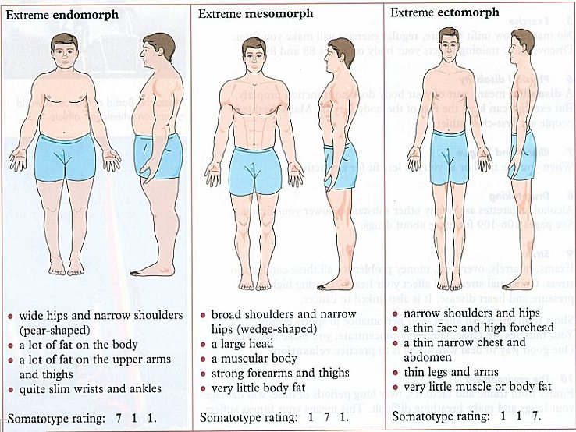
Body Composition
Relative components of total body mass in terms of fat mass and lean body or fat free mass

Slide 7
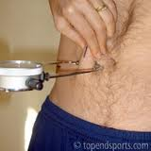
Testing Body Composition
Skin fold
Bioelectric impedance
Hydrostatic weighing
http://www.youtube.com/watch?NR=1&v=Q3gjS0wxVXY
BMI- (weight divided height)

Slide 8
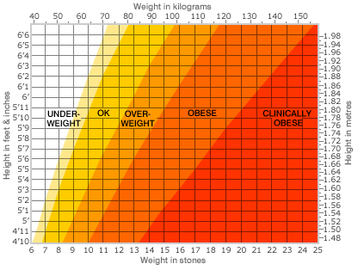
How is ‘Body Mass Index’ (BMI) calculated?
Height and weight/mass;
Weight divided Height 2/ squared.
Underweight = <18.5
Normal weight = 18.5–24.9
Overweight = 25–29.9
Obesity = BMI of 30 or greater

Slide 9
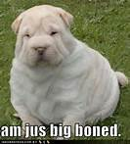
Some people exercise to control their weight Define the term obesity and suggest one limitation of defining this term (2)
Obese= 20-30% body fay BMI > 30/40
Limited as measurement is inaccurate/ subjective/ big muscles/ large frame / physique

Slide 10
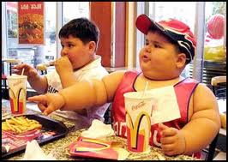
http://www.youtube.com/watch?v=JI9zwGx0Ov4&feature=fvsr

Slide 11
Obesity
Accumulation of body fat to an extend it may impair health
BMI >25
30,000 deaths per year associated health problems
23% obese
40% overweight
17% of 15 years olds obese

Slide 12
http://www.youtube.com/watch?v=fk6qlHSp1z4

Slide 13
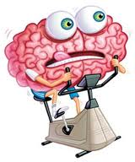
Causes of Obesity?
Brainstorm ….

Slide 14
Causes of Obesity?
Overconsumption
Reduced exercise/ energy expenditure
Imbalance food in and burnt off
Poor diet
Genetic
Socio economic factors

Slide 15
Associated Health Risks
Heart disease/heart attacks
Diabetes
High blood pressure
High cholesterol/fats/lipids in blood/atherosclerosis
Stroke
Lung disease
Liver/gall bladder disease
(Oesteo) arthritis
Gout
Cancer
(Deep vein) thrombosis

Slide 16
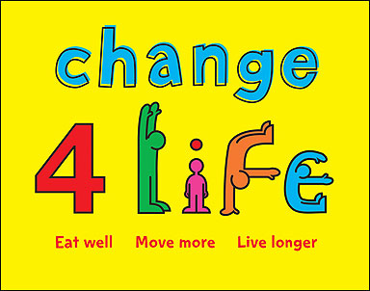
Preventing Obesity
Number of fat cells determined 0-2years
Habits form
Cant get rid of fat cells they just swell/shrink
2 hours PE plus 2 hours club links

Slide 17
How may ‘obesity’ affect performance in different activities? (2 marks)
Limits stamina/endurance/cardiovascular/cardio- respiratory endurance;
Limits flexibility/mobility;
Limits agility/speed/power;
Causes cancer/heart disease/heart attacks/diabetes/high cholesterol/ high fats/high lipids in blood/atherosclerosis/(osteo)arthritis/high
blood pressure/hypertension/stroke/lung disease/liver disease/gall bladder disease/gout/(deep vein)thrombosis/psychosocial problems/ depression.

