Slide 1
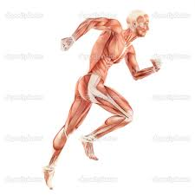
Motor Programmes
Third phase of the information processing model- actually moving
Output
How movement patterns are constructed and utilised and adapted.

Slide 2
Motor Programmes
Develop a skill in cognitive and associative phase it is stored in the long term memory.
When we need the skill the memory retrieves the programme and transmits it via nerve impulses to muscles
Executive motor programme

Slide 3
Motor Programmes
The programme can be recalled when needed and modified
Autonomous (well learnt) = short reaction time
Cognitive phase- long time or not completed correctly

Slide 4
Motor Programmes
Hierarchical structure
Movements that are autonomous at lower levels and more complex subroutines at the top
As performer becomes more skilled the existing executive motor programme is superseded by a new one
Autonomous and over learnt

Slide 5
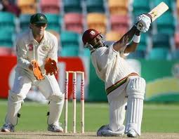
Once developed the subroutines , the cricketer will then develop more specific shots depending on line of the ball, where it pitches etc
Cricket Shot
Stance
Grip
Feet placement
Backswing
Follow through

Slide 6
Motor Programmes
Coach can identify subroutines to pinpoint specific weaknesses and incorporate into training.
Whole part whole etc
TASK
Identify subroutines for your core skills

