Slide 1
Section –B Applied Psychology
Methods of presenting practice

Slide 2
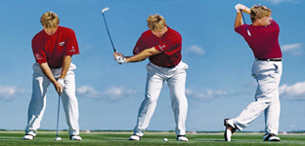
WHOLE LEARNING
Practice where the skill is taught in its entirety (all of it together)
Advantages: Performers develop kinaesthetic awareness
They understand the relationship between different subroutines immediately
They experience the timing needed to execute the skill successfully. Saves time.
Can be transferred into real game situations. Best for autonomous learners.
Disadvantages: It is difficult to use with complex skills
It may be difficult for novice performers to execute initially
It is not ideal for dangerous skills.
Practical example: Golf swing, Javelin throw, continuous skills such as jogging.

Slide 3
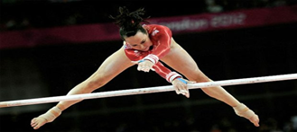
PART PRACTICE
Where the skill is broken down into its subroutines and each part is practices until flawless.
Advantages: Complex skills can be broken down into different subroutines and learnt in stages (helping with understanding).
Specific aspects of the technique can be modified, It reduces the element of risk
It allows for periods of recovery.
Reduces chances of overload, allows performer to build confidence and increase motivation
Disadvantages: It hinders the development of continuity and timing of the complete skill
It reduces overall kinaesthetic awareness
The transfer from part to whole may not be effective
The highly organized skills are difficult to break down, It is time consuming.
Practical example: Gymnastic Routines

Slide 4
PROGRESSIVE PART PRACTICE
This is a variation of the ‘part’ method. Involves the performer attempting the skill in stages and linking the phases after each has been learnt. Also referred to as ‘chaining’.
Advantages: Complex skills can be broken down and introduced gradually
Novice performers can achieve success
Performers with limited attention span can remain focused
Understand the relationship between subroutines
Minimizes the risk involved with potentially dangerous skills
Transfer to the whole skill can be made easier.
Disadvantages: Time consuming
The performer may become too focused on one particular subroutine.
Practical example: Triple Jump...

Slide 5
PROGRESSIVE PART PRACTICE

Slide 6
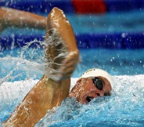
WHOLE-PART-WHOLE PRACTICE
Performing the whole skill and then identifying any weaknesses. The weaker parts are then practiced in isolation and then integrated back into the skill
Advantages: An overall feel for the movement is developed initially
Success is continuous by developing the weaker subroutines
Practice can focus on key areas of weakness.
Could be used by experience performers who have developed problems/ injuries
Disadvantages: Transfer may be difficult from part to the whole skill
Some skills are difficult to break down as the overall timing may be affected
Practical example: Swimming: teaching and practicing front crawl: The whole skill is introduced initially, the arm action is then practiced in isolation with the aid of floats, the whole skill is practiced again with the improved arm action.

Slide 7
Exam Questions
Q) What factors need to be considered before deciding whether to teach a skill by progressive part practice?
A)
Explanation of progressive part/learn first stage, then add second stage then add
third stage/‘Chaining’;
Depends on nature/type of task/skill;
Use part if skill can be broken down into parts/complex;
Serial skills;
Whole for simple/rapid/ballistic movements;
Progressive part or whole to gain ‘feel’/kinesthesis/loss through part;
Part if element of danger;
Depends on stage of learning
Whole for experienced/part for novice;
Depends on level of motivation;
Part is time consuming;

Slide 8
Q) Explain the factors that need to be considered before deciding whether it would be an advantage to teach a skill by whole practice.
A)
Perform whole skill to gain feel/ appreciate flow/ sequences/ kinesthesis
Depends on nature/ type of skill- complex or simple
Use whole if skill complex/ hard to break down/ high organisation/ discrete/simple-no need to break down.
Depends of stage of learning/ beginner/novice/ experienced
Use whole if autonomous/ cognitive stage
Depends on safety/time
Only use whole if safe to do so/ no chance of injury/ short of time
Depends on fitness
Use whole if performer fit enough to manage repeating skill
Depends on motivation

