Slide 1
Section B- Applied Psychology
Methods of Guidance

Slide 2
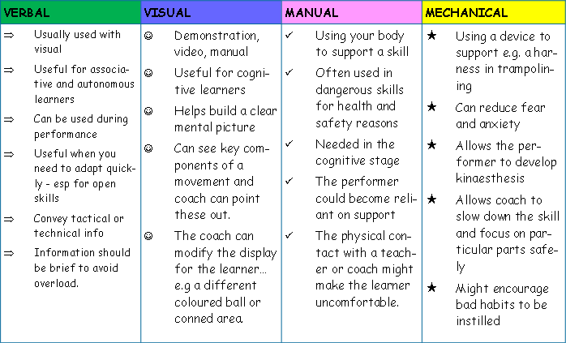

Slide 3
Guidance Recap
Visual- Especially good for Beginners (Cognitive ) leaners. Value in demonstrations to create a mental picture.
Verbal- used on its own or with visual; good for all levels of performers. Although the amount of information given is limited to the level of performer.
Manual- Supporting
Mechanical- Use of an aid

Slide 4
Exam Questions
Q)
Explain how visual and manual guidance can be used effectively when teaching a skill.
A)
Visual – suitable example/watch/show/demonstrate
Manual – suitable example/force/help/assist
Visual – accurate/perfect demonstration
Learner paying attention
Highlight cues/repeat demos
Skill within performers capabilities/memory limitations
Better for beginners
Manual – when difficult/dangerous skill
Good for beginners/weak
Permits kinaesthetic feel
Not for too long

Slide 5
Q)
Explain the different methods of guidance and the factors hat you need to consider when deciding on the most appropriate method of use.
A)
Visual- observe/demon/seen/show
Verbal- tell/speak
Manual- support/ assistance from coach
Mechanical- use of aids/ e.g. harness/ belt/floats
Factors to consider:
Depends on performers stage of learning/ experience/ age
Depends on nature of task/ skill/ complexity
Depends on situation/ environment/ facilities available/ time
Depends on level of danger/ safety of situations
Depends on motivation/ personality of performer
Depends on size of group

Slide 6
Q) Describe how you can use mechanical and manual guidance effectively with a performer.
A)
Manual- Coach moving a body or limb to show correct technique.
Forced movement
Limit movements – physical restriction
Mechanical – use of aid float in swimming
Use when difficult/ dangerous skill
Skill within performers capabilities
Immediate practice after demonstration
Both good for beginners (Cognitive)
Permits (limited) kinaesthetic feel
Limited use- don’t use it for too long

