Slide 1
Memory

Slide 3
Memory
Three stores in memory
Short Term Sensory store
Short Term Memory
Long Term Memory
Three processes in memory
Encoding (putting information into a store)
Maintenance (keeping it ‘alive’)
Retrieval (finding encoded information)

Slide 4
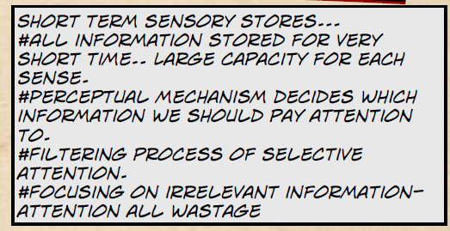
STSS

Slide 5
STM

Slide 6
Improving STM
How can we improve our STM?
Page 91

Slide 7
Players in a team game will use their skills to play effectively. Explain how players use their short-term memory to perform skills during a team game.
Receives information
Selective attention filters information
DCR process
Decisions making/thinking
Receives information from Long Term Memory
Initiates movement (through effectors)

Slide 8
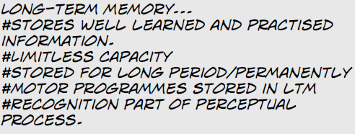
LTM

Slide 9
Retrieving information
Using the LTM involves the process of retrieval of information and passing it into the STM.
Retention and retrieval of information from LTM is influenced by…..
Pg 91

Slide 10
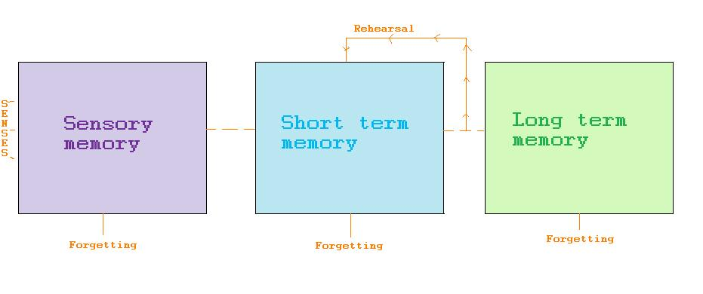
Multi-store model of memory
Information from any of the senses enter the sensory memory, where they are either forgotten about of enter into the short term memory.
Once in the short term memory, rehearsal is needed to retain the information in the short term memory otherwise the information will be lost.
If the information is rehearsed it will also help the information enter the long term memory where it could remain for anything between 2 and 100+ years.
Memory is fragile meaning that it is easy for information to be lost.

Slide 11
In practise …
Performer faced with new situation
Stimuli passed from STM to LTM
Is there a comparison with previous experiences? If so recognised and quick response
If new skill, motor programme formed this may take time

Slide 12
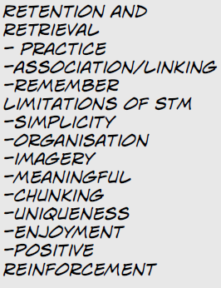
Strategies to improve memory

Slide 13
Homework
Text book 92-93 Makes notes about chaining and mental rehearsal.
2) Revision of everything we have done so far in this section:
-Skill
-Ability
-Skill Classification
-Information processing
-Memory
Progress test (Tues 20th October) Nearly two weeks!!
Remember Thursday P4 Section B-Bring your folder with all section B work in!

