Slide 1
Measuring Intensity of Exercise

Slide 2
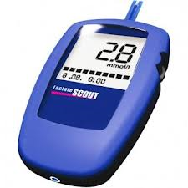
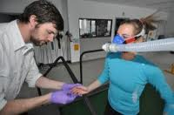
Lactate Sampling
Accumulation of blood lactate
OBLA- when does it occur?
Intensity- measured on treadmill
Why? Predict exhaustion point/ anaerobic threshold

Slide 3
Explain the term Lactate Sampling
Taking blood samples (to measure the level of
lactic acid)
Ensures training is at the correct intensity/monitor improvements over time
Provides accurate/objective measure
Measures OBLA/lactate threshold/occurs at 4 mmols

Slide 4
Respiratory Exchange Ratio
Amount of O2 consumed (VO2)
______________________________________________________________________
Amount of CO2 produced (VCO2)
Quantity of O2 consumed against quantity of exhaled CO2
Higher intensity ex- consume more O2, produce more CO2.

Slide 5
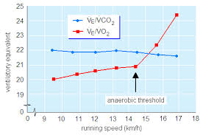
Linked to intensity of exercise
Lower intensity use fat- beta oxidation
Higher- glycogen
RER>1 Using CHO
RER 0.7 Using FAT
Predicts proportion of fuel being used- get close to VO2max

Slide 6
Explain the term RER
(Respiratory Exchange Ratio) – ratio of carbon dioxide released compared to oxygen used by the body
Estimates use of fats and carbohydrates used during exercise/calculates energy expenditure
Tells if performer working aerobically/anaerobically/energy system used
RER close to 1 performer using carbohydrates/close to 0.7 using fats/respiratory quotient

