Slide 1
Measuring Anxiety

Slide 2
Anxiety
‘Anxiety occurs when there is a substantial imbalance between the individual’s perception of their ability and their perception of the demands and importance of the situation.’ (MARTENS)
Perception of the situational
Demands.
e.g. I must win my leg of the relay if my
team is to have the chance of winning.
Perception of ability to cope.
e.g. I am not as good as my
opponent
ANXIETY
Perception of the importance of the situation.
e.g. The result of this competition hinges
on this relay race.

Slide 3
Methods
Observation
Physiological/ Biofeedback
Self Report Questionnaire s
Can you think of advantages and disadvantages for each?

Slide 4
Measures of Anxiety
Physiological Tests- biological tests, such as monitoring HR, or galvanic skin response (sweat levels on the skin)
Advantages- can be done during performance, factual measures
Disadvantages- measuring equipment can be restrictive and the athlete might not be willing to take part in competition, being measured can increase stress.

Slide 5
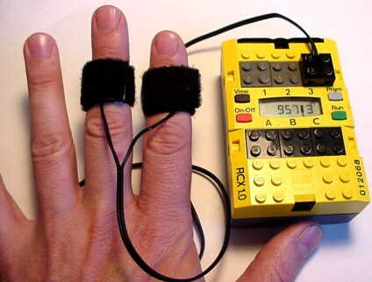
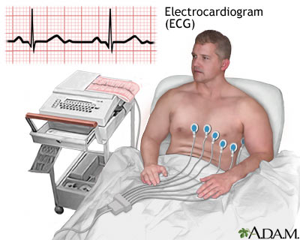
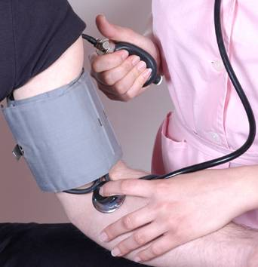

Slide 6
Measures of Anxiety
Observations- involves watching others as they perform, can be done live or via video for example.
Advantage- a realistic, true to life picture can be obtained
Disadvantage- the observer may be biased and need training themselves. Performers’ arousal levels may be increased if the know they are being watched. Time consuming, need more than one person, subjective, evaluation apprehension.

Slide 7
Measures of Anxiety
Questionnaires- SCAT/CSAI-2/STAI
Advantages- quick, easy, cheap, deal with lots of info.
Disadvantages- people tend to give socially acceptable answers and might misunderstand some questions.

Slide 8
State Trait Anxiety Inventory STAI
A self-report questionnaire in which people rate how nervous they feel in both general and in specific situations.
20 statements for state anxiety
20 statements for trait anxiety
The scoring system for the questions gives an indication of both the state anxiety and the trait anxiety of the performer.

Slide 9
Anxiety
Competitive Anxiety
Specific to sport
Main Perceived threat to a sports performer is competition, which can include worries of:
Not playing well
Letting the team down
Not meeting the training demands before the event
Damaging personal relationships
Injury

Slide 10
SCAT
The performer’s competitive trait anxiety and the competitive situation together generate a threatening situation, which in turn increases the performer’s competitive state anxiety.

Slide 11
Competitive Sport Anxiety Inventory CSAI-2
To identify the type of anxiety experienced
Measures sate anxiety and responding behaviour
Cognitive, somatic anxiety and self confidence
Given out an hour before competition
Enables researchers to discover baseline levels of anxiety and compare it with pre-competition levels to see if they differ.

Slide 12
Sport Competition Anxiety SCAT
SCAT developed, this aimed to measure competitive trait anxiety of a performer in pre competitive environment.
15 statements
Scoring from a sport specific situation gives an indication of that person’s level of state anxiety in competition-specific situations.

Slide 13
Many elite performers complete personality and anxiety tests as part of their preparation for competition
Name one self-report questionnaire often used to measure anxiety and outline the disadvantages of using this form of data collection. (3 marks)

Slide 14
Answers
3 marks for 3 of:
Named test
A. Sport Competition Anxiety Test/SCAT
B. State Trait Anxiety Inventory/STAI
C. Competitive Sport Anxiety Inventory/CSAI-2
Disadvantages
D. Misinterpretation of questions/lack of understanding
E. Answers may not be truthful/provide socially desirable answers
F. Questions may not allow for full answers/limited options to express
emotions
G. Inappropriate questions/biased questions
H. Situation when completed may not be ideal/may rush to complete
questionnaire

Slide 15
Different methods of assessment can be used to measure anxiety levels and also to identify potential elite performers.
What are the disadvantages of using observation as a method to assess anxiety? (3 marks)

Slide 16
A. Subjective/not objective
B. Reliant on skill of the observer
C. Time consuming/expensive/needs to be completed several times
D. Observer needs to know normal behaviour patterns of performer for comparison
E. May need several observers (at the same time)
F. If performer knows observation is occurring they may behave differently/become more anxious/increased state
anxiety/experience evaluation apprehension/social inhibition

