Slide 1
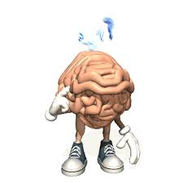
Information Processing

Slide 2
How do we choose a skill to perform?
What decisions do we need to make about performing a skill?
Need to decide when to perform the skill
Need to decide how fast to perform the skill
All depends on what is going on around you

Slide 3
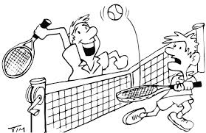
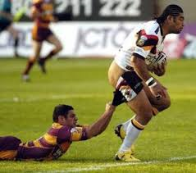
In sport we have to analyse bits of information really quickly
What we see feel, hear etc
This information has to be processed
Hence ‘Information processing’

Slide 4
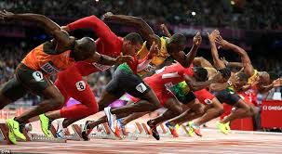
This section..
Process of information though senses/ selective attention
Memory
Decision making
Response time and anticipation
Motor programmes and sub routines
How can we make our information processing systems more efficient?

Slide 5
Information Processing Model
INPUT
DECISION MAKING
OUTPUT
FEEDBACK

Slide 6
TASK

Slide 7
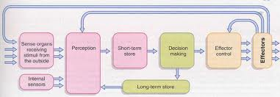
INPUT
Your senses provide you with information – pictures, sounds and feelings
INPUT
This information comes from the environment and is called the DISPLAY

Slide 8
INPUT
This information comes to us through our senses.
Various bits of information from the display
Stimulus identification stage
What are our senses?

Slide 9
Perceptual Mechanism
Interpretation and analysis of information gathered from the environment by the sensory system.
(Info received by sense organs, making sense of information, selective attention)

Slide 10
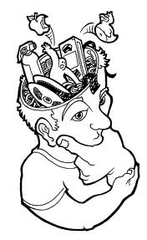
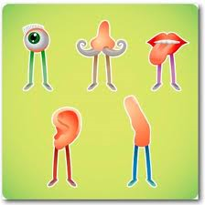
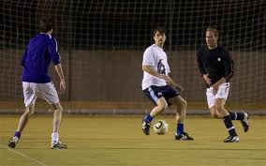
Perception
We need to make sense of this information
PERCEPTION
The information helps us decide how to act
Comes from environment
Comes from memory of previous relevant situations

Slide 11
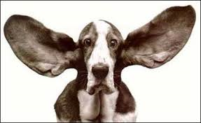
Types of environmental stimulation
External
How do these help us?

Slide 12
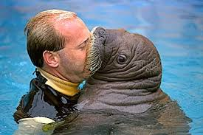
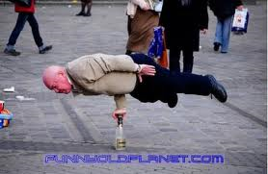
Types of environmental stimulation
Internal- proprioceptive information (body awareness)

Slide 13
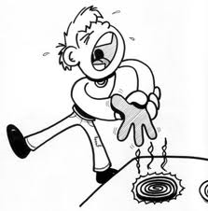
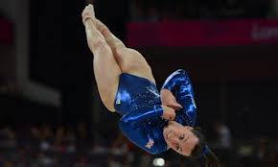
Types of environmental stimulation
Touch- tactile detects pain, pressure, temperature
Equilibrium- balance turning, inverting, tipping
Kinesthesis-information about state of contraction of muscles tendons or joints. Know if a movement is performed correctly.

Slide 14
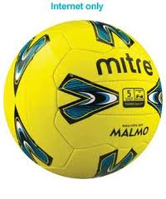
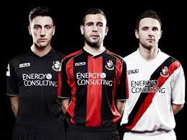
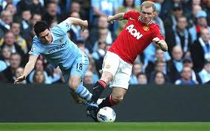
All of these are stimuli- something that stands out form the background
Ball, opponents, teammates
What colours is your team kit?

Slide 15
How do we identify a stimulus?
Process of perception…
Detection- process of registering the stimulus by sense organ
Comparison- process referring to the stimulus to the memory, to compare it to previously stored stimuli
Recognition- process of finding corresponding stimuli in the memory
DCR Process

Slide 16
H/W
Name four types of sensory information used in badminton (4)
Perception is part of information processing . Name each of the three processes that occurs as part of the information processing model. (3)

