Slide 1
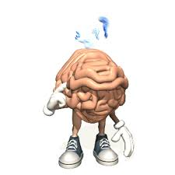
Information Processing
How do we choose a skill to perform?
What decisions do we need to make about performing a skill?
Need to decide when to perform the skill
Need to decide how fast to perform the skill
All depends on what is going on around you

Slide 2
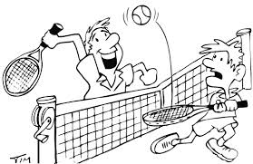
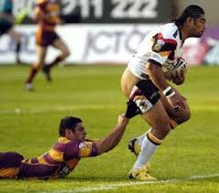
In sport we have to analyse bits of information really quickly
What we see feel, hear etc
This information has to be processed
Hence ‘Information processing’

Slide 3
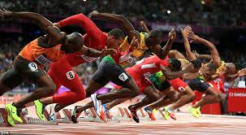
This section..
Process of information though senses/ selective attention
Memory
Decision making
Response time and anticipation
Motor programmes and sub routines
How can we make our information processing systems more efficient?

Slide 4
Information Processing Model
INPUT
DECISION MAKING
OUTPUT
FEEDBACK

Slide 5
Input
Your senses provide you with information (input)
These can be sounds, pictures, sounds.
The information that comes from the environment that surrounds the performer. This information is called the display.
The brain has to decide what the information being received from the environment represents.
This is called the stimulus identification stage.
The other stages in decision making are:
RESPONSE SELECTION (deciding how to respond) and RESPONSE PROGRAMMING (selecting a response).
Stimulus identification
Response selection
Response programming
Input
Output

Slide 6
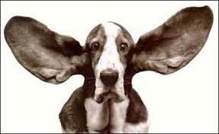
Perception
The performer must make sense of the information being displayed.
The information helps us decide how to act
Comes from environment
Comes from memory of previous relevant situations
Information from the external environment
e.g vision and hearing
Information from the internal environment (proprioceptive information)
e.g body awareness
Proprioception has three components:
Touch- tactile sense that detects pressure, pain, temperature.
Equilibrium- balance, tipping, turning, inverting.
Kinaesthesis- provides information about the state of contraction of muscles, tendons or joints.

Slide 7
Perceptual Mechanism
How do we identify a stimulus?
DETECTION, COMPARISON, RECOGNITION (DCR process)
Detection: the process of the registering of the stimulus by the sense organ
Comparison: the process of referring the stimulus to memory, to compare it to previously stored stimuli.
Recognition: the process of finding corresponding stimuli in the memory.
During sport, we will be receiving a huge amount of information from our senses. There is so much that we can not detect, compare and recognise it all…
https://www.youtube.com/watch?v=Ahg6qcgoay4
Receives information/stimulus is from/display
By the sensory organs;
Filters out of information;
Makes sense of the information
Simply put, the perceptual mechanism:

Slide 8
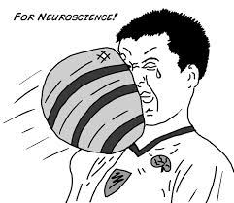
Selective attention
Selective Attention
Ability to select relevant information from irrelevant information
Concentrate on relevant information
Prevents overload of information
Amount of information presented to you will depend on experience of skill
If new/ beginner- lots of information= overload
If experienced- you automatically filter out the irrelevant stuff
We focus on just a few of the millions of stimuli

Slide 9
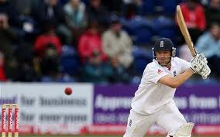
Selective Attention
Experienced cricketer
Ignores majority of information and concentrates on flight of ball automatically
Detects relevant stimuli quicker without thinking= improved stimulus identification

Slide 10
Poor selective attention
A skill may break down at the input stage due to poor selective attention.
This will happen if….
- there is too much information (information overload)
-The performer is unable to focus
-The performer loses concentration
-The performer focuses on irrelevant information

Slide 11
Improving Selective Attention
Increase the intensity of the stimulus (e.g colour of the ball)
Motivate the performer
Refer to past experiences (transfer)
Cue identification- direct them to a cue
Learn to ignore irrelevant stimuli (practise with distractions)
Make the stimulus meaningful/ unique (wave goodbye to basketball)
Mental rehearsal
Relevant practice

Slide 12
Recap
1.The information that comes from the environment that surrounds the performer is called what?
The display
2. Response selection is…
Deciding how to respond
3. Making sense of information is called….
Perception
4. Information comes from two places:
Internal environment and external environment.
5. DCR process stands for
Detection, Comparison, Recognition
6. Selective attention is…
Filtering relevant information from irrelevant information

Slide 13
Information processing model
Simple IP Model
There are other models that you need to know. Just remember- they are similar to this model but a bit more complicated!
INPUT
DECISION MAKING
OUTPUT
FEEDBACK

Slide 14
WELFORD’S MODEL
Extrinsic feedback
Effector mechanism-The brain function that is responsible for the organisation, initiation and control of the motor programme.
Intrinsic feedback
Sensory mechanism
Perceptual mechanism
Effector mechanism
Sense organs receiving information from the display
Perception
Short Term Store
Decision Making
Effector Control
Effectors
Internal Sensors
Long term store
e.g played them before
Lasts up to 30 seconds
Sensory Mechanism-
Touch, Kineasthesis, Equilibrium
DCR Process
Muscular system-Carry out MP
Short term sensory store- large capacity temporary store for all incoming sensory info. Filters information (selective attention)

Slide 15
Put these in order according to Whiting’s Model
Input from display e.g players/ ball
Perceptual Mechanism (interpreting information, selective attention. E.g recognise the object as a ball/focus on ball
Sense organs receive or detect stimuli -vision/audition/kineasthesis e.g eyes see ball coming
Effector mechanism
Transfers information from the brain to muscles e.g sent via nervous system to limbs
Muscular system- muscles move to catch the ball
Response end product or movement or outcome e.g ball is caught
Decision making- involves memory or DCR process. E.g decision to move hands to catch the ball

Slide 16
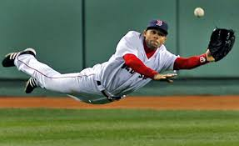
Input from display e.g players/ ball
Sense organs receive or detect stimuli -vision/audition/kineasthesis e.g eyes see ball coming
A practical example
Perceptual Mechanism (interpreting information, selective attention. E.g recognise the object as a ball/focus on ball
Decision making- involves memory or DCR process. E.g decision to move hands to catch the ball
Effector mechanism
Transfers information from the brain to muscles e.g sent via nervous system to limbs
Muscular system- muscles move to catch the ball
Response end product or movement or outcome e.g ball is caught

Slide 17
Recap
Create a poster for Welfords Model.
Homework
Complete poster
Complete the exam questions on information processing

