Slide 1
Goal Setting

Slide 2
Goal Setting
Improves
Motivation
Task persistence
Self Confidence

Slide 3
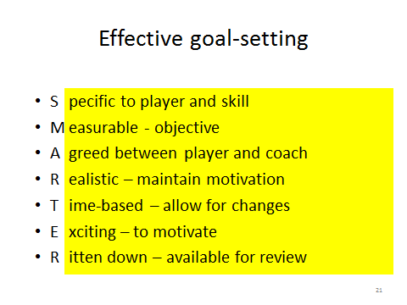

Slide 4
Goal Setting
Outcome- About result
Win race/ top three
Performance -About you
Judged by own standards
PB/ technique

