Slide 1
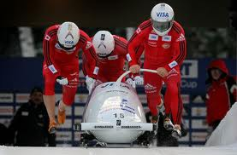
Forces and Mechanics of Movement

Slide 2
Forces Recap
Forces are the push and pull that one body applies to another body which affects it state of motion.
Not all forces are big enough to have these effects
Internal:- those we generate ourselves- muscles
External- outside the body air resistance and gravity
Forces are vectors- they have magnitude and direction

Slide 3
Vectors and Scalars
Our world is governed by time in three dimensions- up/down. Back/forth/. Left/right
Some processes in our world depend on direction and some don't.
Volume of an object (space it occupies) doesn't depend on direction i.e. 1KG metal is still 1KG metal whether you move it up/down/left/right
The location of an object does depend on direction move 1KG metal 8km east Vs 5 km west.

Slide 4
Vectors and Scalars
Vectors have magnitude and direction
When comparing 2 vectors you have to consider magnitude and direction
Velocity, acceleration and displacement are vectors.
Scalars only magnitude or amount of what you are measuring.
Only have to compare magnitude
Speed distance and temperature only have magnitude and are called scalars

Slide 5
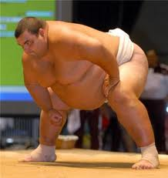
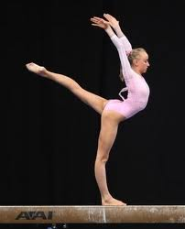
Mass Vs Weight
Mass is a physical quantity expressing the amount of matter in a body. Ie bones, tissue, fat.
Sumo wrestler will have greater mass than a gymnast.
Scalar quality as it has just size and not direction

Slide 6
Mass Vs Weight
Weight- is a force on a given mass due to gravity.
Gravitational force on earth is the same anywhere, so the gravitational force on an object is proportionate to its mass.
Sumo has mass 3x gymnast, weight is 3 x more
Weight is a vector- size and direction (weight acting downwards from the centre of mass) Newtons

Slide 7
Inertia
Resistance an object has to change in its state of motion.
Bigger mass= bigger inertia
Rugby players running towards you 75kg and 100kg- which is easier to stop?
Newtons First Law

Slide 8
Distance Vs Displacement
These are used to describe the extent of the body's motion.
Distance is the length of path the body follows when it is moving from one position to another.
200m runner will have completed a distance of 200m
Scalar quality as it just measures size.

Slide 9
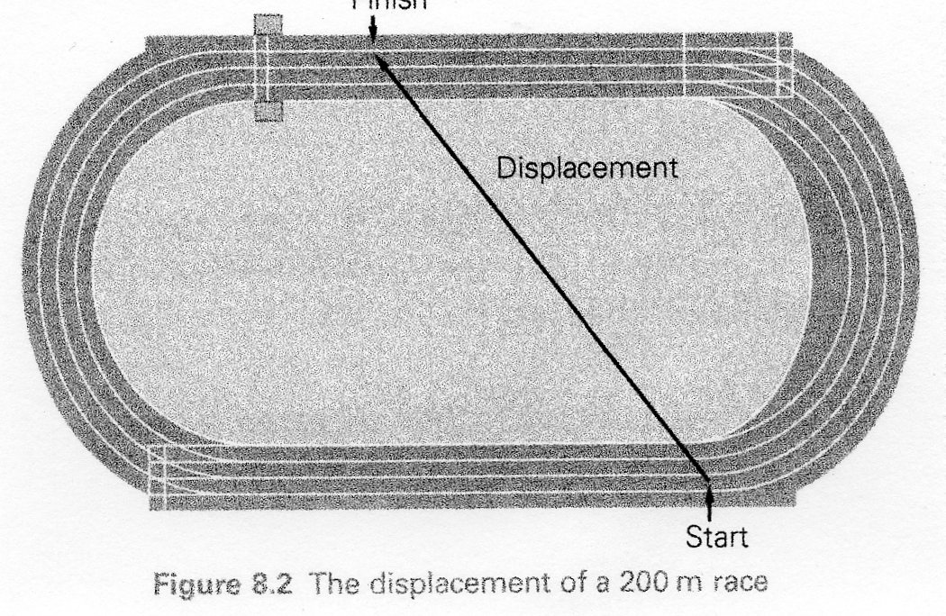
Distance Vs Displacement
Displacement- length of a straight line joining the start and finish points
Distance of 200m runner is 200m
Displacement will be start to finish as the crow flies.
Vector as it have size and direction

Slide 10
Examples of distance Vs displacement

Slide 11
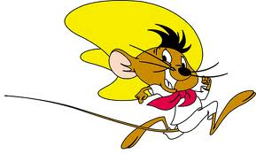
Speed Vs Velocity
Speed- rate of change of position.
Scalar as it doesn't consider direction.
Speed (ms-1) = distance covered (m)
---------------------------
time taken (s)

Slide 12
Speed Vs Velocity
Velocity- rate of change of position with reference to direction
It is a more precise description of motion
Considers size and direction= vector
Velocity (ms-1)= displacement (m)
----------------------------
Time taken (s)

Slide 13
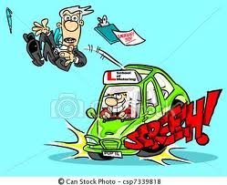
Acceleration Vs Deceleration
Both are the rate of change of velocity
Acceleration- velocity increase
Deceleration- velocity decreases
Vectors
Acceleration = change in velocity (ms-1)
---------------------------------
time taken (s)

Slide 14
To calculate the change in velocity
Change in velocity= Vf-Vi
----------
t
Final velocity - initial velocity
__________________________
Time

Slide 15
Calculating velocity
Use 100-metre sprinting
Timekeepers at intervals
Calculate for each 10 metre section
Calculate for each section of track
Velocity =
10-metre
times
average velocity
displacement ÷ time

Slide 16
Calculating velocity
Use 100-metre sprinting
Timekeepers at intervals
Calculate for each 10 metre section
Calculate for each section of track
Velocity =
10-metre
times
average velocity
displacement ÷ time

Slide 17
Average velocity
Average velocity varies during 100 m sprint
Slowest at
Fastest at about
Reduces again
beginning
half-way
near end

Slide 18
Change in velocity
Average velocity changes
Change in velocity over a period of time is called
acceleration
final velocity – initial velocity
Acceleration =
time taken

Slide 19
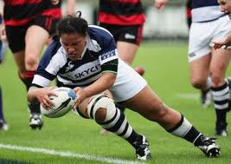
Momentum
Product of mass and velocity of an object
Momentum (Kgms-1)=mass (kg) x velocity (ms-1)
As this is calculated using velocity it has magnitude and direction so it is a vector.
Task...
Large mass plus high velocity = High momentum

Slide 20
Forces
Need to consider the size and magnitude of a force- dependent on how many muscle fibres are used
Direction of a force – if force is applied in the middle it will move in the same direction as the force.
The position of application of a force is important- force applied through centre= linear motion
Off centre force = spin (angular momentum)
It is a vector quantity

Slide 21
