Slide 1
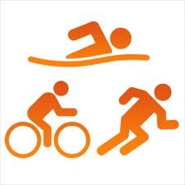
Section B-Exercise Physiology
Fitness Tests

Slide 2
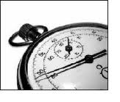
Reasons for Fitness Testing
WHY??
Identify the strengths and weaknesses of the performance/ performer.
Used as a starting level of fitness
Able to compare against the norms of the group
Helps motivate the performer/ set goals to achieve
Provides variety to training programme

Slide 3
Limitations of Fitness Testing
Not sport specific- too general
Don’t replicate the movements of the activity
Don’t replicate the competitive nature of the sporting situations
Many don’t use direct measurements/ sub max so inaccurate
Some require motivation
Tests lack validity
Validity- do they test what they are supposed to test?

Slide 4
KEY WORDS
Validity
Does the test actually test what it claims to?
Reliability
If your fitness hasn’t changed would you get a similar result if you repeated the test?

Slide 5
Health Components
Flexibility
Speed
Power
Strength
Muscular Endurance
Stamina

Slide 6
Skill Components
Agility
Balance
Coordination
Reaction Time

Slide 7
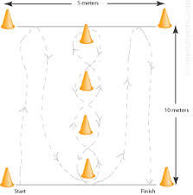
Agility
Test- Illinois Agility Run
10m long/ 60 meters in total
Learn to draw it!
Subject starts lying down (on front)
Subject sprints and weaves though cones
Time taken/ measured in seconds = agility
Shorter time the better the agility of the performer

Slide 8
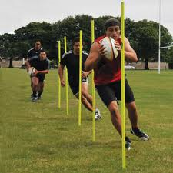
Agility
Strengths | Limitations
Easy testing procedure | Manual timing- human error
Little equipment | Running surface can affect results
Lots of data available with which to compare to | Not sports specific

Slide 9
Balance
Test- Standing Stork Test
Stand on both feet with hands on hips
Lift one leg and place toes of this foot against knee of other leg.
On signal, raise heel of straight leg and stand on toes.
Balance for as long as possible without letting the heel of the foot touch the floor.
Greater time in balance = better balance

Slide 10
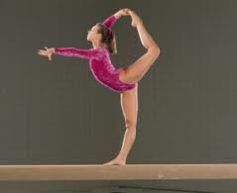
Balance
Strengths | Limitations
Easy testing procedure | Non sports specific
Little equipment needed | Most sports need dynamic balance not static

Slide 11
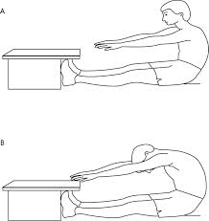
Flexibility
Test- Sit and Reach test
Sitting position, legs outstretched, knees locked and feet flat against the box. Shoes off
Reach forward pushing the cursor along the box and hold for 2 second count
No bouncing or jerking allowed
Record the highest score from three
Greater distance= greater flexibility

Slide 12
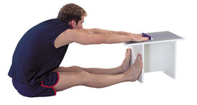
Flexibility
Strengths | Limitations
Easy testing procedure | Only measures flexibility of lower back and hamstrings
Little equipment needed | Extend of warm up will affect results
 | Variations in limb length makes comparison difficult

Slide 13
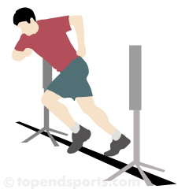
Speed
Test- 30m sprint test
From a 1m flying start, the time taken for the performer to cover the 30m distance is recorded.
Time taken in seconds to cover distance- quicker= better speed.

Slide 14
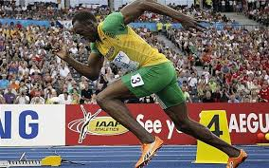
Speed
Strengths | Limitations
Easy testing procedure | Manual timing can be affected by human error
Little equipment needed | Running surface and weather can affect results
 | Non sports specific as most are multidirectional.

Slide 15
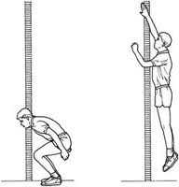
Power
Test 1- sergeant jump
Preparation- licks or chalks fingers
Pre jump makes a mark on the wall as high as they can reach.
Jumps as high as possible
Distance above stretch height= power measure

Slide 16
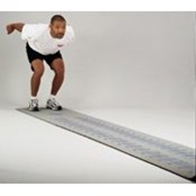
Power
Test 2- Standing broad jump
Subject jumps as far as possible horizontally
Stand behind a marker
Two footed take off and two footed landing
Distance between start line and nearest heel is recorded.
Best score from three

Slide 17
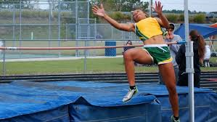
Power
Strengths | Limitations
Quick and easy testing procedure | Only predicts leg power
Little equipment needed | Depended on technique

Slide 18
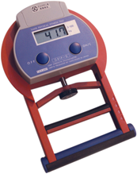
Strength
Tests-Handgrip Dynamometer or 1 rep Max Test.
Having adjusted the grip for hand size, the performer holds the dynamometer in one hand at shoulder height.
The subject brings the dynamometer down to their side while squeezing the handle.
Record the highest reading from three attempts for both dominant and non-dominant hand.

Slide 19
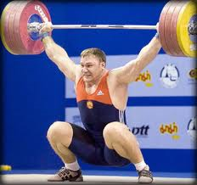
Strength
Strengths | Limitations
Easy testing procedure | Erroneous adjusting of the handgrip can affect the results.
Little equipment needed | This test only gives an indication of the strength of the handgrip and forearm.
 | Care should be taken if using handgrip scores to comment on general body strength

Slide 20
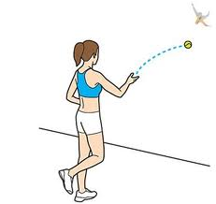
Coordination
Test- Anderson ball toss test
A mark is placed 2 meters from the wall.
The person stands behind the line and faces the wall.
The ball is thrown from one hand in an underarm action against the wall, and attempted to be caught with the opposite hand.
The ball is then thrown back against the wall and caught with the initial hand.
The test continues for 30 seconds.

Slide 21
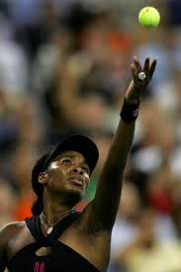
Coordination
Strengths | Limitations
Minimal equipment and costs are involved in conducting this test | The ability to catch the ball can be affected by how hard and straight the ball is thrown to the wall.
Can be self-administered. | The test results may be skewed if the subject 'flukes' a few catches, so repeating the test a few times may result in more accurate results.
 | You may want to draw a target on the wall to help with throwing accuracy

Slide 22
Stamina
Test- Multi stage fitness test
Performers run the 20m distance in time to the bleeps emitted from the CD.
They should aim to place their foot on or over the line as the bleep sounds.
After every minute, the time interval between the bleeps decreases and the performer must increase his or her running speed accordingly.
Performers must continue to run in time to the bleeps until they can no longer keep up (exhaustion).
This is judged to be when the performer fails to make it to the line as the bleep sounds. At this point, the level and shuttle number attained are recorded.

Slide 23
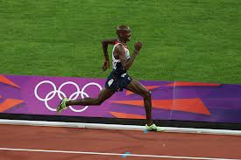
Stamina
Strengths | Disadvantages
Easy testing procedure. | The test is only a prediction of VO2max, not an absolute measure.
Standardised data that easily converts into a predicted VO2max score. | The test is maximal and to exhaustion, and is therefore dependent upon the performer’s level of motivation.
Large groups can be tested at the same time. | As the test involves a running action, it may favour runners. Test scores for swimmers and cyclists may be distorted.

Slide 24
Muscular Endurance
Test- NCF Abdominal conditioning test
Thoroughly warm up. Follow the instructions on the CD. Subjects are required to perform as many sit-ups as possible while keeping in time with the signals emitted from the CD.
A partner counts the number of sit-ups completed and times the duration of the work period.
The test should be halted when the performer can no longer keep in time with the signals or when their technique deteriorates.

Slide 25
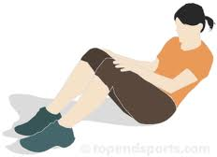
Muscular Endurance
Strengths | Limitations
Easy testing procedure. | The test is maximal and therefore relies upon the motivation of the performer to work to exhaustion.
Large groups can be tested at once. | It is difficult to monitor the correct technique. East to cheat.
Little equipment needed. | Full sit-ups should not be completed on a regular basis due to excessive strain being placed on the lumbar region of the spine.

Slide 26
Reaction Time
Test- Ruler Drop Test
The person to be tested stands or sits near the edge of a table, resting their elbow on the table so that their wrist extends over the side.
The assessor holds the ruler vertically in the air between the subject's thumb and index finger, but not touching. Align the zero mark with the subject’s fingers.
The subject should indicate when they are ready. Without warning, release the ruler and let it drop - the subject must catch it as quickly as possible as soon as they see it fall. Record in meters the distance the ruler fell.
Repeat several times and take the average score.

Slide 27
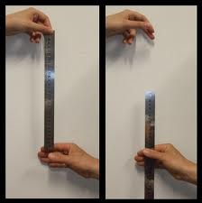
Reaction Time
Strengths | Limitations
Minimal equipment and costs are involved. | Not sport specific- in the slightest!

Slide 28
Exam Questions
Name and describe one suitable test that would measure the students leg power and one suitable test that would measure their agility.

Slide 29
Power- Sargent jump/ vertical jump test
Preparation, chalks, licks their fingers, uses a measuring device
Pre jump reaches up as high as possible with one hand and marks the wall/ pushes green scale up with fingers
Jumps as high as possible
Distance above stretch height= power measure.
Also acceptable- standing long/ broad jump

Slide 30
Agility- Illinois agility run
10 meters long/ 60 meters in total
Subject start lying down
Subject sprints and weaves
Annotated diagram
Time taken/ measured in seconds = agility

Slide 31
Q)
Identify the main reasons for conducting fitness tests and discuss the possible limitations of fitness testing
A)
Main reasons:
Identify strengths and/or weaknesses in a performance/success of a training programme/show improvement;
Physiological potential/identifies (starting) level of fitness/some (maximal) tests increase fitness/aid training;
Compared against norms of the group;
Helps motivate performer/sets goals;
Provides variety to training programme;
Limitations:
They are not sport specific/too general;
They do not replicate movements of activity;
Do not replicate competitive conditions required in sports;
Many do not use direct measuring/sub-maximal – therefore inaccurate/some need motivation/some have questionable reliability;
Tests used often/may lack validity/eg;
Validity – test what they are supposed to test;

