Slide 1
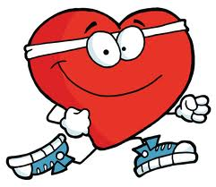
Effects of Exercise on the Heart

Slide 2
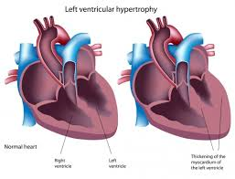
Effects of Exercise on the Heart
Training= heart to get bigger like any other muscle
Hypertrophy (Cardiac)
Athletes heart
Increase in thickness of muscle and ventricle wall

Slide 3
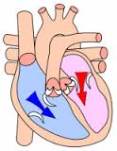
What does this mean for the heart?
Increased diastolic filling
Increases in strength of contraction
Increased Stroke Volume

Slide 4
What does this mean for the heart?
When we train we see an increase in blood volume
So increase in venous return
Starlings law
Greater contraction more blood ejected per beat
Heart rate will decrease

Slide 5
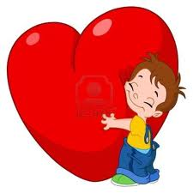
Bradycardia
Reduction in resting heart rate as a result of training
Below 60 beats per minute

Slide 6
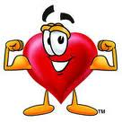
Bradycardia
Q= SV x HR
Training increases Stroke volume so heart rate goes down
Less demand for oxygen by the heart as less energy required to beat
MORE O2 available to muscles

Slide 7
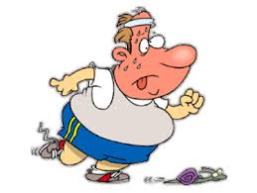
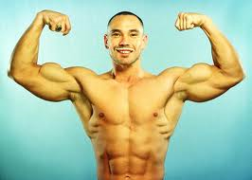
Trained Vs Untrained
VS
How can an untrained performer have the same cardiac output as the fit performer for a given workload?

Slide 8
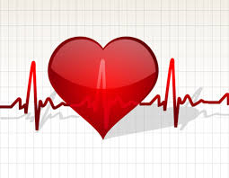
Trained Vs Untrained
Unfit- high HR, Low SV
Fit- Low HR, High SV

