Slide 1
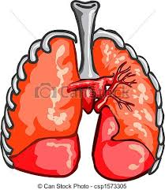
Starter
Will the partial pressure of O2 and CO2 at the LUNGS vary during periods of exercise?
List the factors that make diffusion of oxygen from the LUNGS into the blood very efficient

Slide 2
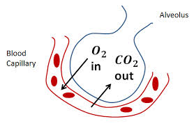
Will the partial pressure of O2 and CO2 at the LUNGS vary during periods of exercise?
NO!
The partial pressure of air will not change if we are exercising or not.

Slide 3
EXAM ALERT!
List the factors that make diffusion of oxygen from the LUNGS into the blood very efficient.
Permeability of alveoli and capillary walls
Short distance between alveoli and capillary wall
Readiness of haemoglobin to combine with O2.
Diffusion gradient cased by partial pressures
Large surface area of alveoli
Moisture layer
Slow movement of blood through capillary

Slide 4
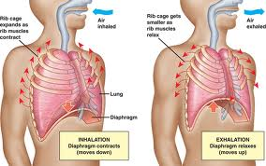
Control of breathing & role of carbon dioxide

Slide 5
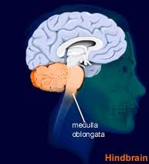
The rate and depth of breathing (respiration) is controlled by respiratory centre in our Medulla Oblongata.
It uses both neural and chemical control to alter breathing.

Slide 6
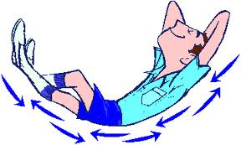
Breathing at rest
Inspiratory centre sends nerve impulses to diaphragm and external intercostal causing them to contract.
We breathe in….
After approx. 2 seconds it stops sending the nerve impulses
Intercostals and the diaphragm relax
Elastic recoil of lungs means we breathe out.

Slide 7
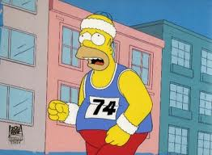
Breathing during Exercise
Exercising- breathe deeper and faster
Partly caused by the expiratory centre- recruiting skeletal muscles.
Other factors neural and chemical influences are also responsible …
Increase in C02 dissolved in blood- blood is more acidic, lowering pH
Increase in lactic acid
production – lowers pH

Slide 8
Carbon Dioxide
By product of the breakdown of glucose
Only escape by diffusing out of the cell and expired via lungs.
Transported in 3 ways:-
5% dissolved in blood plasma (pC02)
20% combined with haemoglobin carbaminohaemoglobin
60-80% combines with water to form bicarbonate in plasma. Forms carbonic acid. This dissociate to from carbonate and hydrogen ions.

Slide 9
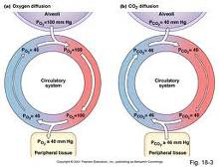
We know that there is always some C02 in thee blood- this causes the diffusion gradient linked to partial pressures.
This small amount of C02 provides a chemical stimulation for breathing.

Slide 10
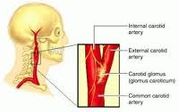
Role of Carbon dioxide in breathing regulation
Increase in C02 increases blood acidity
Stimulates Chemoreceptors- sensitive to changes in blood acidity
Aortic arch and carotid artery
Detect a rise send message to respiratory centre to increase ventilation until blood acidity has returned to normal

Slide 11
The partial pressure of O2 is not reduced significantly to stimulate change in ventilation rates. (in normal exercise, altitude, lung damage may)
It is the change in C02 that stimulates increase in ventilation.

Slide 12
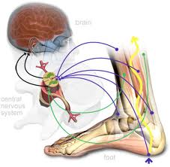
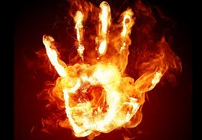
Neural influences on Exercise
Anticipation of exercise causes hormones to be releases- Adrenaline. Anticipatory rise
Stimulation from proprioceptors in joints and muscles
Increase in body temperature- thermoreceptors

