Slide 1
Groups- Recap
Put these in order:
Storming
Norming
Forming
Performing
Match these characteristics to the stages:
Familiarisation
All contribute to success
Establishment of roles
Development of cohesion
Match these characteristics to the stages:
Familiarisation
Development of cohesion
Establishment of roles
All contribute to success
What are the three types
of role?
Formal roles
Formal task/performance roles
Informal roles
Forming
Storming
Norming
Performing
What are the two types of cohesion?
Task
Social
What is the difference?
Task-the ability of the group to achieve a common goal
The ability of the group to relate well to each other
What are examples of these?
Formal roles (teacher/coach)
Formal task/performance roles (goal keeper, penalty taker)
Informal roles (team diplomat, joker)

Slide 2
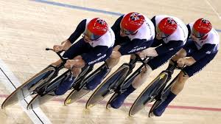
Group unity
Leadership
Common goal
Group Success
Past success
Collective identity
Motivation
Social cohesion
Communication
Task cohesion

Slide 3
Carron’s Model 1933
4 key antecedents (factors) that effect group cohesion.
Environmental factors
Personal factors
Leadership factors
Team factors

Slide 4
Personal
Each individuals personality/ characteristics
Attitudes
Similarity of group
Ability
Motivation
Leadership
The team can be cohesive and have clear goals but the leader must be cohesive with the team
Preferred leadership style/ personality
Relationship with the group
Environmental
Location
Age
Size of the group
The closer they are the better the cohesion
All live together
18/19 years old with 30/35years olds?
Time
Facilities
Team
Individual beliefs
Trust
Ability/ motivation
Stability
Shared experiences

Slide 5
Strategies for group cohesion
Strong leadership
Punishment
Clear roles
Practice set plays
Evaluate individual performance
Team building
Select team goals
Reinforce team success

Slide 6
Team Success
Success of a team (Actual Productivity)
is equal to the best it can do (Potential Productivity)
minus Faulty Processes
(When things go pear shaped!)

Slide 7
Steiner’s Model
ACTUAL = POTENTIAL - LOSSES DUE TO
PRODUCTIVITY PRODUCTIVITY FAULTY PROCESSES
(AP) (PP) (FP)
If we get rid of the losses then our performance will get better.
What are the losses?
The maximum capability of the group when cohesiveness is strongest
Factors that go wrong in team performance which impede/ prevent group cohesion e.g. co-ordination losses & motivational losses
The team performance at any given time (due to successful interaction)
GROUP COHESION IS THE FORCE THAT BINDS A GROUP TOGETHER, HELPING TO PREVENT FAULTY PROCESSES.

Slide 8
Faulty Processes
Co-ordination Losses
These occur when the ‘operational effectiveness’ of the group cannot be sustained for the whole match.
Planned strategies/tactics may go wrong due to positional error or bad timing, e.g. Line out in rugby.
Motivation Losses
This may occur if the task is too difficult.
Also an individual might suffer loss of motivation causing them to withdraw effort and coast through that part of the game.
A co-ordination loss that leads to a breakdown in team work is called the RINGLEMANN EFFECT. Problems with team co-ordination are more likely to increase as the number of team members increase.
e.g more likely in rugby than in basketball
A motivation loss that leads to a reduction in effort is called SOCIAL LOAFING. This is when an individuals efforts go unnoticed or when someone feels like the others on their team are not trying hard enough. People with low SC tend to be loafers.
‘Coasting’ or ‘Hiding

Slide 9
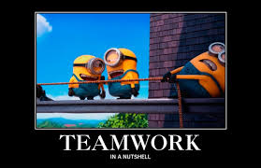
The Ringlemann Effect
Group performance decreases with group size.
There is less effort exerted when working with others.
Ringlemann studied rope pulling & found that a group of 8 did not pull their rope as hard as 1 person.
Some individuals performed only at 50% effort when in a group.

Slide 10
Other losses
These losses cause our actual productivity to go down
If we want it to go up we need to eliminate these losses:
Injury
Incentive- people don’t see the value
Confusion- not knowing their role within the team
Personality
Rest players
Rewards/praise
Make tactics clear
Role models

Slide 11
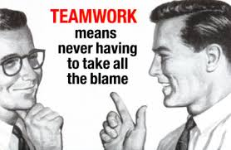
Causes of social loafing
(motivational losses)
Social loafing is caused by:
A belief that your effort won’t change the result
A perception that others are not trying, so why should you?
A belief that others will cover for your lack of effort
Individual effort not being recognised
Lack of reinforcement from others
Low confidence
Perceived low ability
Low arousal/motivation
Poor leadership
Negative attitudes

Slide 12
Preventing social loafing (Reducing motivational losses)
To stop the players feeling a lack of motivation towards the team, the coach should try:
Highlighting individual performances
Monitoring individuals with feedback
Using positive reinforcement when possible
Rewards
Promoting task cohesion within the team
Setting individual goals
Effective captain

Slide 13
Reducing the Ringlemann Effect (coordination losses)
Practice/training to ensure all understand the tactics
Give individuals specific responsibility/set goals
Explain specific roles within the team
Give feedback/video analysis of performance/ reinforcement
Develop peer support/encourage each other/encourage open discussion/an effective leader
Vary practice to maintain motivation/train in small groups
Improve fitness levels

Slide 14
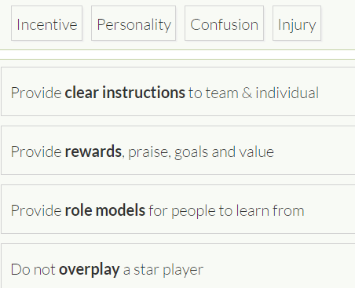
Questions

Slide 15
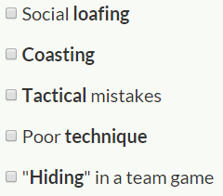

Slide 16
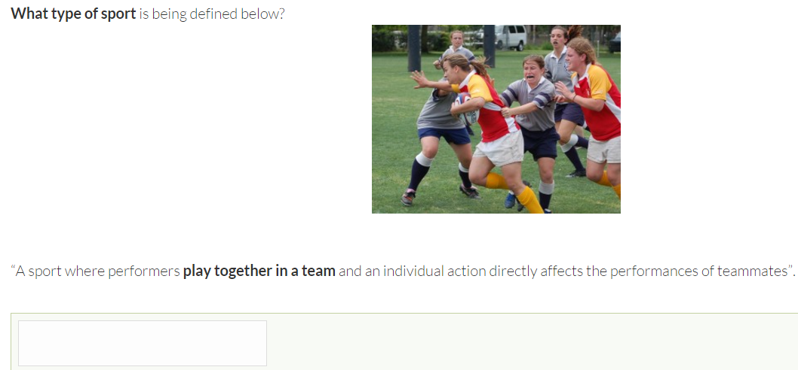
Interactive

Slide 17
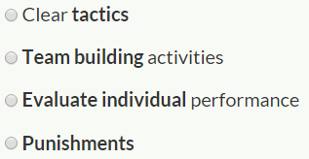
social
task
social
task

Slide 18
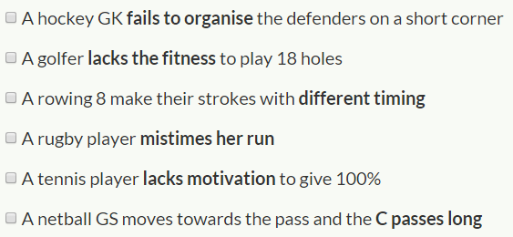
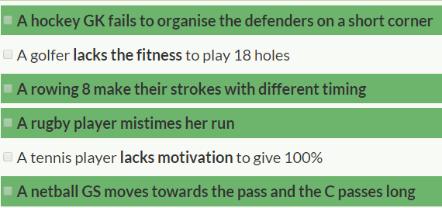

Slide 19
Top tips
-Use the equation
-what are faulty processes?
-what do they lead to?
-You must talk about group productivity (social and task cohesion) and what affect faulty processes have on this.

Slide 20
