Slide 1
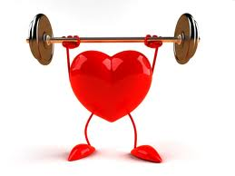
Recap
Relationship SV & HR?
Effects of aerobic training on the heart? Key words?
How is it possible for a trained performer and an untrained performer to have the same cardiac output for a given workload?

Slide 2
Cardiovascular Drift

Slide 3
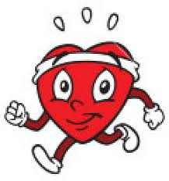
What is Cardiovascular Drift?
Heart rate ‘drifts’ upwards over time despite performer working at a steady/ constant rate.

Slide 4
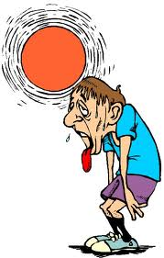
What is Cardiovascular Drift?
Occurs in warmer environments
As you exercise you sweat more- more blood to skin to cool you down. 10 mins plus.
Sweating reduces the volume of the blood
returning back to the heart
Think about Starlings Law- what impact will this have?

Slide 5
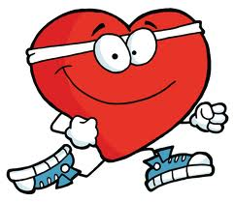
What is Cardiovascular Drift?
Less blood going back to the heart will mean smaller stroke volume.
Heart rate will have to increase to compensate for the reduced stroke volume in order to maintain the current Cardiac output values.
Sometime Q may even go up as more enrgy needed to cool body!

Slide 6
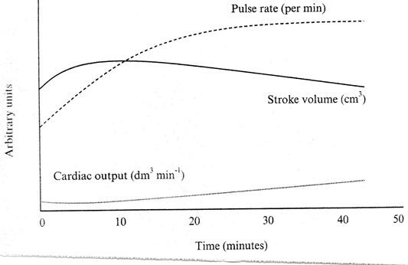

Slide 7
What is CV Drift?
Cardiovascular drift occurs 10 mins plus
Heart rate increases as stroke volume /ejection fraction decreases
Fluid lost as sweat
Reduced blood volume
Reduced venous return
Starlings law
Cardiac output may also increase due to more energy needed to cool body

