Slide 1
Section B- Physiology
Calculating workload intensities

Slide 2
Calculating workload intensities
How you measure the intensity of your training will depend on the type of training you do.
Weight, continuous, fartlek, interval etc

Slide 3
Heart Rate Training Zone
Used for measuring intensity of continuous training, Fartlek, Interval and Circuit.
Use your Maximum HR (220-age) to find your training zones. Each training zone suits a particular focus i.e. to improve Aerobic Fitness or to improve Anaerobic Fitness. See the training zones or thresholds below.
Training Zone | % of Max HR
Level 1- Fat Burning or Easy | 50-60%
Level 2- Lower Aerobic or Steady | 60-70%
Level 3- Upper Aerobic or Medium | 70-80%
Level 4- Anaerobic Threshold or Hard | 80-90%
Level 5- Anaerobic or Very Hard | 90-95%
Level 6-Lactic or Maximum | 95-100%

Slide 4
Karvonen Principle
Karvonen developed a more appropriate formula which takes account of individual levels of fitness (resting HR used to work out training zones).
(Heart Range x intensity %) + (Resting Heart Rate)
To work out your HRR…
Heart Rate Range=max heart rate – resting heart rate
This is more accurate as it considers individual resting heart rates.

Slide 5
Karvonen Principle
1 | Easy/Recovery | 60-70%
2 | Moderate Endurance | 71-80%
3 | Hill Work | 81-85%
4 | Race pace for endurance athletes | 86-90%
5 | Speed/ racing short distances | 91-100%

Slide 6
One Rep max
To find your 1 rep max you need to find the heaviest weight that your muscle can lift only once.
This happens through trial and error– changing the load of a weight stack to find the specific value.
From this figure you can work out a % weight that you should be lifting whilst training. As your fitness improves you 1 rep max value may improve (if you improve your strength component of fitness) and so regular testing of the 1 rep max is important.

Slide 7
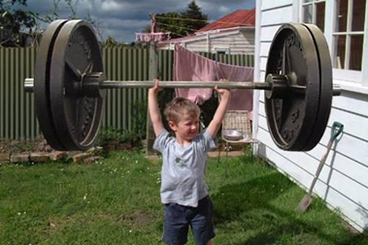
One Rep max
If you are doing weight training to improve Strength:
You should be lifting 85% of your 1 rep max and doing low repetitions i.e. 5 sets of 6 reps.
If you are doing weight training to improve Muscular Endurance:
You should be lifting 50% of you 1 rep max and doing high repetitions i e. 3 set of 20 reps.

Slide 8
Borg Scale
This is a perceived rate of exertion scale from 6-20.
Whilst exercising you perceive how hard you think the intensity of the exercise is and rate it on a chart. 6 is no exertion at all up to 20 which is maximal exertion. For any benefits from training to be made, overload should occur and so the athlete should be rating the training as hard (15+ on the scale).
It’s a quick measure, inexpensive and doesn’t require specialist equipment.
However, reliability can be questioned as a persons motivation/perception may influence their rating.
Subjective

Slide 9
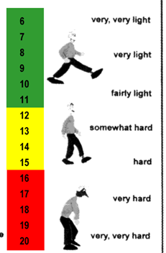
Borg Scale

Slide 10
Exam Questions
Explain how you would calculate individual workload intensities for a continuous training programme.
Top Tip!
So here you need to pick up on the training method ‘continuous’ and only select the appropriate methods i.e. not one rep max as this is for developing muscular strength or endurance

Slide 11
Methods to calculate intensity:
Use heart rate to measure intensity
Heart rate training zone
60-80%of maximum heart rate
Karvonen principle stated
Karvonen formula detailed- exercising heart rate = (heart rate range x intensity%) + (resting heart rate)
Use Borg Scale to measure intensity
Rate of perceived exhaustion RPE
Subjective/ opinion
Scores 6-20

