Slide 1
Angular Momentum
http://www.youtube.com/watch?v=1gPKzr7-eeE
http://www.youtube.com/watch?v=AQLtcEAG9v0

Slide 2
Key Terms
Angular momentum
Angular velocity
Moment of inertia

Slide 3
Moment of Inertia
Measure of resistance of an object to rotation, and the desire of the body to want to continue to rotate once it has been set in motion.
Mass of object
Distribution of mass around the axis of rotation

Slide 4
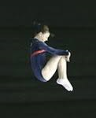
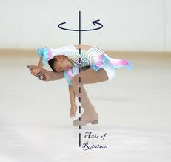
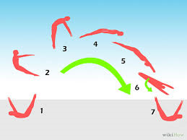
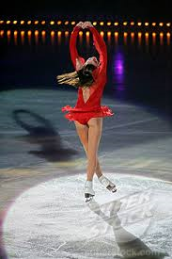
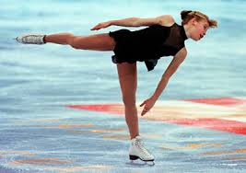
Applying MI to sport

Slide 5
Angular Momentum
The quantity of rotation a body possesses which reflects the moment of inertia and angular velocity
Angular Momentum =
Moment of Inertia x Angular Velocity

Slide 6
Angular Momentum
Relationship between angular velocity and moment of inertia is inversely proportional.
One goes up the other goes down
Angular momentum must remain constant when the object is in flight and can not change until external force applied.

Slide 7
Angular Momentum
Angular momentum can not be changed during flight
If you want to do a quadruple jump you need to generate maximal angular momentum on take off- arms out to the side – generates torque (turning movement)
The further the force is generated from the axis of rotation the larger the torque.

Slide 8
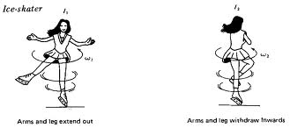
Angular Momentum
Once in flight a skater will bring arms into body which decreases moment of inertia and increases angular velocity - so spins faster

Slide 9
