Slide 1
Angular Momentum

Slide 2
Angular Momentum
Movement around a fixed point or axis
Spin; somersault
Occurs when a force is applied outside the centre of mass
An off centre force is referred to as an eccentric force.
Examples of a force being applied outside the centre of mass of an object or body to cause rotation.

Slide 3
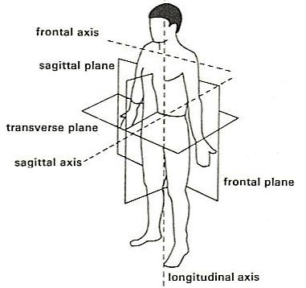
Axes of rotation
Longitudinal
Frontal
Transverse

Slide 4
Quantities used in Angular motion
Torque- rotation force (moment)
Causes an object to rotate about its axis
Moment of force/ torque=force x distance from fulcrum
Angular distance-angle of distance rotated about an axis when moving form one potion to another
1 Radian= 57.3 degrees

Slide 5
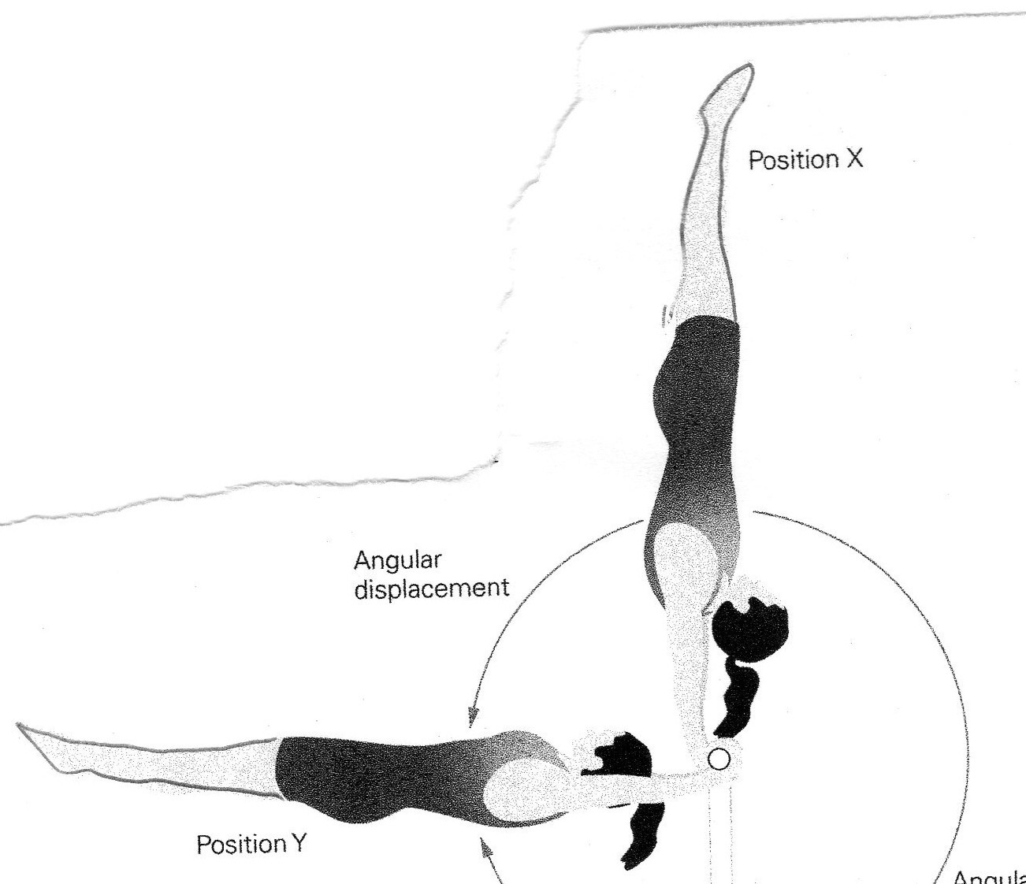
Angular displacement; smallest change between starting position and finish. Radians
Angular velocity;
Angular displacement
-------------------------
Time
Angular acceleration;
Change in velocity
---------------------
Time taken

Slide 6
Newton’s Laws applied to angular motion
First law- a rotating body will continue in its state of angular motion unless an external force (torque) is exerted upon it.
Example: ice skater will continue to spin until she lands. The ground exerts an external force (torque) which changes her state of angular momentum.

Slide 7
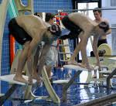
Newton’s Laws applied to angular motion
Second Law; the rate of change of angular momentum of a body is proportional to the force (torque) causing it and the change that takes place in the direction in which the force (torque) acts.
Example: leaning forwards form a diving board will create more angular momentum than standing straight.

Slide 8
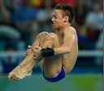
Newton’s Laws applied to angular motion
Third law; when a force (torque) is applied by one body or another, the second body will exert an equal and opposite force (torque) on the other body.
Example; in a dive when changing position from a tight tuck to a lay out position, the diver rotates the trunk back. The reaction is for the lower body to rotate in the opposite direction (ext at the hips)

Slide 9
Moment of Inertia
Resistance to change in motion
So it is the resistance of a body to angular motion (rotation)
It depends on the mass of the body and the distribution of mass around the axis.

Slide 10
Mass of the object/body
Greater the mass, the greater the resistance to change, and so the greater the moment of inertia.
A medicine ball is harder to roll than a tennis ball
Distribution of mass from axis of rotation
Closer mass is to axis- easier it is to turn- inertia is low
Somersault/ pole vaulter

Slide 11
Straight position has higher inertia. Bending limbs decreases inertia

Slide 12
Angular momentum depends on moment of inertia and angular velocity.
Inversely proportional- one increases the other decreases.

Slide 13
Conservation of angular momentum
Can be conserved- it stays constant unless an external force acts upon it (first law)
Ice skater executes a spin there is no change in angular momentum until they use their blades to slow down.
Ice is friction free surface so no resistance to movement.
Skater spins on longitudinal axis
Only the skater can manipulate the moment of inertia and speed up or slow down the spin.

Slide 14
Conservation of angular momentum
At the start of the spin arms are outstretched. This increases distance from axis of rotation
Large moment of inertia and large angular momentum to start the spin.
Rotation is slow
Angular momentum= moment of inertia x angular velocity

Slide 15
Conservation of angular momentum
When the skater brings their arms and legs back in line with their body, the distance of these body part from the axis of rotation decreases a lot.
Moment of inertia decreased, so angular momentum must increase = fast spin

Slide 17
Question
Explain why an ice skater is able to alter her speed of rotation by changing her body shape whilst spinning (6)

