Slide 1
Changing Behaviour
Attitudes an introduction
http://www.youtube.com/watch?v=gAIQQflJ6uI&list=PL03B96EBEDD01E386

Slide 2
Questions...
Have you got the right attitude to do well in your a level exam?
Have you got a positive attitude to sport?
Have you got a negative attitude to cheating in sport?
Do you have prejudices? What are they?
Does an attitude always affect behaviour?
Does your attitude always reflect behaviour?

Slide 3
Changing behaviour
Sporting performances depend on how we behave within a competitive situation- our approach.
Performers attitude to an opponent, event, object or training will have an effect on the outcome.
Attitudes: a complex mix of feelings, beliefs and values that predisposes an individual to behave towards something in a consistent way.

Slide 4
What is an attitude?
A view held by an individual towards an object
Stable
Blend of values and beliefs
Can be positive, negative or neutral
Pre disposes a person to act in a certain way towards the attitude object.
http://www.youtube.com/watch?v=jmgV3OFn0aE

Slide 5
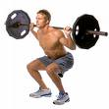
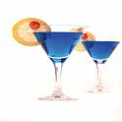
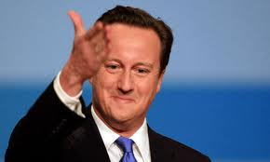
Your attitudes..

Slide 6
Athlete may have a poor attitude towards weight training, resulting in a half hearted approach.
A team player may have an attitude towards an umpire which causes them to act in a certain way towards them, such as disagreeing with their decisions.
Does that mean this player will have the same attitude to all umpires?

Slide 7
Prejudice
White men cant jump
Girls are better at dance than boys
Football is a game for yobs

Slide 8
prejudice
A value judgement about someone or something you make before you have the full picture, and is most likely based on incomplete inaccurate stereotypical views.
These are attitudes as they predispose the holder of the prejudice to behave in a certain way.
Attitudes are multidimensional- combination of knowledge, emotion and behaviour.

Slide 9
Stereotypes
Stereotypes: A belief held by a collection of people about traits shared by a certain category of person.
In sport there are many stereotypes:
White men can’t jump.
Black people are better sprinters than whites.
Women’s cannot play football or rugby well.
You can be too young or old to play at international level.
The history of the Olympic Games

Slide 10
Social Norms
Change attitude if it is not helpful or approved
National curriculum and PE- positive?
Rules that is socially enforced or a standard of behaviour, unwritten.
Helps control social behaviour- based on a consensus
Enforced through social approval or disapproval.
Examples????

Slide 11
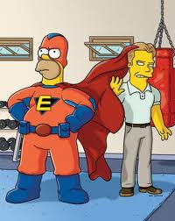
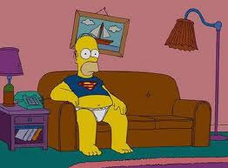
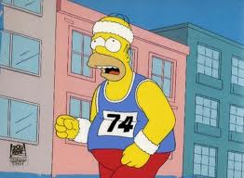
Components of an attitude
Cognitive
I know training is good for me.. Benefits..
Affective
I don’t like training
Behavioural
Do I attend training or not?

Slide 12
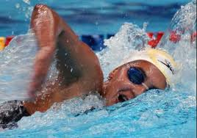
Cognitive: Reflects our beliefs, thoughts, knowledge, ideas and information we have on an object.
E.g.; based on info from our parents and pe lesson we may think swimming is good in terms of our health and safety.

Slide 13
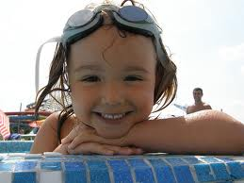
Affective: Emotional response or feelings towards attitude object.
E.g. we enjoyed going swimming with our friends in the past- positive feeling towards participation.
If we had had a negative experience (fear of personal safety) then future participation may be affected.

Slide 14
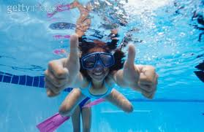
Behavioural: Intended or actual behaviour towards the object. Based on evaluation of first two components.
Eg. Because of positive beliefs and experiences with swimming, we actually participate regularly in swimming.
Cognitive and affective components don’t always predict behaviour… do you actually go swimming?

Slide 15
The Triadic Model of Attitudes
According to this model our beliefs are formed through past experiences and what we have learned from others.
Behaviour may not always be consistent with attitude (i.e. fitness training).
A person is likely to behave in a way that reveals their attitude.

Slide 16
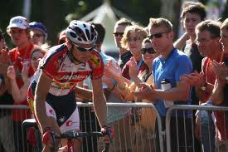
Formation of Attitudes
Most developed through social learning/ watching others and operant conditioning- positive reinforcement.
Peer groups
Familiarity- more they experience it more likely positive attitude
Influences- parents, peers, teachers, coaches, media, role models.
Why may someone develop a negative attitude?

Slide 17
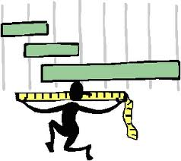
Measurement of Attitudes
We need to measure a performers attitude to understand their emotions and beliefs. If they do not meet our expectations we can implement strategies to change.
Most popular methods are interviews and self report questionnaires. Less subjective.
Thurston Scale
Likert Scale
Osgoods Semantic Differential Scale

Slide 18
Thurston Scale
Statements covering a range of opinions towards an attitude object
100 statements
Rated favourableness to unfavourableness
Allows good comparison with other individuals but is
Time consuming
Large number of experts to construct it
Because it uses averages- can hide extremes.

Slide 19
Likert Scale
Simplified version
Most frequently used
Series of statements
Rates 5= strongly agree, 4= agree, 3=undecided,2=disagree,1= strongly disagree.
Advantages; range of answers, easy to administer, cheaper to construct, reliable results.

Slide 20
Osgoods Semantic Differential Scale
Participant required to give the attitude object a 7 step rating based on two opposing adjectives. Has to select a point that reflects their feelings
How do you feel about doing aerobics?
PLEASANT: −3 −2 −1 0 +1 +2 +3 UNPLEASANT quick and simple
Not much choice as only two words
May be interpreted differently.

