Slide 1
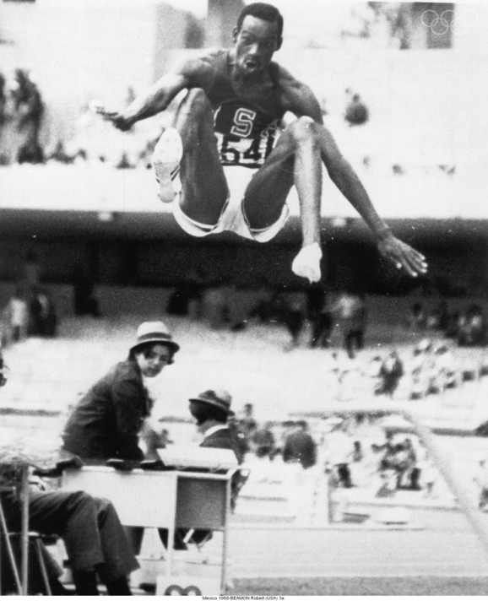
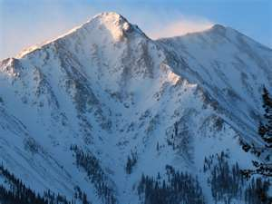
Altitude Training

Slide 2
Specialised Training Method
Widely used although research is still going on
No guarantee it will work on you
Cant turn a donkey into a racehorse!
Benefits widespread from increased endurance to buffering capacity.

Slide 3
The Theory
As altitude increases the pressure of oxygen decreases meaning the diffusion gradients in the alveoli/capillaries gets smaller.
This means there is less oxygen available to the body.
As a result the kidneys produce greater amounts of EPO and stimulate RBC production.
Note:- artificial injection of EPO is a banned ergogenic aid

Slide 4
The Theory
After approx. 2 weeks of altitude the body will produce a significant amount of ‘extra’ RBC’s
The performer then returns to sea level and competes with the advantage of lots more RBC’s and so theoretically greater endurance/ use of V02 max.

Slide 5
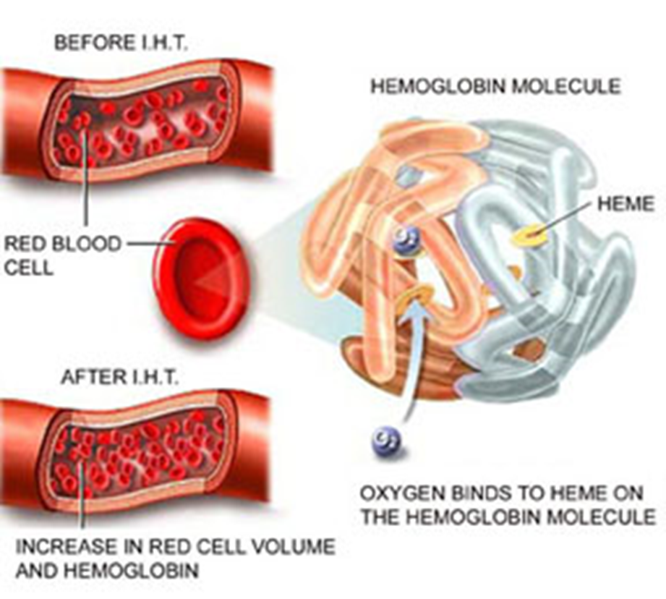

Slide 6
Describe Altitude Training
Over 2000m/8000 feet above sea level
Usually for at least 30 days/month/3 phases acclimatisation, primary training, recovery
Partial pressure of oxygen is lower/less oxygen available
Body produces erythropoietin/EPO/hEPO
Alternative methods now available, eg hypoxic tents/altitude tents/oxygen tents/apartments/train low, live high

Slide 7
Benefits- does it improve performance?
Increased number/concentration/red blood cells
Increased concentration of haemoglobin/myoglobin/increased haematocrit
Increased capacity to carry oxygen
Increased tolerance to lactic acid/buffering/delayed OBLA
Benefits last for up to 6 to 8 weeks.

Slide 8
Drawbacks- how it hinders performance
Altitude sickness
Training at same intensity difficult/detraining may occur/loss of fitness
Every 1000m altitude loose 6-7% V02max
Benefits lost within few days back at sea level/up to few days
Psychological problems linked to travel/time away from home
No guarentee

Slide 9
Famous Examples of Altitude
Bob Beamon- 1968 Mexico Olympics
8.9 m, 2240 meters above sea level.
Lots of other records broken.
Chris Hoy- attempt ay 1km record in Boliva, La Paz, 3,408m above sea level.
World Cup in south Africa- stadium heights
Lots of athletes use it today to improve stamina

Slide 11
Technological Advances
Hypoxic chambers
Tents, masks etc that restrict the amount of oxygen that you inhale whilst you train.
‘Live High, Train Low’ phenomenon

Slide 12
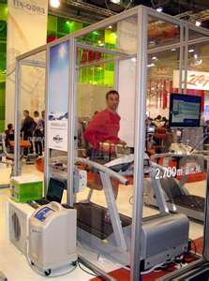
Live High Train Low
Performers spend most of their day at high altitude- sleep in oxygen tents. Gain benefits of altitude.
Then train at sea level to really try and train hard.
Hyperbaric chambers link…
Used for acclimatisation.

Slide 13
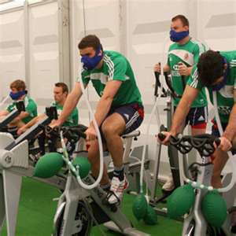
Live High Train Low
Intermittent Hypoxic Training
Performers wear masks and train- fed oxygen starved air and then blasts of oxygen rich air.
Try to induce the effects of altitude training.

Slide 14
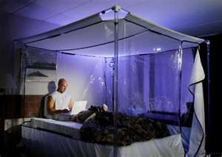
What you need to know…
The Theory- What is it, does it work? What does it do?
Benefits/ advantages
Disadvantages
Technological developments
Who would use it – type of performer
Discuss the advantages and disadvantages of attitude training
Discuss altitude training as a training method.

