Slide 1
Muscle Fibres & Motor Units

Slide 2
How do we produce muscle contractions of varying strength?

Slide 3
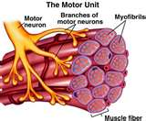
Motor Unit
http://www.youtube.com/watch?v=hzXVe4RS8-A

Slide 4
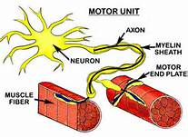
What is a motor unit?
Motor neuron and the fibres it stimulates

Slide 5
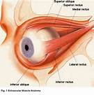
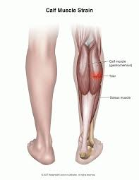
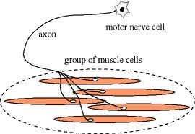
Size of motor units

Slide 6
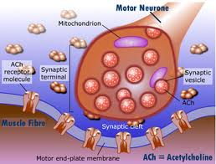
All or None Law
Each fibre within a motor unit either contracts or not!
A minimum amount of stimulation is required to start a muscular contraction.

Slide 7
What influences the strength of contraction?
Number of motor units recruited by the brain
Frequency at which the impulse arrives at the muscle
Wave and spatial summation

Slide 8
Gradation of Contraction
Recruitment- bigger number of motor units recruited the bigger and stronger the contraction. Multiple unit summation
Frequency- greater the frequency of stimulation the greater the tension developed. Spatial and wave summation…
Timing- if all of the motor units contract at the same time, max force can be applied
Fast twitch units- more force tan slow twitch

