Slide 1
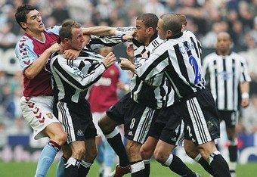
Aggression in sport

Slide 2
Definition
“Any behaviour that is intended to harm another individual by physical or verbal means.”
Bull
“Any form of behaviour directed toward the goal of harming or injuring another living being who is motivated to avoid such treatment.”
Baron

Slide 3
Defining Aggression
The difficulty with defining aggression is shown below
Increasing control
Aggression
?
Assertion
Increasing frustration

Slide 4
Socially acceptable?
The definitions imply that it isn’t, but then why should we justify actions such as tackling in rugby and punches in boxing?

Slide 5
Baron’s 3 categories
Hostile (reactive) aggression
Instrumental (channelled) aggression
Assertive behaviour

Slide 6
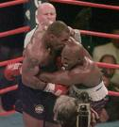
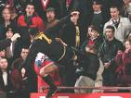
Hostile (reactive) aggression
Prime motive is to harm an opponent outside of the rules of the sport.
Dysfunctional
Hostile aggression involves anger.
“Hostile destructiveness”.

Slide 7
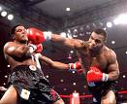
Instrumental (channelled) aggression
An aggressive action that is within the rules.
Prime motive is to execute skill successfully, but to also inflict pain on opponent.
E.g. hard tackle in rugby and punch in boxing.

Slide 8
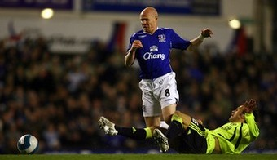
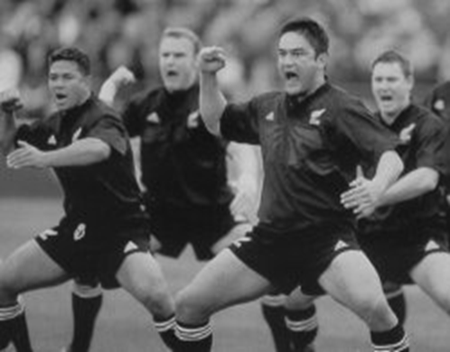
Assertive behaviour
No attempt to harm and strictly within rules of the game.
Robust but functional play.
E.g. tough tackle in football without going over the top; driving through a crowd of players in basketball.

Slide 9
Types of Aggression
Assertive behaviour
1. No intent to harm
2. Legitimate force
3. Unusual effort and
energy expenditure
Hostile aggression
1. Intent to harm
2. Goal to harm
3. Unusual effort and
energy expenditure
Instrumental
aggression
1. Intent to harm
2. Goal to win
3. No anger

Slide 10
Which of these are aggressive behaviours?
1. Question: A basketball coach breaks a chair in protesting to a disputed call?
Answer: Not aggressive behaviour as violence is directed at an object and not a person.
2. Question: Alan, a hockey player, uses his stick to purposely hit his opponent in the shin in retaliation for his opponent’s doing the same thing to him.
Answer: Aggressive behaviour. The behaviour was aimed at injuring another player.
3. Question: A race car driver kills a fellow competitor by running into the competitors stalled car coming out of a turn.
Answer: Not an aggressive action as there was no intent.

Slide 11
.......continued
4. Question: Barry knows that John is very sensitive and self-conscious about his ability to putt under pressure, so he tells John that the coach said that if does not putt better he will be replaced in the line-up. The coach never said this.
Answer: Aggressive behaviour. There was deliberate intent to cause psychological damage.
5. Question: Jane bowls a fast ball that hit Tom on the leg.
Answer: Not aggressive behaviour as there was no intent. A fast ball is part of the game.

Slide 12
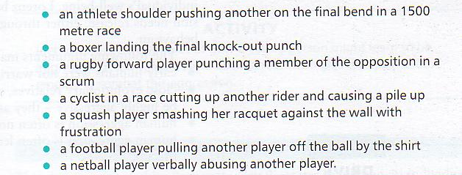
Task
Place the following examples into the 3 categories.

Slide 13
Antecedents of aggression
Task
Think of as many different causes of aggression as you can.
Nature of game (contact/non-contact)
Losing badly
Grudge from previous match/encounter
Frustration (poor form/opposition/referee)
Hostile crowds (intimidation)
Venue (home/away)
Over-arousal
Extrinsic rewards

Slide 14
Theories of aggression
Instinct theory
Social learning theory
Frustration aggression hypothesis
Aggression cue hypothesis

Slide 15
Instinct theory
Trait perspective
Aggression genetically inherited.
Freud – a trait of violence lies within everyone due to a basic instinct to dominate.
Lorenz proposed that aggressive energy is constantly building up and needs to be released.

Slide 16
Social Learning Theory
Social learning (environmental) perspective
Bandura
Aggression is nurtured through environmental forces.
Learned by watching and copying from role models and becomes accepted if it is reinforced.

Slide 17
Frustration-Aggression Hypothesis
Interactionist perspective
Dollard
Frustration develops when a goal or need to achieve is blocked.
Aggression occurs as a result
Successful aggression (getting away with it) releases the frustration.
Unsuccessful aggression (getting punished) leads to further frustration.

Slide 18
Frustration aggression hypothesis
Catharsis
Success
Drive to goal
Obstacle to goal
Frustration
Aggression
Punishment
Task
Use examples from sport to explain each part of the model.

Slide 19
Aggression cue hypothesis
Interactionist perspective
Berkowitz – building on Dollard’s work.
Frustration leads to arousal which in some situations results in aggression.
Whether or not this occurs will depend on the presence of aggressive cues.
Possible cues = bats; sticks; nature of game; violent act being witnessed.
Task
List possible aggression cues from your sport

Slide 20
Aggression cue hypothesis
Presence of
aggression cues
Increased chance
of aggression
Frustration
Increased arousal
Absence of
aggression cues
Decreased chance
of aggression
Task
Use examples from sport to explain each part of the model.

Slide 21
Theories of Aggression
INSTINCT THEORY (TRAIT PERSPECTIVE)
- Proposed by FRUED but
developed but LORENZ in 1966.
- ‘Aggression is genetically inherited
and that trait of violence lies within everyone
due to a basic instinct to dominate.’
- ‘Death instinct’ (FREUD)
- ‘Aggressive energy is constantly building
up and needs to be released’ (LORENZ)
SOCIAL LEARNING THEORY
Proposed by BANDURA, 1966 but
developed by LEAKEY.
Aggression is not biologically based
but is nurtured through environmental forces.
Learned by watching and copying
role models and it becomes an
excepted mode of behaviour if reinforced.
FRUSTRATION AGGRESSION HYPOTHESIS
– INTERACTIONIST PERSPECTIVE
- Proposed by DOLLARD.
- ‘Frustration develops when goal-directed
behaviour or NACH is blocked.’
It is instinctive to fulfil the need
to release frustration.
- Instinct theory – aggression is the goal.
- Aggression = successful = catharsis
- Aggression = unsuccessful = more frustration
AGGRESSION CUE HYPOTHESIS
(BERKOWITZ, 1969)
– INTERACTIONIST PERSPECTIVE
- Builds upon DOLLARD’S work.
Frustration leads to an increase in arousal which,
in some situations will result in aggression.
Cues = baseball bats, violent acts being witnessed,
nature of the game will trigger aggression if
arousal is high.
Best players have the ability/temperament
to control frustration and arousal.

Slide 22
Practical application of aggression theories
Watch the video clips and use each of the theories to explain Water Boy’s aggressive behaviour.

Slide 23
Analysis of Happy
Instinct theory?
Frustration – aggression theory?
Social Learning theory?
Aggressive cue theory?
http://www.youtube.com/watch?v=8qaAKxJp0EM&list=PLAFCC5ED68095D84F

Slide 24
Can we identify aggressive people?
People high in trait anger are more likely to become highly
aroused and angry when they are losing than those low in trait anger
People who have a previously watched or had aggressive
behaviour positively reinforced are more likely to be
aggressive than people where aggression was negatively
reinforced

Slide 25
How can we eliminate aggression?
Negative reinforcement from the media.
Positive reinforcement of skilful, non-aggressive players (e.g. fair play awards).
Psychological support and guidance.
Professional officiating (as in the NFL).
Clear differentiation of aggression and assertiveness.
Severe punishments for aggressive behaviour.
Governing bodies and law courts should punish offenders.
Society (esp. schools) should highlight non-aggressive morals
Teach athletes to control aggressive tendencies (relaxation, thought stopping etc.)

Slide 26
Managing aggressive performers
Strategy | Individual’s actions | Coach / manager’s actions | Governing body actions
Punish aggressive behaviour
Avoid aggressive situations

Slide 27
Eliminating aggressive tendencies
Coach positively reinforces non-aggressive behaviour
Coach negatively reinforces aggressive behaviour.
Punish aggressive play.
Withdraw potentially violent player from situation.
Change athlete’s perception of situation.

Slide 28
Eliminating aggressive tendencies
Stress performance rather than outcome goals.
Emphasise non-aggressive role models.
Attribute success to skilfulness rather than intimidation
Lower arousal / anxiety / stress
Use cognitive strategies such as rational thinking and imagery to prevent aggressive behaviour.

Slide 29
Preventing Aggression
A coach might use the following tactics to prevent aggression:
Do not reinforce aggressive acts in training
Punish aggression with fines
Substitute an aggressive player or remove him from the situation
Reinforce non-aggression, eg. Give a fair play award
Promote peer-group pressure within the team

Slide 30
Preventing Aggression cont..
Use mental rehearsal or relaxation to lower arousal
Point out responsibilities to the team
Point out non-aggressive role-models
Set non-aggressive goals
Channel aggression into assertion

